Slide 1
On “Vitality” of Primary Latvian Verbs
a pilot diachronic study

Slide 2
Primary verbs
Primary verbs are derived not from other words, but from roots preserved either in verbs or as well in nouns or adjectives [Mūsdienu latviešu literārās valodas gramatika. I. daļa. Fonētika un morfoloģija, lpp. 332].
b. *tum > v. tumst ‘to get dark’
n. tumsa ‘darkness’
adj. tumšs ‘dark’
Also: verbs that are formed from the same root but differ in vocalism:
birt ‘to pour, to run out’ | bērt ‘to pour, to strew’
lauzt ‘to break’ | lūzt ‘to break, to crack'

Slide 3
WHY did SOME Primary verbs DISAPPEAR?
Most disappeared verbs had ordinary, still actual meanings:
*bīt ‘to push’
*dirt ‘to spread (out)’
*gozt ‘to curve’
*kalt ‘to speak’ etc.
-> Not semantics of the verb was the main factor for disappearance.

Slide 4
WHY did SOME Primary verbs DISAPPEAR?
In the “Dictionary of Latvian Etymology” the possible reason for the disappearance is the conflict of homonyms (about 20 cases):
*dēt ‘to say’ replaced by dēt ‘to put’
*salt ‘to get sweet’ replaced by salt ‘to get cold’ etc.
Question that cannot be answered:
How exactly did homonyms compete with each other? What influenced the disappearance of one of them – frequency, semantic properties or something else?
Is any other reason for the disappearance?

Slide 5
WHY did SOME Primary verbs DISAPPEAR?
Purpose of the study
Which factors influenced the preservation or disappearance of primary verbs of the Latvian language?
Hypothesis
The semantic and morphological properties of the derivatives could influence the disappearance or the preservation of primary verbs.
Material
461 primary verbs from the “Dictionary of Latvian Etymology” were analysed in terms of their current status, productivity, and semantics of their derivatives.

Slide 6
Example of information
Primary verb | braukt ‘*to rub; to go’ | *dert ‘to tear, to split’
Derivatives | braucīt ‘to rub’, braukāt ‘to go’ | darīt ‘to do’, derēt ‘to suit’
Suffixes | -īt; -āt | -īt; -ēt
Conjuction of derivatives | 3d и 2nd | 3d
Historical meanings | iterative | causative; iterative
Status of the verb | preserved | disappeared (reconstruction)

Slide 7
Status of the verb
Status of the verb | Number | %
preserved | 282 | 61,2
disappeared | 179 | 38,8

Slide 8
MeaningS of derivatives
Meanings | % of meanings
iterative | 62,0
causative | 31,1
durative | 4,1
intensive | 2,8
Due to the small number of durative and intensive meanings, these meanings were further ignored.
This decision corresponds with the modern division of suffixal verbs into two groups: causative and iterative [Mūsdienu latviešu literārās valodas gramatika. I. daļa. Fonētika un morfoloģija, lpp. 332–333].

Slide 9
Meaning of derivatives - 2
Meanings | % of verbs
iterative | 59,9
causative | 23,6
iterative + causative | 16,5

Slide 10
Shortcomings of the database
Obviously, not all derivatives were included in the dictionary.
Phonetic doublets such as brāzāt ‘to rush’, brāžāt ‘to rush’.

Slide 11
Examples of derivational means
berzt ‘to rub’–> berzēt ‘to rub’ *dzent ‘to chop, to hack’–> dzenēt ‘to chop, to hack’’ birt ‘to pour, to run out’ –> bērt ‘to pour, to strew’, birdināt ‘to pour, to strew’, dial. birināt ‘to pour, to strew’ *šķelt ‘to rinse’ –> skalot ‘to rinse’, skalināt ‘to rinse’ | -ēt -ēt suffixless; -ināt -ot; -ināt
In total, 32 combinations of derivational means.

Slide 12
In general, derivational properties of disappeared and preserved verbs are very similar, but the variety of derivational means for the latter is slightly greater.
<- lack of information about disappeared verbs?
<- more productive verbs had a greater chance to survive?

Slide 13
To test working hypothesis, contingency tables were created for variables “the number of derivational means”, “meanings of derivatives”, “suffixes of derivatives”, “verb status” (IBM SPSS Statistics).

Slide 14
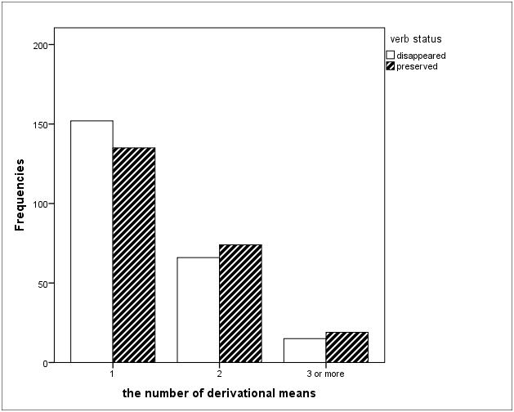
Results
No statistical correlation between the variables “verb status” vs. “the number of derivational means”.
However, with an increase in the number of word-forming means, there is a tendency to preserve the verb.

Slide 15
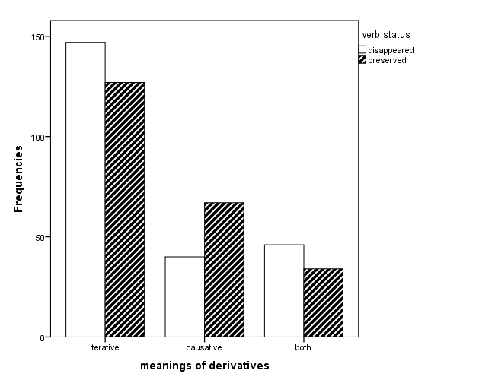
Results
Statistically significant correlation for variables “verb status” vs. “meanings of derivatives”: χ²=10,020, df=2, p<0,05.
Verbs with causative derivatives more often were preserved, while verbs with iterative derivatives and with derivatives of both groups of meanings more often disappeared.

Slide 16
Results
A separate analysis for the meanings “iterative” and “causative” also showed significant results:
χ2=8,830, df=1, p<0.05 (the presence of iterative derivatives correlates with the disappearance of the verb);
χ2=3,262, df=1, p<0.05 (the presence of causative derivatives correlates with the preservation of the verb).

Slide 17
Discussion
The results indicate that there is a connection between the meaning of derivatives and the survival of the primary verbs, but they do not mean a causal relationship and they are not an interpretation in themselves.
Obviously, the “vitality” of each particular verb could be influenced by a number of factors interacting with each other in a complex way.

Slide 18
Results
Statistically significant results were also obtained for individual suffixes:
χ2=6,990, df=1, p<0.05 (the presence of derivatives with the suffix -ēt correlates with the disappearance of the verb);
χ2=4,818, df=1, p<0.05 (the presence of derivatives with the suffix -ināt correlates with the preservation of the verb);
χ2=5,283, df=1, p<0.05 (the presence of derivatives with the suffix -īt correlates with the preservation of the verb).

Slide 19
Results
Statistically significant results were also obtained for individual suffixes:
χ2=6,990, df=1, p<0.05 (the presence of derivatives with the suffix -ēt correlates with the disappearance of the verb);
χ2=4,818, df=1, p<0.05 (the presence of derivatives with the suffix -ināt correlates with the preservation of the verb);
χ2=5,283, df=1, p<0.05 (the presence of derivatives with the suffix -īt correlates with the preservation of the verb).
most derivatives have an iterative meaning
most derivatives have a causative meaning
most derivatives have an iterative meaning

Slide 20
PERSPECTIVES
The strength of the semantic relationship?
a)causative derivatives
dzimt ‘to be born’ -> dzemdēt ‘to give birth’ – clear connection
b) iterative derivatives
dust ‘hard to breathe’ -> dusēt ‘to sleep' – meanings are too different
niezt ‘to scratch’ -> niezēt ‘to scratch‘ – meanings are hard to distinguish

Slide 21
Conclusion
The “vitality” of primary verbs correlates with the semantic properties of their derivatives: primary verbs with iterative derivatives disappeared more often than primary verbs with causative derivatives.
There was no statistically significant correlation between the “vitality” of a verb and the morphological properties of verb’s derivatives, however, the preserved verbs are characterized by a slightly greater variety of word-formation means compared to the disappeared verbs.

Slide 22
THANK YOU FOR YOUR ATTENTION!

