Slide 1
A brief overview of diachronic typology
Eitan Grossman (Hebrew University of Jerusalem)
Academia Grammaticorum Salensis 24-30 July 2022

Slide 2
Some questions
Why are linguistic properties distributed the way they are across languages in time and space (Greenberg 1978, Nichols 1992, Bickel 2007)?
Why are some linguistic properties common, and others rare (Greenberg 1978, Harris 2008, Wohlgemuth & Cysouw 2009)?
It is probably easier to explain the universal absence or the universal presence of a property, but such absolute universals are often rare, or are trivial or even simply definitional criteria of language, and often have more to do with communication than with linguistic structure.

Slide 3
The past tense in a sample of the world’s languages
(Dahl & Velupillai 2013)

Slide 4
Sources of crosslinguistic frequency asymmetries?
Constraints on processing?
Constraints on memory?
Constraints on learnability?
Constraints on articulation?
Constraints on perception?
Genetically-determined Universal Grammar?
What about constraints on social interaction?

Slide 5
But how do these constraints translate into language structure?
Is there a direct mapping between cognition or physiology and language structures, or is this connection mediated somehow, and if so, by what?

Slide 6
An underappreciated aspect of Greenbergian typology
What mediates between cognition/physiology and language structures is language change.

Slide 7
Greenberg (1978)
“If a particular phenomenon can arise very frequently and is highly stable once it occurs, it should be universal or near universal (…). If it tends to come into existence often and in various ways, but its stability is low, it should be found fairly often but distributed relatively evenly among genetic linguistic stocks. […] If a particular property rarely arises but is highly stable when it arises, it should be fairly frequent on a global scale but be largely confined to a few genetic stocks. If it occurs only rarely and is unstable when it occurs, it should be highly infrequent or non-existent or sporadic in its genealogical and genetic distribution” (Greenberg 1978: 76).

Slide 8
Diachronic typology
Diachronic typology is the typological study of processes of language change and their causes.

Slide 9
Diachronic typology
Cross-linguistically recurrent categories are generally assumed to be the result of cross-linguistically recurrent patterns of grammaticalization or other general and regular processes of change.
Joan Bybee, William Pagliuca & Revere Perkins (1994), The Evolution of Grammar. Tense, aspect and modality in the languages of the world. Chicago.

Slide 10
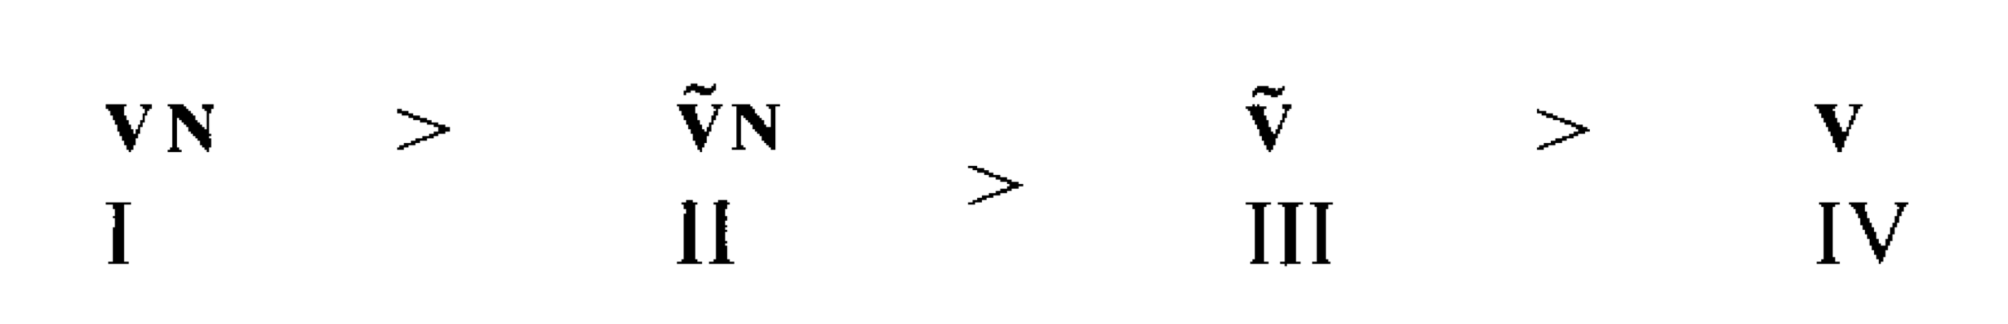
Diachronic typology
Cross-linguistically recurrent sound patterns are generally assumed to be the result of cross-linguistically recurrent patterns of sound change and retention.
For example, nasal vowels are typically the result of VN sequences in which the vowel is contextually nasalized, and the nasal consonant is eventually lost. The nasality of the vowel can subsequently be lost (Greenberg 1969).

Slide 11
Diachronic typology
More broadly, synchronic distributions are the result of biases in language change, which are in turn rooted in a variety of factors, including usage biases.
Joseph Greenberg
Talmy Givón
Charles Ferguson
John Ohala
Joan Bybee
Juliette Blevins
Spike Gildea
Andrea Sansò
Sonia Cristofaro

Slide 12
Diachronic typology
More broadly, synchronic distributions are the result of biases in language change, which are in turn rooted in a variety of factors, including usage biases.
For Greenberg (1969, 1978) and Bybee (2006 and elsewhere), diachronic universals are more robust than synchronic ones – synchronic states are epiphenomenal.
For Blevins (2004), a principled diachronic explanation makes a synchronic explanation redundant.
Similar ideas in Cristofaro (2017, 2019), who argues for a source-oriented approach to synchronic distributions.

Slide 13
Focusing the question
Why do some categories become conventionalized (grammaticalized or phonemicized) in many – but not all – languages?

Slide 14
A possible answer
From the point of view of diachronic typology, cross-linguistically common categories are common because they involve (Grossman 2016, Grossman et al 2018, Grossman & Polis 2018)):
TYPE: the type of change is common (vs. rare types of change)
PATH: multiple pathways of change that converge (vs. a single pathway)
STAGE: one-step or simple pathways of development (vs. many-step or complex pathways)
SOURCE: common source constructions vs. rare source constructions
STABILITY: once grammaticalized, the category type tends to be stable
DIFFUSABILITY: the category spreads easily via language contact.

Slide 16
Mutatis mutandis
The more that these factors converge, the more common a particular category will be, cross-linguistically.
And cross-linguistic rarities can be explained by the convergence of these factors, but in reverse.

Slide 17
Some brief examples from phonology
Northwest Mekeo (Austronesian) lacks any coronal segments, the result of 3 distinct processes of change, some of which are rare. However, the language is now developing allophonic coronals, so the state of having no coronals seems to be inherently unstable (Blevins 2009).
Aspirated fricatives are very rare (Jacques 2011). Interestingly, they can develop along multiple pathways from common sources, but they seem to be perceptually similar to other sounds, which leads them to quickly merge.
Similarly, Nikolaev & Grossman (2018) show that affricate-dense inventories develop from common sources through common types of change, but they are unstable unless supported by language contact, i.e., they are lost when isolated areally.

Slide 18
Some brief examples from phonology
On the other hand, Bybee & Easterday (2022) show that while ejectives can develop from common source patterns in relatively simple processes (like the fusion of a voiceless obstruent with a following glottal stop), there is little evidence for such changes to be the source of most ejectives in the world’s languages.
Ejectives may simply be very old and very stable in the parts of the world where they are documented.

Slide 19
Summary
In contrast to traditional (and some contemporary) views, the cross-linguistic frequency or rarity of a category is not simple a reflection of cognitive, physical, or social biases or constraints.
Rather, cross-linguistic frequency distributions are the result of different factors, which may act independently and interact.

Slide 20
Summary
TYPE: the type of change is common (vs. rare types of change)
PATH: multiple pathways of change that converge (vs. a single pathway)
STAGE: one-step or simple pathways of development (vs. many-step or complex pathways)
SOURCE: common source constructions vs. rare source constructions
STABILITY: once grammaticalized, the category type tends to be stable
DIFFUSABILITY: the category spreads easily via language contact.

Slide 21
Universally dispreferred structures through change
The diachrony of affix ordering in Egyptian-Coptic
Academia Grammaticorum Salensis 24-30 July 2022

Slide 22
Outline of the talk
Introduction
  Observation. A worldwide preference for suffixes as opposed to affixes
  Argument. Rare or universally dispreferred structures can and do arise as the result of regular language change, given the right background structures as the particular ‘ecology’ in which change takes place
Case-study: Egyptian-Coptic (Afroasiatic)
  Long-term diachronic macro-change from mixed suffixing-prefixing to an overwhelming preference for prefixing
Conclusions
  Each of the micro-changes implicated in this macro-change are better understood in terms of changes at the level of individual constructions, via grammaticalization, rather than in terms of a broad Sapirian ‘drift.’
  These micro-changes take place at different times and have different rates

Slide 23
A worldwide preference for suffixes as opposed to prefixes

Slide 24
Preference for suffixes
There is a worldwide preference for suffixes as opposed to prefixes in a proportion of about 3 to 1 in the languages of the world (Bybee et al. 1990, Cysouw 2009, Greenberg 1957, Hall 1998, Hawkins & Cutler 1988, Himmelmann 2014, Sapir 1921, and more)

Slide 25
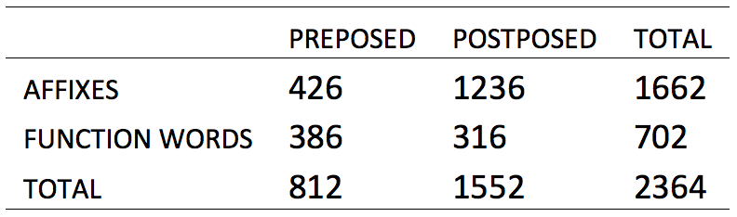
Preference for suffixes
There is a worldwide preference for suffixes as opposed to prefixes in a proportion of about 3 to 1 in the languages of the world (Bybee et al. 1990, Cysouw 2009, Greenberg 1957, Hall 1998, Hawkins & Cutler 1988, Himmelmann 2014, Sapir 1921, and more)
Two distinct universal preferences (Himmelmann 2014): grammatical morphemes have a significant tendency
  (a) to be postposed and
  (b) to be bound, i.e., suffixes
Table 1. The suffixing preference in verbal grammatical elements from 71 languages
(Himmelmann 2014, from the database of Bybee et al. 1990: 5)

Slide 26
Preference for suffixes
Possible explanations….
  some form of Universal Grammar
  language contact (but see Seifart 2015)
  processing or some other cognitive mechanism (Cutler, Hawkins & Gillingan 1986, Caballero et al. 2008)
  a correlation with the linear order of major constituents (Jacques 2013)
  a world-wide retention from Proto-World (cf. Gell-Mann & Ruhlen 2011)
  processes of language change, e.g., grammaticalization (Givón 1971, Bybee 1985, Bybee et. al 1990), perhaps due to online usage factors (Hall 1988, Himmelmann 2014)

Slide 27
Preference for suffixes
Explanations provided (so far)
‘it does not seem to be a fruitful approach to consider the suffixation preference as a monolithic observation to be explained by one overarching theory of linguistic affixation’ (Cysouw 2003).

Slide 28
Preference for suffixes
Explanations provided (so far)
‘it does not seem to be a fruitful approach to consider the suffixation preference as a monolithic observation to be explained by one overarching theory of linguistic affixation’ (Cysouw 2003).
Macro-characteristics of individual languages (e.g., Nichols 1986, Haspelmath et al. 2014) result from generalizations made over individual constructions

Slide 29
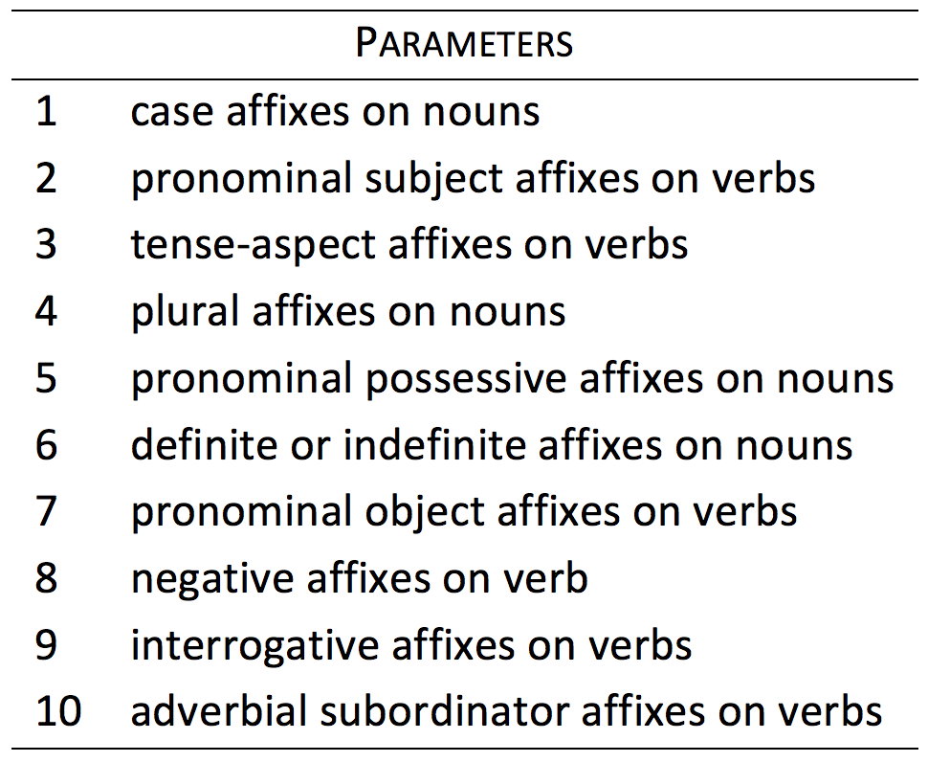
Preference for suffixes
This is captured by Dryer’s (2013) method for comparing the degree to which languages are characterized by a preference for prefixing, suffixing, or neither.
Table 2. Types of inflexional affixes (Dryer 2013)

Slide 30
Preference for suffixes
Following Dryer (2013), a language receives
  a single point for prefixing or suffixing if it is predominantly prefixing or suffixing for a given parameter,
  half a point for each if it has both prefixing and suffixing, with neither deemed dominant
  no point when there is no affixing for a given parameter
The first three parameters (case affixes on nouns, subject and tense-aspect affixes in verbs) are deemed especially important: their score is doubled

Slide 31
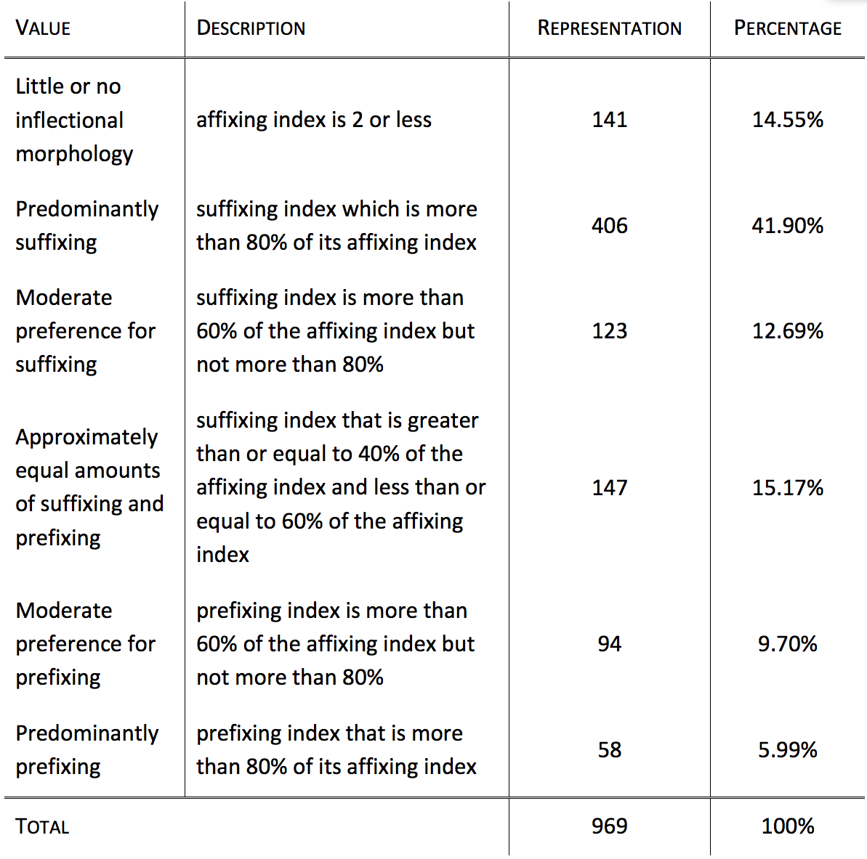
Preference for suffixes
Table 3. Suffixing vs Prefixing in Inflectional Morphology (Dryer 2003)

Slide 32
Preference for suffixes
Table 3. Suffixing vs Prefixing in Inflectional Morphology (Dryer 2003)

Slide 33
Interim summary
As far as inflectional morphemes are concerned, typology corroborates a worldwide preference for postposed and suffixed elements.
Languages that are predominantly prefixing are rare.

Slide 34
Ancient Egyptian-Coptic
Long-term changes towards a predominantly prefixing language

Slide 35
Ancient Egyptian-Coptic
Background information
  An independent branch of the Afroasiatic phylum or ‘quasi-stock’
  First attested at the end of the fourth millenium BCE, and documented continually until sometime in the 13th or 14th century CE, when all of its speakers shifted to Arabic

Slide 36
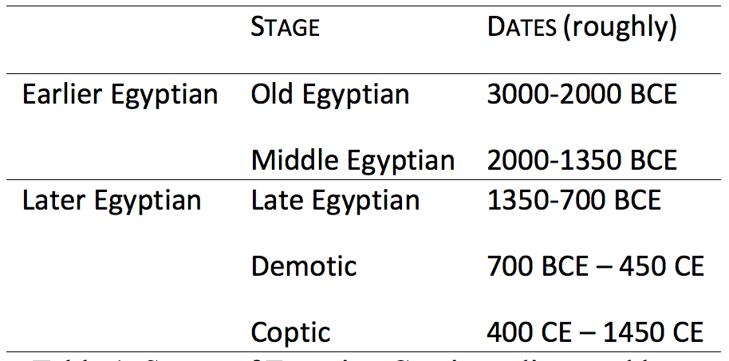
Ancient Egyptian-Coptic
Background information
  Standardly divided into five stages and and two macro-phases
Table 4. Stages of Egyptian-Coptic (as discussed here)

Slide 37
Ancient Egyptian-Coptic
Background information
  Standardly divided into five stages and and two macro-phases
Table 4. Stages of Egyptian-Coptic (as discussed here)

Slide 38
Ancient Egyptian-Coptic
Background information
Coptic is a predominantly prefixing language
Earlier Egyptian is not:
  Dominant VSO order of major constituents
  A small number (1-3) of postposed or suffixed inflectional morphemes on nouns and verbs
A diachronic trend from synthetic to analytic to agglutination and polysynthesis (anasynthesis, Haspelmath 2011)
A diachronic trend towards prefixed grammatical elements

Slide 39
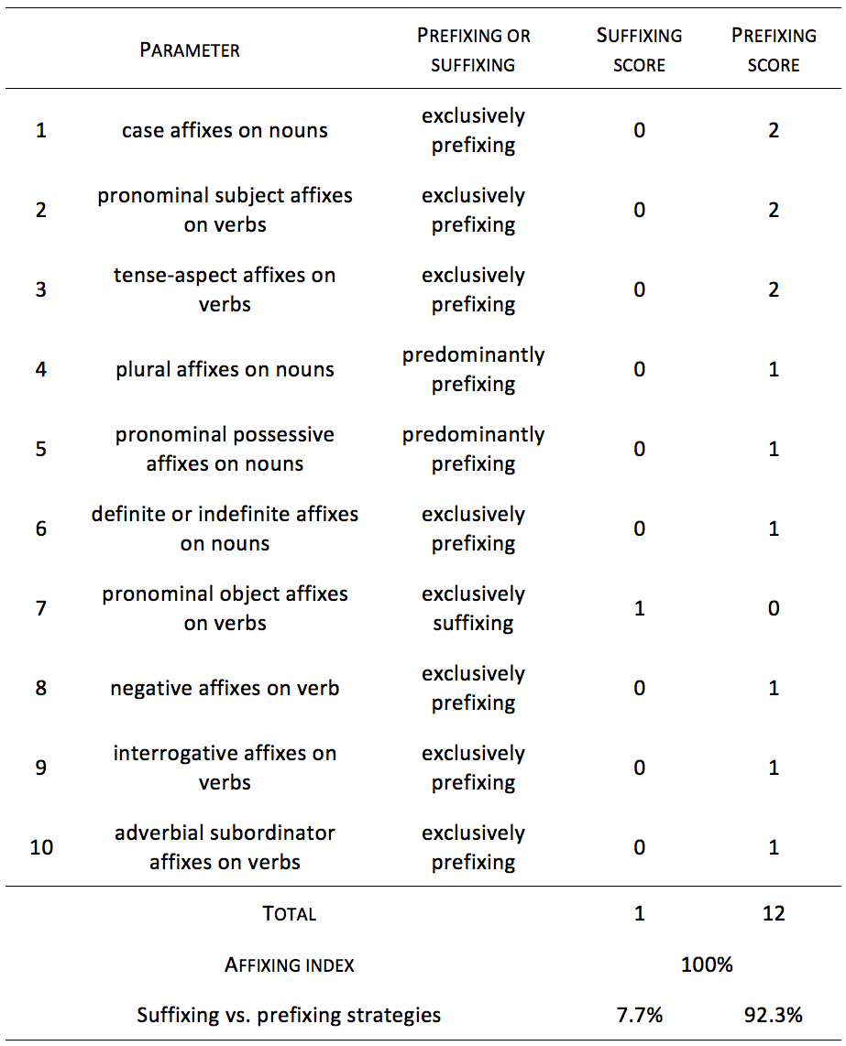
Ancient Egyptian-Coptic
Table 5. Calculation of the affixing index for Coptic

Slide 40
Ancient Egyptian-Coptic
Table 5. Calculation of the affixing index for Coptic

Slide 41
Ancient Egyptian-Coptic
Table 5. Calculation of the affixing index for Coptic

Slide 42
Ancient Egyptian-Coptic
Background information
Coptic is a predominantly prefixing language
  With its extremely high prefixing preference (12/13), Coptic belongs to the rare 6% or so of languages that are predominantly prefixing.
  Moreover, it has a higher prefixing index than any other language in Dryer’s 969-language sample. (The closest competitor is Hunde [Bantu; Democratic Republic of Congo; Kahombo 1992], with a prefixing index of 9.5/13.)

Slide 43
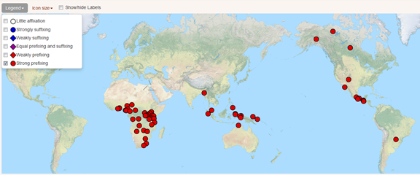
Ancient Egyptian-Coptic
Background information
Coptic is a predominantly prefixing language
  With its extremely high prefixing preference (12/13), Coptic belongs to the rare 6% or so of languages that are predominantly prefixing.
  Moreover, it has a higher prefixing index than any other language in Dryer’s 969-language sample. (The closest competitor is Hunde [Bantu; Democratic Republic of Congo; Kahombo 1992], with a prefixing index of 9.5/13.)
Coptic is an areal outlier
  While predominantly prefixing languages are relatively common in Mesoamerica and in Africa, within Africa it is only in western and southern sub-Saharan Africa that predominant prefixing is common

Slide 44
A template for noun morphosyntax

Slide 45
A template for verb morphosyntax

Slide 46
The diachrony of affix ordering
Methodology
For diachronic purposes, a modified form of Dryer’s typology is useful.
Rather than limiting the score to 0 for no affix, 1 for either suffixing or prefixing, and 0.5 for both prefixing and affixing, we suggest using two scales, both of which admit a more fine-grained analysis

Slide 47
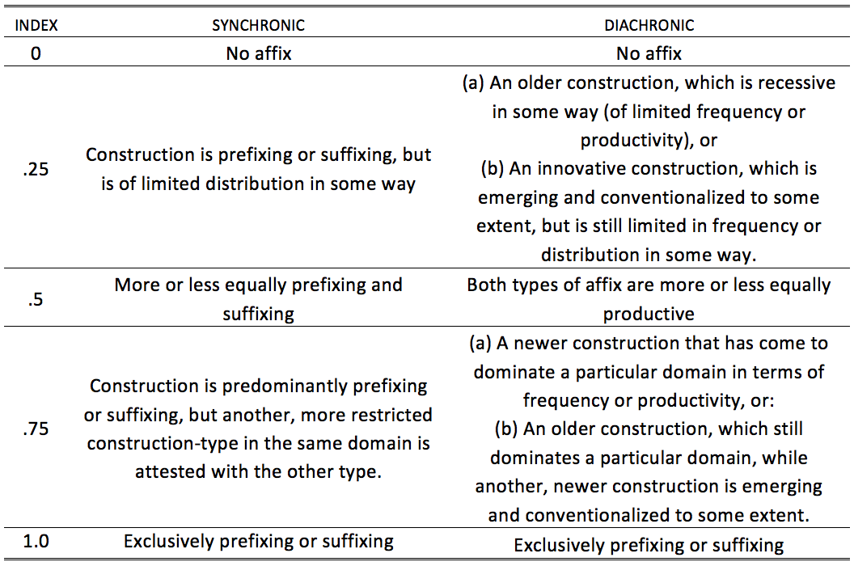
The diachrony of affix ordering
Methodology
Table 6. A finer-grained index for affixing

Slide 48
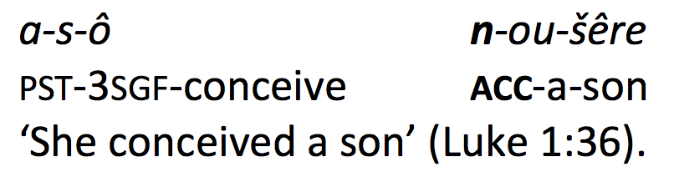
The diachrony of affix ordering
Parameter 1 – Case affixes on nouns
Coptic
Prefixed case markers (on postverbal noun phrases in S, A, or P role)

Slide 49
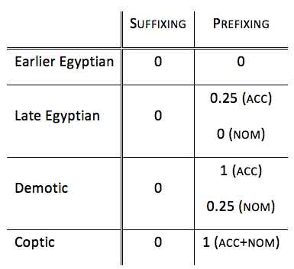
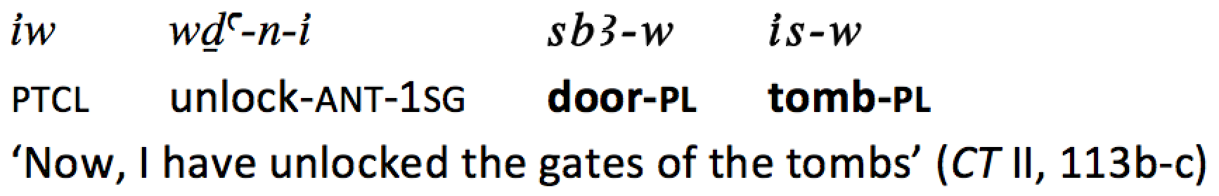
The diachrony of affix ordering
Parameter 1 – Case affixes on nouns
Previous stages
Coptic
Prefixed case markers (on postverbal noun phrases in S, A, or P role)

Slide 50
The diachrony of affix ordering
Parameter 1 – Case affixes on nouns
Previous stages
Coptic
Prefixed case markers (on postverbal noun phrases in S, A, or P role)
Type of change: (secondary) grammaticalization (from preposition to accusative case marker, and from antitopic marker to nominative marker)

Slide 51
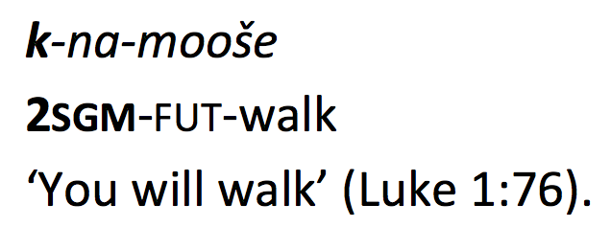
The diachrony of affix ordering
Parameter 2 – Subject affixes on verbs
Coptic
Prefixed subject affixes on verbs

Slide 52
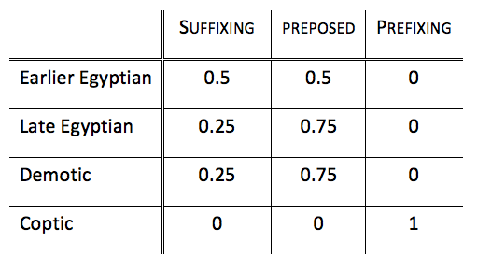
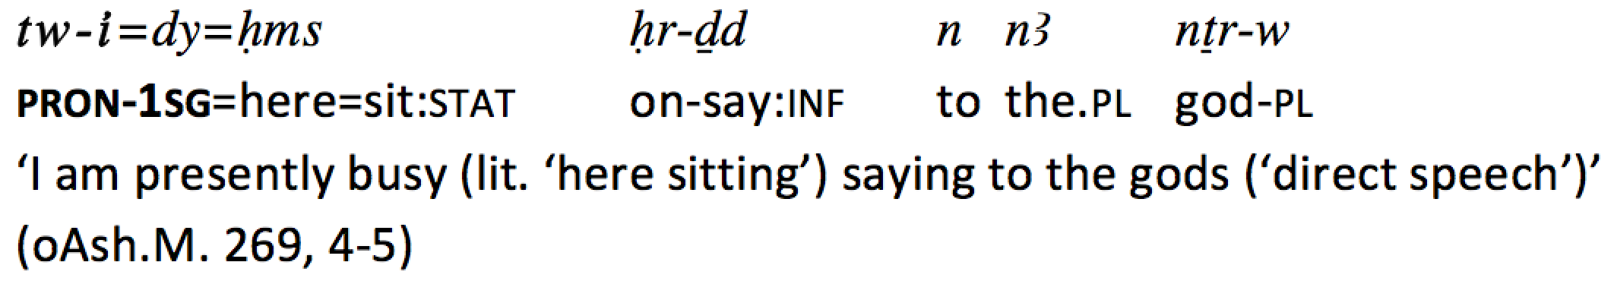
The diachrony of affix ordering
Parameter 2 – Subject affixes on verbs
Previous stages
Coptic
Prefixed subject affixes on verbs

Slide 53
The diachrony of affix ordering
Parameter 2 – Subject affixes on verbs
Previous stages
Coptic
Prefixed subject affixes on verbs
Type of change: development of a new pronoun paradigm (which gradually becomes a subject prefix) and the shift of a minor usage pattern (a periphrastic construction involving an auxiliary) to a major pattern

Slide 54
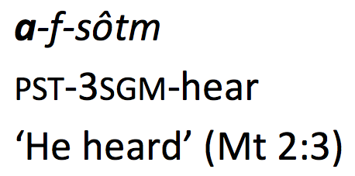
The diachrony of affix ordering
Parameter 3 – Tense-aspect affixes on verbs
Coptic
Prefixed tense-aspect affixes on verbs

Slide 55
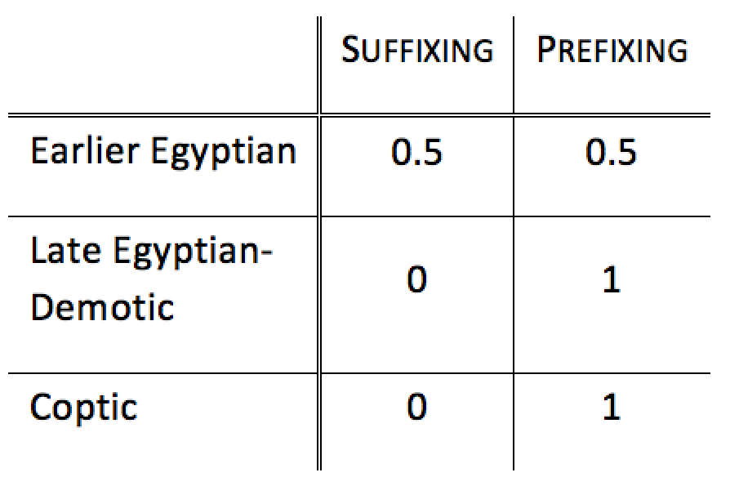
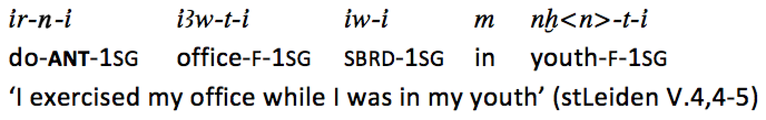
The diachrony of affix ordering
Parameter 3 – Tense-aspect affixes on verbs
Previous stages
Coptic
Prefixed tense-aspect affixes on verbs

Slide 56
Anasynthesis of the verb

Slide 57
The diachrony of affix ordering
Parameter 3 – Tense-aspect affixes on verbs
Previous stages
Coptic
Prefixed tense-aspect affixes on verbs
Type of change: Old tense-aspect suffixes are lost, while new TAM markers are grammaticalized from auxiliary verbs in periphrastic constructions.
Since the linear order of these grammaticalizing constructions follows that of basic verbal clauses, i.e., VSO/AuxSV, the result is tense-aspect prefixes.

Slide 58
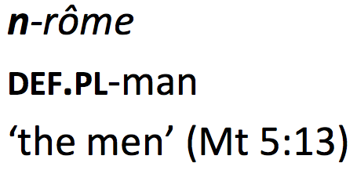
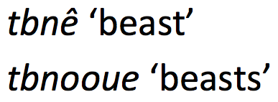
The diachrony of affix ordering
Parameter 4 – Plural affixes on nouns
Coptic
Productive: prefixed plural markers
Non-productive: plural-suffixing construction (which often involves stem-internal alternations)

Slide 59
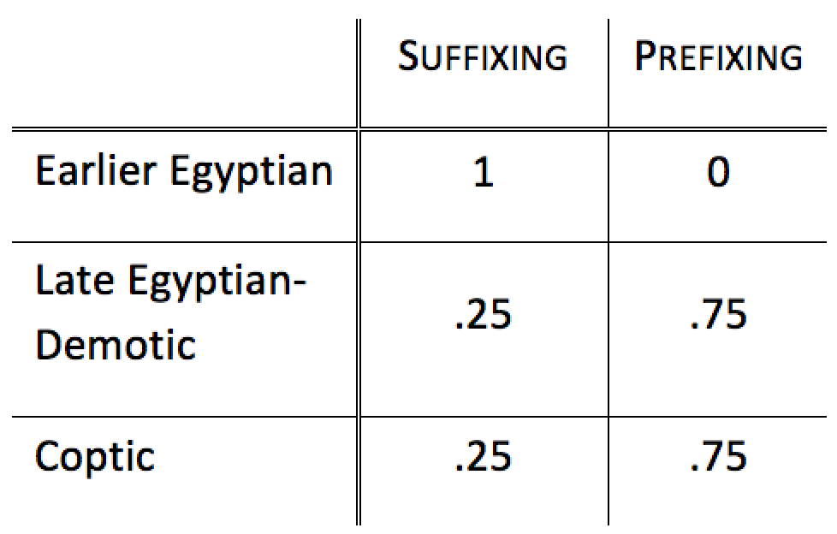
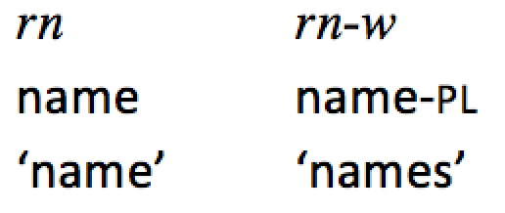
The diachrony of affix ordering
Parameter 4 – Plural affixes on nouns
Previous stages
Coptic
Productive: prefixed plural markers
Non-productive: plural-suffixing construction (which often involves stem-internal alternations)

Slide 60
The diachrony of affix ordering
Parameter 4 – Plural affixes on nouns
Previous stages
Coptic
Productive: prefixed plural markers
Non-productive: plural-suffixing construction (which often involves stem-internal alternations)
Type of change: emergence of new preposed articles that unambiguously mark number, and loss of plural suffixes.

Slide 61
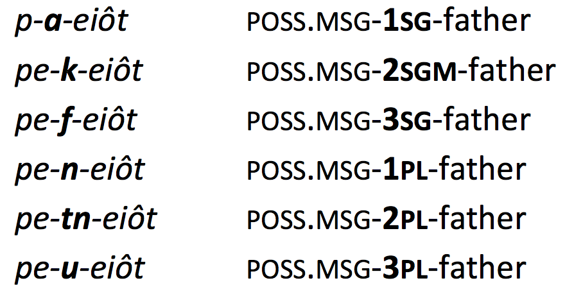
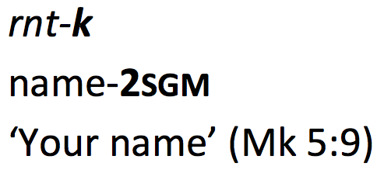
The diachrony of affix ordering
Parameter 5 – Possessive affixes on nouns
Coptic
Productive: prefixed possessives on nouns
Non-productive: suffixed possessives

Slide 62
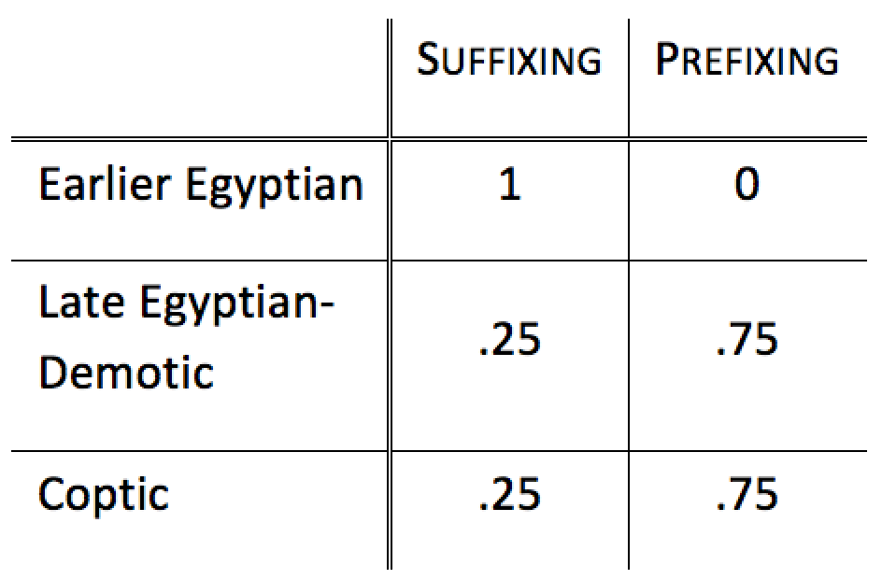
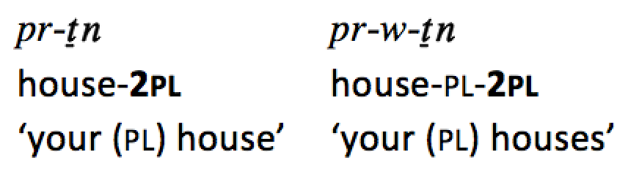
The diachrony of affix ordering
Parameter 5 – Possessive affixes on nouns
Previous stages
Coptic
Productive: prefixed possessives on nouns
Non-productive: suffixed possessives

Slide 63
The diachrony of affix ordering
Parameter 5 – Possessive affixes on nouns
Previous stages
Coptic
Productive: prefixed possessives on nouns
Non-productive: suffixed possessives
Type of change: emergence of new preposed articles that unambiguously mark number, and loss of plural suffixes.

Slide 64
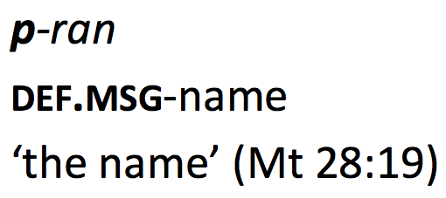
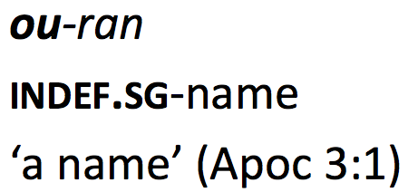
The diachrony of affix ordering
Parameter 6 – (In)definite affixes on nouns
Coptic
Definite and indefinite prefixes on nouns

Slide 65
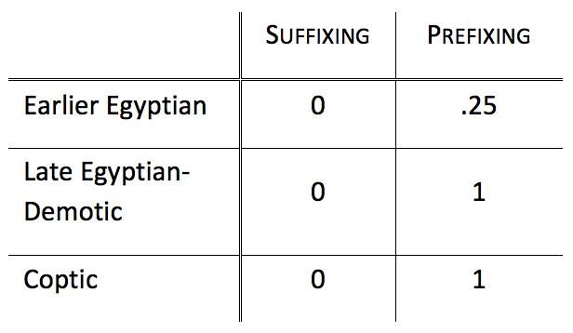
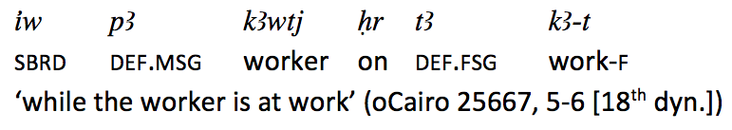
The diachrony of affix ordering
Parameter 6 – (In)definite affixes on nouns
Previous stages
Coptic
Definite and indefinite prefixes on nouns

Slide 66
The diachrony of affix ordering
Parameter 6 – (In)definite affixes on nouns
Previous stages
Coptic
Definite and indefinite prefixes on nouns
Type of change: Grammaticalization (demonstrative > definite article > definite affix; ‘one’ > indefinite article > indefinite affix) ; Independent word > affix

Slide 67
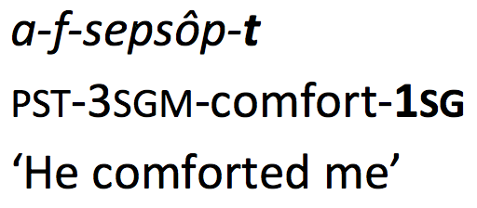
The diachrony of affix ordering
Parameter 7 – Pron. object affixes on verbs
Coptic
Suffixed pronominal object on verbs

Slide 68
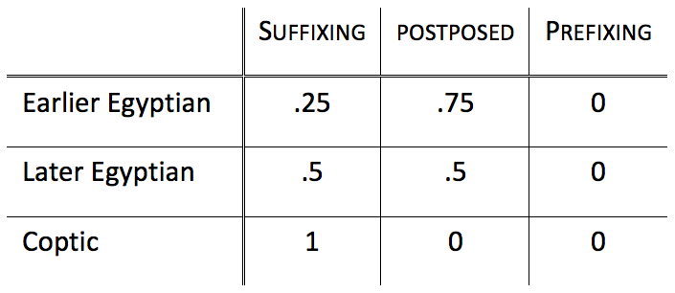
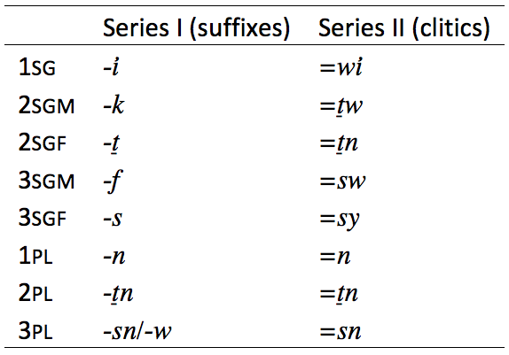
The diachrony of affix ordering
Parameter 7 – Pron. object affixes on verbs
Previous stages
Coptic
Suffixed pronominal object on verbs
Table 7. Two series of bound person markers

Slide 69
The diachrony of affix ordering
Parameter 7 – Pron. object affixes on verbs
Previous stages
Coptic
Suffixed pronominal object on verbs
Type of change: shift from a minor usage pattern to a major one. The ‘suffix takeover’ is the result of grammaticalization of verb forms with suffixed P markers, and the loss of verb forms with clitic P markers, there is no ‘clitic-to-affix’ grammaticalization involved (Hopper & Traugott 2003, Himmelmann 2014).

Slide 70
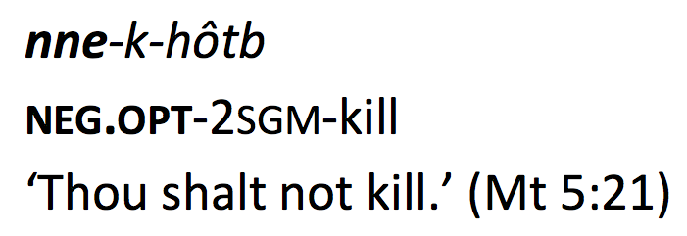
The diachrony of affix ordering
Parameter 8 – Negative affixes on verbs
Coptic
Portmanteau prefixes that code both TAM values and polarity

Slide 71
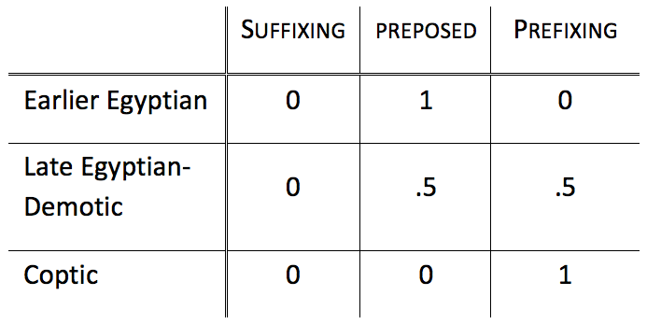
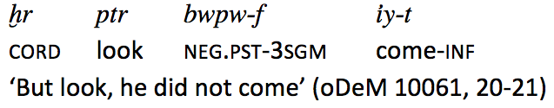
The diachrony of affix ordering
Parameter 8 – Negative affixes on verbs
Previous stages
Coptic
Portmanteau prefixes that code both TAM values and polarity

Slide 72
The diachrony of affix ordering
Parameter 8 – Negative affixes on verbs
Previous stages
Coptic
Portmanteau prefixes that code both TAM values and polarity
Type of change: from Late Egyptian onwards, negations in main verbal clauses began to be univerbated with TAM auxiliaries (univerbation, grammaticalization of portmanteau TAM/Polarity prefixes)

Slide 73
The development of negative prefixes
The Egyptian-Coptic nondumitive (‘not yet’)

Slide 74
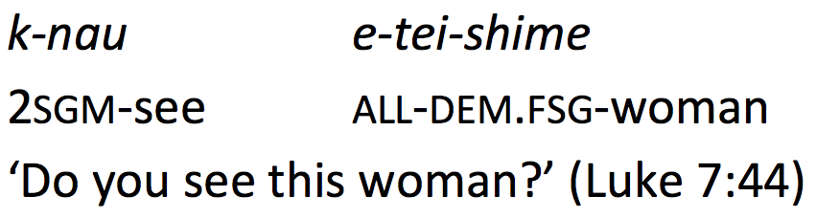
The diachrony of affix ordering
Parameter 9 – Interrogative affixes on verbs
Coptic
Unmarked direct yes/no questions

Slide 75
The diachrony of affix ordering
Parameter 9 – Interrogative affixes on verbs
Previous stages
Coptic
No prefixed or suffixed interrogation markers
Unmarked direct yes/no questions

Slide 76
The diachrony of affix ordering
Parameter 9 – Interrogative affixes on verbs
From focus construction to interrogative marker
Stage 1: Wh-questions are typically constructed as cleft sentences

Slide 77
The diachrony of affix ordering
Parameter 9 – Interrogative affixes on verbs
From focus construction to interrogative marker
Stage 2: Same, but with periphrasis based on the verb iri ‘to do’

Slide 78
The diachrony of affix ordering
Parameter 9 – Interrogative affixes on verbs
From focus construction to interrogative marker
Stage 3: Earlier nominalization opaque, just a focus-marking prefix

Slide 79
The diachrony of affix ordering
Parameter 9 – Interrogative affixes on verbs
From focus construction to interrogative marker
Stage 4: Focus-marking prefix extended to yes-no questions
Type of change: secondary grammaticalization (from nominalizer to focus to interrogative prefix

Slide 80
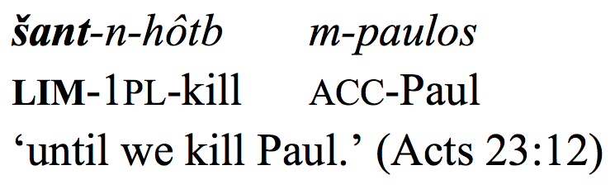
The diachrony of affix ordering
Parameter 10 – Adv. subordinator affixes on verbs
Coptic
Coptic has a set of verbal prefixes that indicate subordinate-clause status

Slide 81
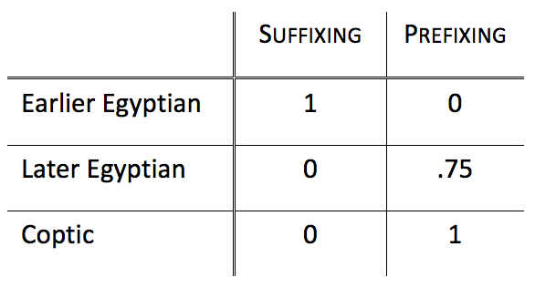
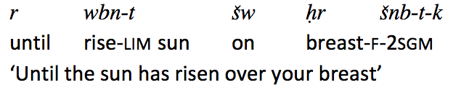
The diachrony of affix ordering
Parameter 10 – Adv. subordinator affixes on verbs
Previous stages
Coptic
Coptic has a set of verbal prefixes that indicate subordinate-clause status
Interestingly, Dryer (2013) claims that adverbial subordination prefixes don’t exist.
Grossman, Antonov & Jacques (2018) point out that they do exist.
Dryer (2021) also argues that they exist, but doesn;’t mention earlier work.

Slide 82
The diachrony of affix ordering
Parameter 10 – Adv. subordinator affixes on verbs
Previous stages
Coptic
Coptic has a set of verbal prefixes that indicate subordinate-clause status
Type of change: from Late Egyptian onwards, clause-initial conjunctions begin to be univerbated with auxiliary verbs, creating, in effect, adverbial subordinator prefixes on verbs (grammaticalization, via periphrasis and univerbation)

Slide 83
Universally disprefered structures through change
Conclusions

Slide 84
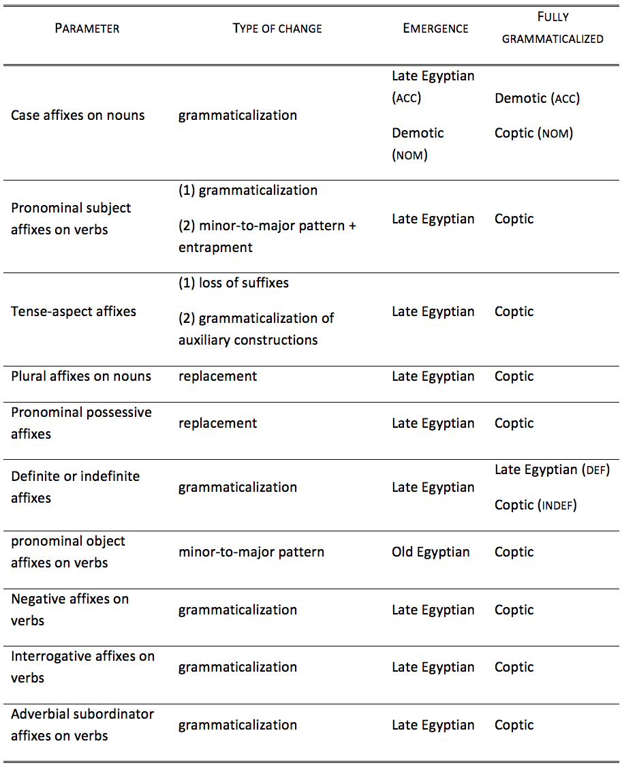
Types of change and stages
Table 8. Summary of types of changes, period of emergence and of full grammaticalization

Slide 85
Types of change and stages
Table 8. Summary of types of changes, period of emergence and of full grammaticalization
Grammaticalization

Slide 86
Types of change and stages
Table 8. Summary of types of changes, period of emergence and of full grammaticalization
Grammaticalization
Minor to major patterns

Slide 87
Types of change and stages
Table 8. Summary of types of changes, period of emergence and of full grammaticalization
Grammaticalization
Minor to major patterns
Replacement

Slide 88
Types of change and stages
Table 8. Summary of types of changes, period of emergence and of full grammaticalization
Grammaticalization
Minor to major patterns
Replacement
Loss of suffixes

Slide 89
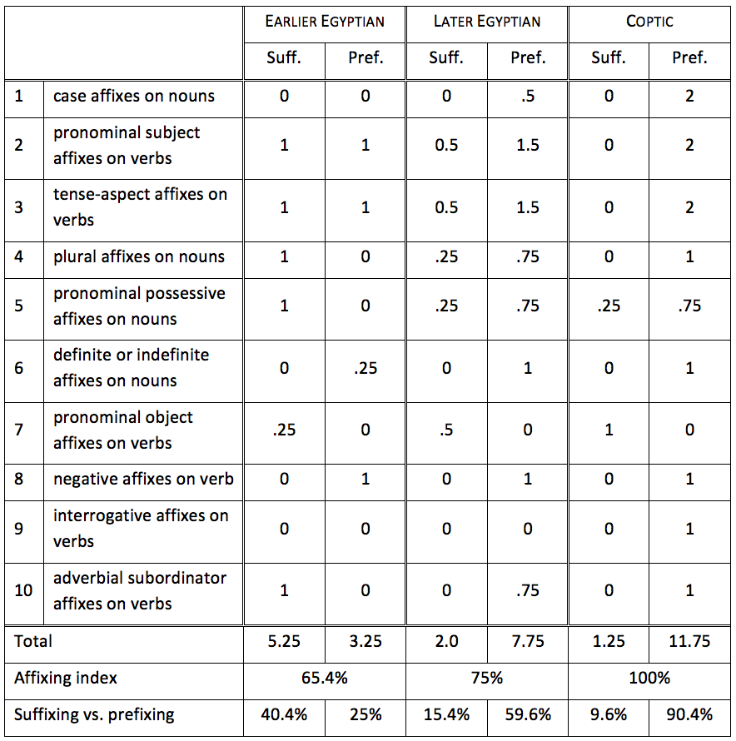
The diachrony of affixing preferences

Slide 90
The diachrony of affixing preferences

Slide 91
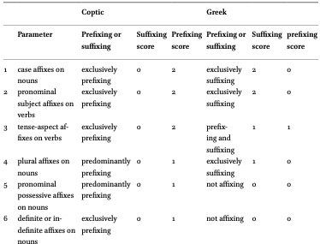

Contact?
Grossman (2018)

Slide 92
Conclusions
Directly relevant for larger questions, such as the relationship between language universals and language change (e.g., Good 2008): do synchronic structural universals constrain change, or do diachronic universals, ultimately motivated by synchronic usage factors, give rise to synchronic universals?
Apparently ‘counter-directional’ changes are crucial here: why should language change lead to universally dispreferred distributions of linguistic structures?
In brief, language change seems to be indifferent to typological distributions.

Slide 93
Conclusions
Ancient Egyptian-Coptic (Afroasiatic) shows a long-term diachronic macro-change from mixed suffixing-prefixing to an overwhelming preference for prefixing.
Changes in affix order in Ancient Egyptian-Coptic occur at different times, at different rates, and to different degrees in different domains.
Crucially, there is nothing unusual about the actual processes of change themselves; what may be unusual, from a cross-linguistic point of view, is the length of uninterrupted documentation of a single language, which allows us to observe long-term changes with abundant evidence.
Other factors include (rare) VSO order in Earlier Egyptian,
As such, while Coptic-Egyptian seems to be swimming against the typological tide, it is just paddling along, construction by construction, with regular processes of language change.

Slide 94
Once again
TYPE: the types of change are not themselves unusual or rare for the most part.
PATH: multiple pathways of change that converge (vs. a single pathway)
STAGE: mostly many-step or complex pathways
SOURCE: most of the source constructions are not rare themselves, but VSO order, which probably played a large role, is relatively rare.
STABILITY: inflectional prefixes in Egyptian-Coptic, once grammaticalized, are stable.
DIFFUSABILITY: not due to contact, probably not very diffusable anyway.

Slide 95
But is that all?
Dryer’s typological studies relied on orthographic evidence for word division, and hence the number and nature of affixes.
But how reliable is this?

Slide 96
From Arkadiev (2005, ms)

Slide 97
From Arkadiev (2005, ms)

Slide 99
Thank you!

