Slide 1
Typology and diachrony of the middle voice
Guglielmo Inglese
guglielmo.inglese@unito.it
Academia Grammaticorum Salensis Undevigesima, 25-30/07/2022

Slide 2
Content of the class
Background: valency and transitivity
Background: voice and valency change
What is the middle voice? A historical sketch
The typology of the middle voice: Kemmer 1993
The typology of the middle voice: a reassessment
The diachronic typology of the middle voice

Slide 3
1. Background: valency and transitivity

Slide 4
What is a verb?
Croft 2001: 88
Basic components of verbal meaning (Ježek 2016: 107):
lexical semantics + lexical aspect + valency
hit ‘an Agent hits a Patient’ + achievement + bivalent

Slide 5
Valency
“Le nœud verbal […] exprime tout un petit drame. Comme un drame en effet, il comporte obligatoirement un procès, et le plus souvent des acteurs et des circonstances.” (Tesnière 1959: 102)
“It is an undisputed fact that the meaning of a verb is inherently relational: it involves one or more entities (or arguments) that are necessary for the situation it describes to be conceived of. For example, the verb kill makes reference to a killer and a victim, without which any event of killing cannot be conceptualized.” (Perek 2015: 15)

Slide 6
Valency
Avalent: It rains
Monovalent: The baby cries
Bivalent: The ball hits the door
Trivalent: I gave a letter to Mary

Slide 7
Semantic vs. syntactic valency
cf. Haspelmath (2014) and Forker (2014)
agent addressee theme
John talked with Mary about the news
subject adjunct adjunct
John told Mary the news
subject indirect object direct object
monovalent
trivalent
Where is valency stored?
Property of the verbs vs. property of the constructions (Perek 2015)

Slide 8
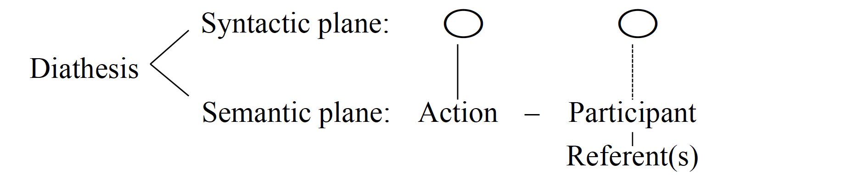
Diathesis
“pattern of mapping of semantic arguments onto syntactic functions (grammatical relations).” (Kulikov 2013: 262)
Bahrt 2021: 20

Slide 9
Transitivity
“In many languages […] the transitivity relationship lies at the core of most grammatical processes” (Hopper & Thompson 1982: 1)
Approaches to transitivity (cf. Kittilä 2011):
syntactic
semantic
(pragmatic)

Slide 10
Syntactic transitivity
transitive verbs can take a direct object, intransitive verbs cannot
The plumber repaired the sink vs. *The dog arrived the food
→ Syntactic transitivity is a cross-linguistically problematic notion, because it relies on the non-trivial identification of ‘direct object’ (Haspelmath 2011)

Slide 11
Syntactic transitivity vs. syntactic valency
Are all syntactically bivalent verbs transitive?
The man kicks the ball
?The man kicks
The ball is kicked by the man
bivalent & transitive
The man goes to the cinema
?The man goes
*The cinema is gone by the man
bivalent & intransitive

Slide 12
Semantic transitivity
Transitive event: “a verbal event in which a human entity (an Agent) acts volitionally, exerting physical force on an inanimate definite entity (a Patient) which is directly and completely affected by that event” (cf. Kemmer 1993: 50)
semantic transivity is a gradient notion, made up by several parameters (agency, control, positive polarity, perfective aspect, participant’s individuation etc., see Hopper & Thompson 1980 and Næss 2007);
Semantic transitivity does not overlap with semantic valency (semantic valency is only one parameter of semantic transitivity)!

Slide 13
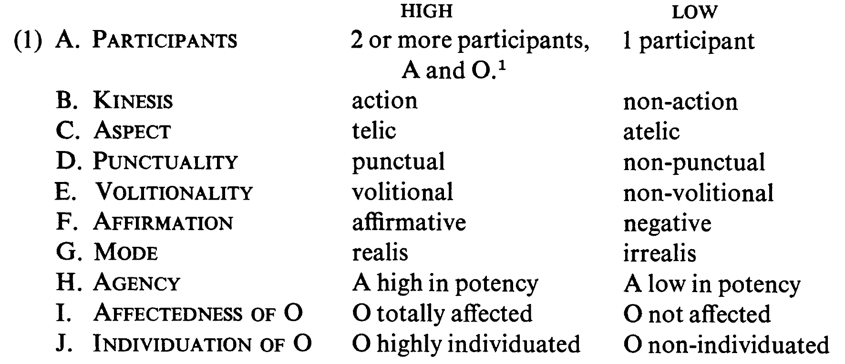
Semantic transitivity
Hopper & Thompson 1980: 252

Slide 14
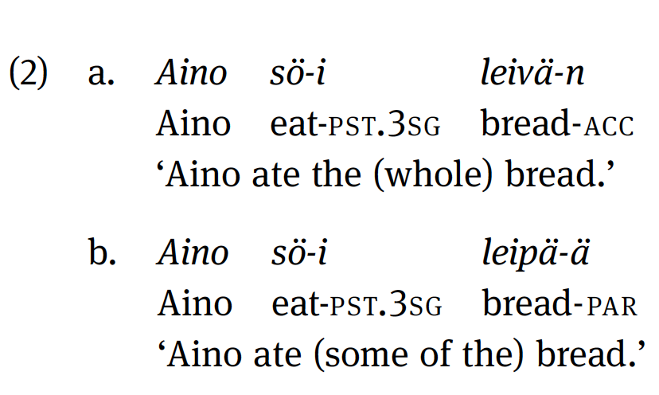
Semantic transitivity
Language-specific construction may affect semantic transitivity but leave semantic valency unaltered, e.g. partitive case in Finnish (see Luraghi & Huumo 2014)

Slide 15
2. Valency change and voice

Slide 16
Changing valency: which types?
Valency-increasing: causative, applicative
Valency-decreasing: passive, anticausative, impersonal, antipassive, object incorporation
Argument-identifying strategies: reflexive, reciprocal
valency reduction
see Dixon & Aikhenvald 2000, Creissels 2006, Kulikov 2011, Malchukov 2015, Zúñiga & Kittilä 2019, Bahrt 2021

Slide 17
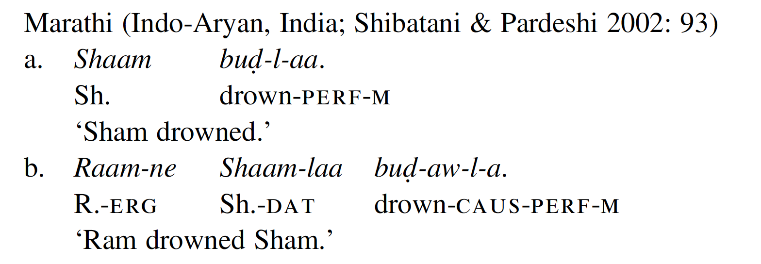
Changing valency: why?
Semantic vs. pragmatic valency change (Givón 2001)
Semantic valency change: manipulate the semantics of the verb, create a new verb with a different semantics;

Slide 18
Valency change and derivation
Valency change is a type of derivation (see Alexiadou et al. 2015: 3–4)
Valency changing constructions frequently realized via derivational morphology (esp. as compared to other grammatical categories of verbs such as agreement and TAM, Bybee 1985: 29–32; Aikhenvald 2011)
Hittite (Indo-European, Anatolian; Hoffner & Melchert 2008: 178–179)
verb: ar- ‘arrive’ > ar-nu- ‘cause to arrive’
adjective: daššu-‘strong’ > daš(ša)-nu- ‘make strong’
noun: ešḫar- ‘blood’ > ešḫar-nu- ‘to make bloody’

Slide 19
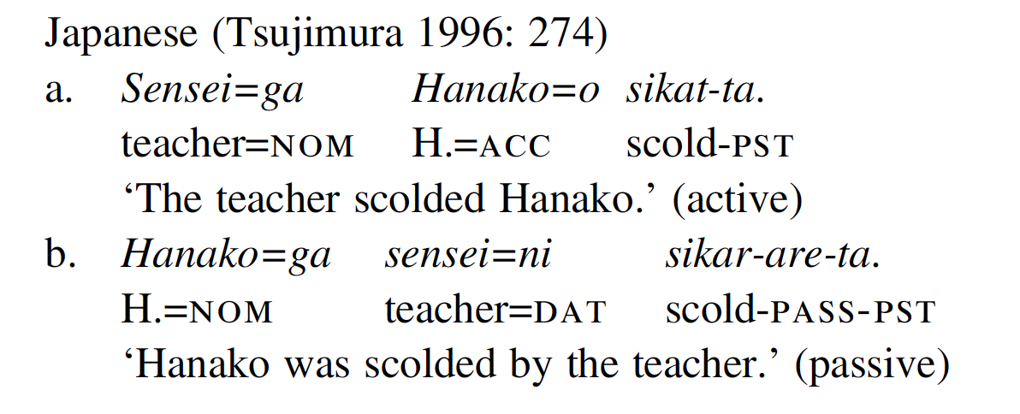
Changing valency: why?
b. Pragmatic valency change: “render the same semantically-transitive event from different pragmatic perspectives. These perspectives turn out to involve, primarily although not exclusively, the relative topicality of the agent and patient.” (Givón 2001: 93)

Slide 20
Changing valency: syntactic reasons
Janic & Witzlac-Makarevich 2021: 20-22

Slide 21
Changing valency: which level?
Valency-changing operations differ as to the level of valency that they manipulate:
Semantic and syntactic valency: e.g. causative, anticausative
Syntactic valency only: e.g. passive, antipassive
Semantic valency only: e.g. reflexive, reciprocal (but not always)

Slide 22
Verbal voice
Voice = bound morphology
“[is] a regular encoding of diathesis through the verbal morphology” (Kulikov 2013: 264)
“minimally consists of an affix which here also encompasses reduplication and any suprasegmental features” (Bahrt 2021: 37)
Voice = predicate marking
“Voice refers to the way a specific diathesis is formally marked on functional or lexical verbs in the predicate complex.” (Zúñiga & Kittilä 2019: 4)

Slide 23
Changing valency: how?
Synthetic strategies: bound morphology (derivational/inflectional)
Hittite ar- ‘arrive’ > ar-nu- ‘cause to arrive’
b. Analytic strategies: use of free-standing morphemes
Italian il gatto è inseguito dal cane ‘the cat is chased by the dog’
c. Uncoded alternations: the same form in different valency frames (lability)
English the boy broke the vase/the vase broke

Slide 24
Focus on valency reduction/identification
We will focus on the main valency-reducing/identifying operations: passive, antipassive, anticausative, reflexive and reciprocal
The choice is not random:
languages often show the same strategy for two or more of these functions (voice syncretism);
they often result in a reduction of syntactic transitivity;
diachronic connections exist among these;
they have all been linked to the middle voice.

Slide 25
Typologizing voice: a caveat
Each valency operation is a prototype with various formal and semantic variants
“we arrive at the voice prototypes […] by distilling shared traits from disparate language-specific constructions. These particular constructions may instantiate the prototypes to varying degrees, deviating from them, as they often do, in ways that are complex, subtle, or both.” (Zúñiga & Kittilä 2019: 6)
Valency operations are not pre-established grammatical categories but comparative concepts that typologists use to carry out cross-linguistic comparison (Haspelmath 2007, 2010, 2020)

Slide 26
1. Passive voice

Slide 27
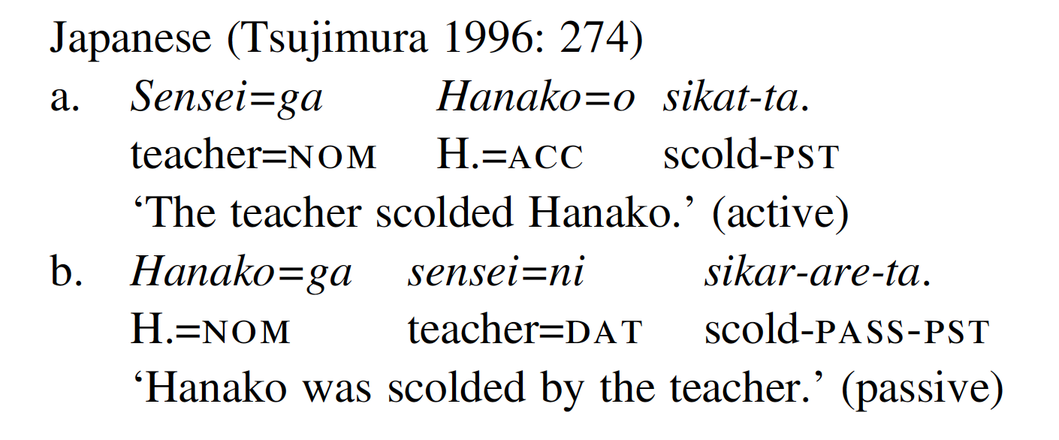
1.A. The prototypical passive

Slide 28
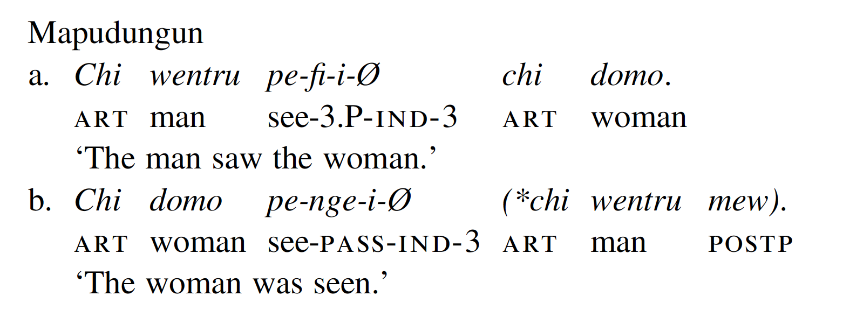
1.B. The agentless passive

Slide 29
1.B. The agentless passive
Also the Romance impersonal passive of the type It. si vendono case ‘houses are sold/on sale” belongs here.
Impersonal passives typically apply to intransitive verb bases as well, e.g. Lat. itur ‘one goes’, Germ. es wurde geklatscht ‘people clapped’ (Neshcheret & Witzlack-Makarevich 2016)
If a language has a passive construction that is used with intransitive verb, the same construction must also be available for transitive verbs (Keenan & Dryer 2007)

Slide 30
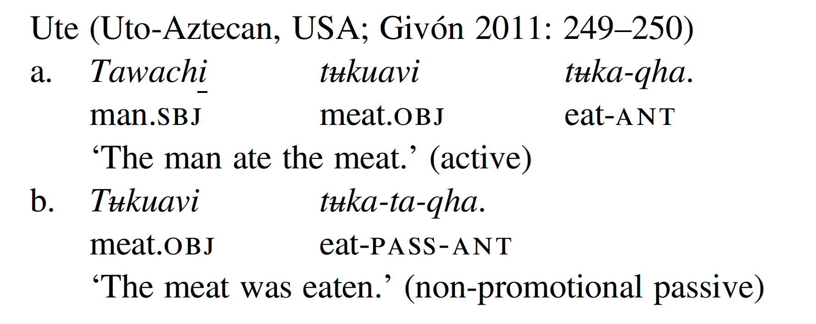
1.C. The non-promotional passive

Slide 31
1.D. The facilitative/potential passive
NB: this is described as ‘middle’ in the generative tradition!
cf. Holvoet 2020: Chap. 6

Slide 32
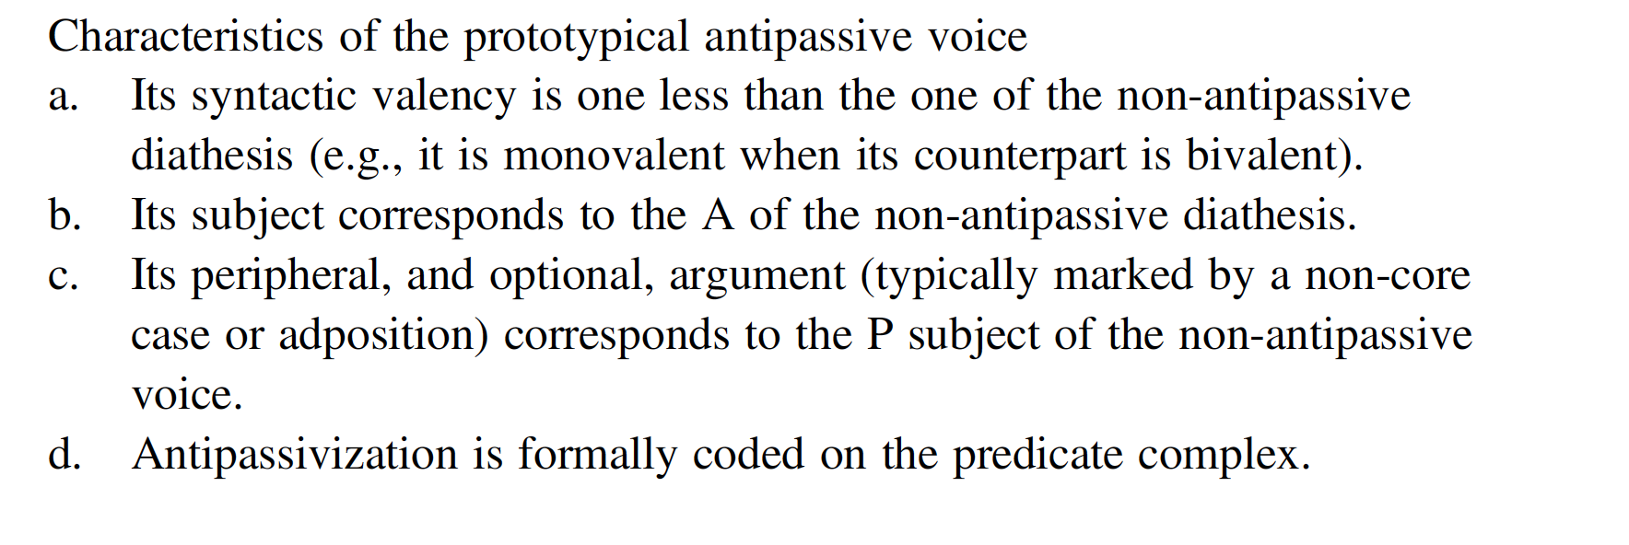
2. Antipassive voice

Slide 33
2.A. The prototypical anti passive

Slide 34
The antipassive in nominative languages
The antipassive voice has been traditionally described as the mirror-image of the passive voice in ergative-absolutive languages: this view has been abandoned, since antipassive constructions likewise occur in nominative-accusative languages (Janic 2016; Holvoet 2020: Chap. 3).

Slide 35
2.B. The patientless antipassive

Slide 36
3. The anticausative alternation
Grammatical alternation whereby languages encode events that are conceived as brought about by an external volitional entity (e.g. the boy broke the vase) as opposed to ones that are portrayed as coming about spontaneously (e.g. the vase broke).
Language | Verb pair |  | Operation
 | Spontaneous | Externally caused
Hittite | ze- ‘cook (intr.)’ | za-nu- ‘cook (tr.)’ | causativization
Russian | serdit’-sja ‘get angry’ | serdit’ ‘make angry’ | anticausativization

Slide 37
3. Anticausative voice

Slide 38
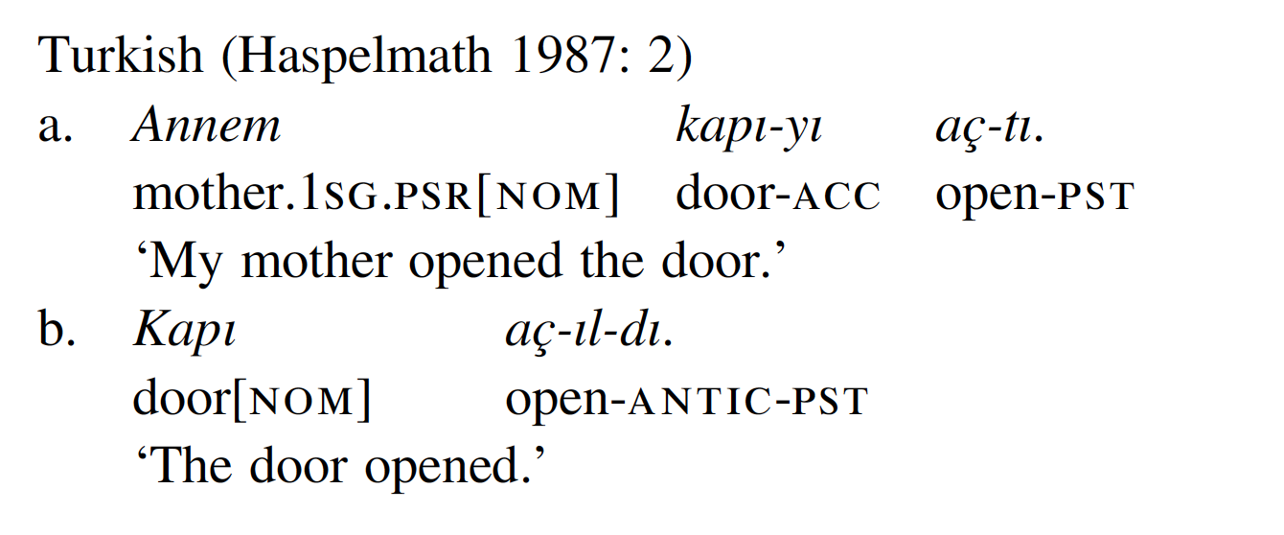
3.A. The prototypical anticausative
Incompatible with Agent expressions, but compatible with Cause/Force/Instrument

Slide 39
Autocausative vs. decausative
Huron-Wyandot (Iroquoian; Wendat 2018: 204-205)
decausative
autocausative
Haspelmath 1987, Creissels 2006: 10, Cennamo et al 2015: 280

Slide 40
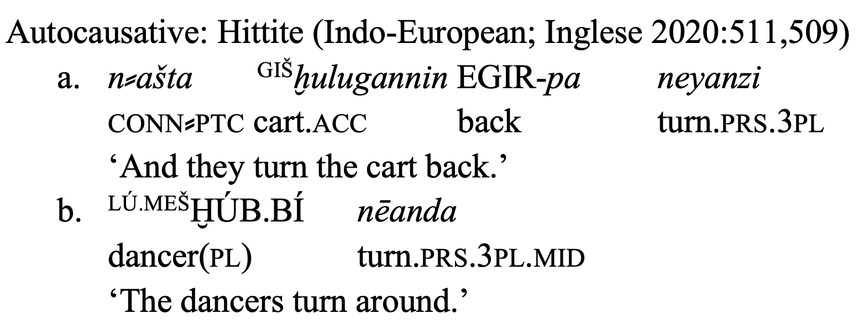
Where do autocausatives belong?
Anticausatives are a hybrid diathesis type, as they may be analysed as either A-demoting (like anticausatives), P-demoting (like antipassives) or as argumenti-identifying (like reflexives)!

Slide 41
Valency change and lexical restrictions
The availability of voice operations in general is constrained by lexical restrictions (van Lier & Messerschmidt 2022): certain operations are incompatible with specific verb meanings (or even lexemes).
Verbs entailing agent-oriented meaning components, that is “actions […] which imply specific instruments or methods” (Haspelmath 1993: 94)
Verbs that lexicalize a manner component (Rappaport Hovav & Levin 2010) or a specified causer (Koontz-Garboden 2009: 80–86)
*the paper tore vs. the paper cut
*the man murdered vs. the man died

Slide 42
The duplex diathesis
«This diathesis – the duplex – consists in a multiple, or at least double, assignment of semantic roles to grammatical relations, such that the subject is simultaneously the A and the P.» (Z&K 2019: 152)

Slide 43
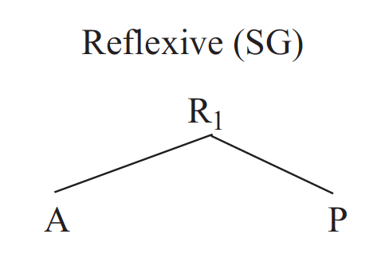
4. Reflexive voice

Slide 44
How many reflexives?
Direct reflexive: He hits himself (A=P)
Indirect reflexive: He sends a letter to himself (A=R)
Self-benefactive: He bakes a cake for himself (A=B)

Slide 45
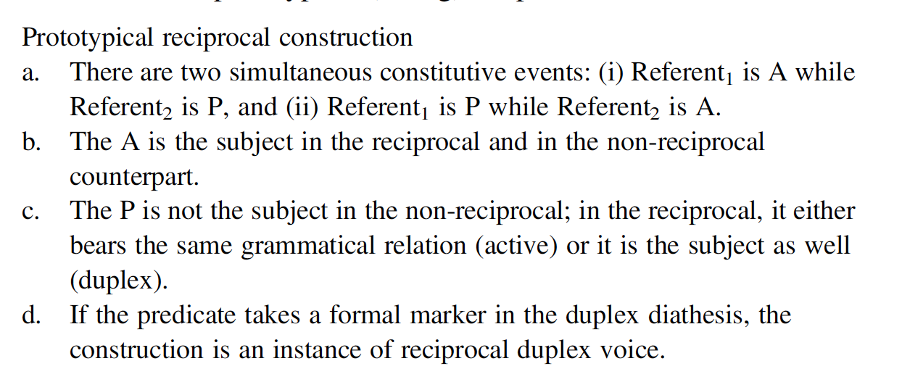
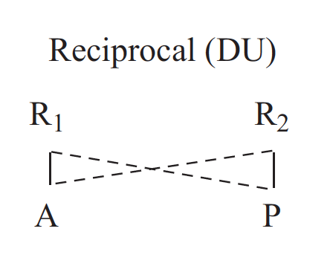
5. Reciprocal voice

Slide 46
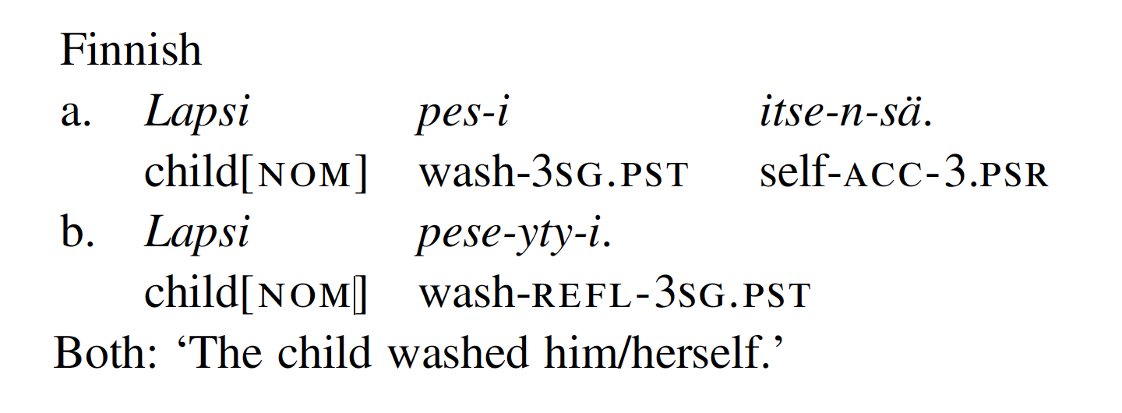
Reflexive constructions and transitivity
Verbal reflexives typically also reduce the syntactic valency of the verb (intransitivization), while pro(nominal) reflexives leave the argument structure of the verb unaltered.

Slide 47
Reciprocal constructions and transitivity
Ngiyambaa (Pama-Nyungan)

Slide 48
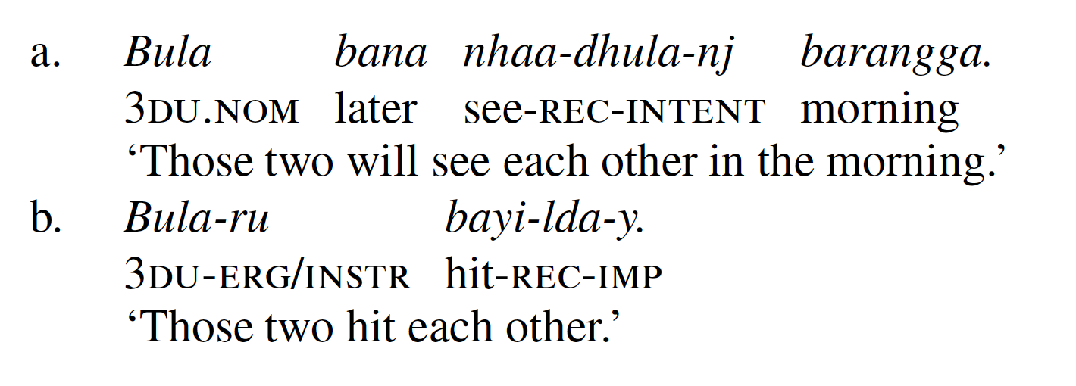
Duplex voice and transitivity
Badjala (Pama-Nyungan; Bell 2003: 131)
Evans et al. 2007

Slide 49
Summary
 | Effect on semantic valency | Effect of syntactic valency
Passive | unaltered | reduction (demotion/suppression of A)
Antipassive | unaltered | reduction (demotion/suppression of P)
Anticausative | reduction (omission of A) | reduction (suppression of A)
Reflexive | rearrangement | reduction (suppression of P) or unaltered (nominal reflexives)
Reciprocal | rearrangement | reduction (suppression of P) or unaltered (nominal reciprocals)

Slide 50
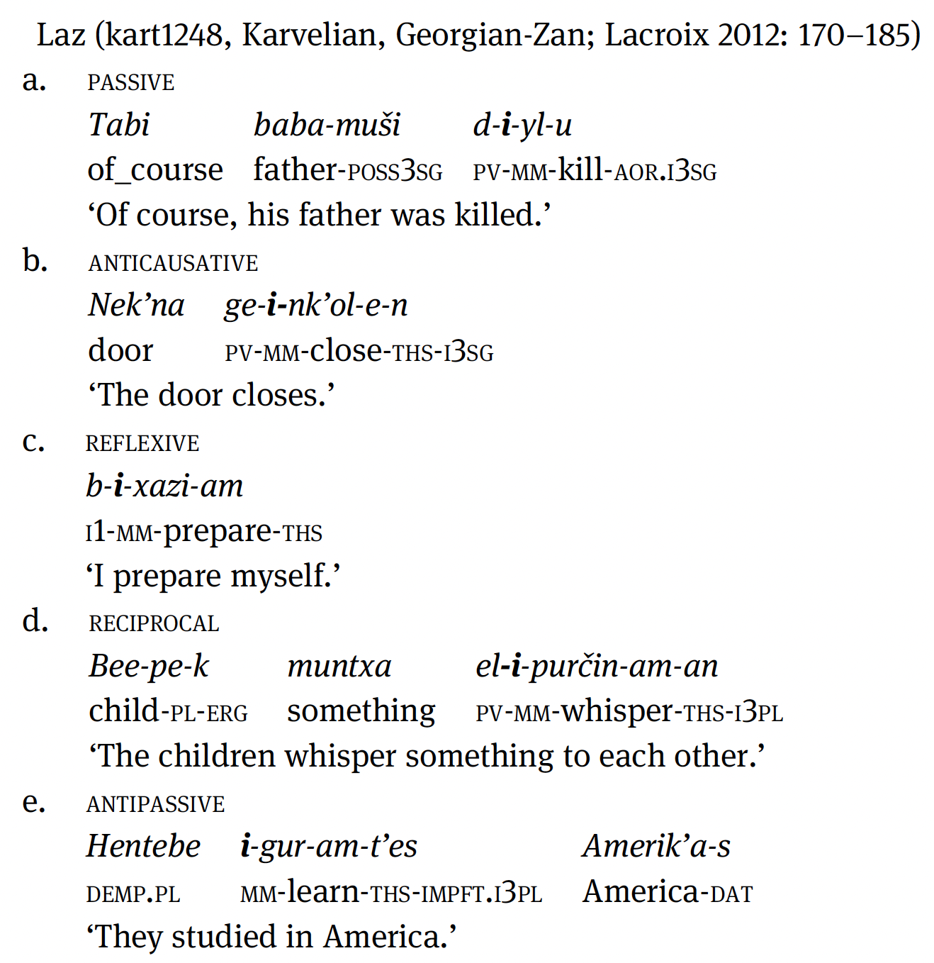
Voice syncretism
«Voice syncretism refers to formal verbal marking shared by two or more voice operations»
(Bahrt 2021)

Slide 51
3. What is the middle voice?

Slide 52
The middle voice in Ancient Greek
Present: two voices
lú-ō vs. lú-omai
‘I release’ ‘I am released, I release myself’
Aorist: three voices
élus-a vs. elusá-mēn vs. elú-then
‘I released’ ‘I released myself’ ‘I was released’
mesótēs diáthesis
Benedetti 2002, 2012, 2014, 2016

Slide 53
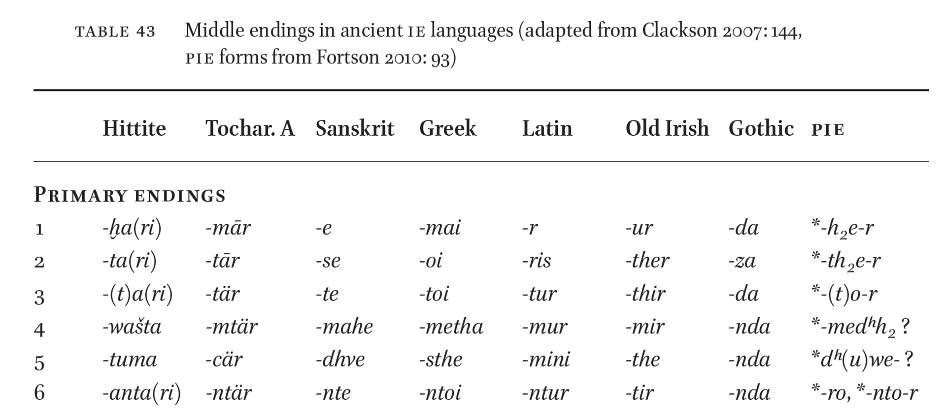

Slide 54
The Indo-European middle
Ancient grammarians:
• mesótēs diáthesis (Greek)
• vox media (Latin)
• ātmanēpada (Sanskrit)
Neogrammarians: Medium as set of inflectional endings of Indo-European languages (Bopp 1816, Brugmann 1889, Delbrück 1897; see Benedetti 2016, Signes Codoñer 2016)
Morphological approach: the ‘middle’ is an inflectional set of ending of the verbal paradigm of ancient IE languages

Slide 55
The Indo-European middle
Two groups of middle verbs in IE (Bopp 1816, Brugmann 1889, Delbrück 1897)
Non-oppositional middle verbs (media tantum, deponents): verbs that occur in the middle voice only. These include spontaneous change-of-state events, states, and event that involve high degree of affectedness/self-involvement.
Oppositional middle verbs: verbs that occur both in the active and in the middle voice. With these verbs the opposition is functionally motivated (e.g. reflexive, selfbenefactive, anticausative, passive, reciprocal, impersonal functions)

Slide 56
The Indo-European middle: Greek
A. Non-oppositional middles (media tantum):
hêmai’ ‘sit’, keîmai ‘lie’, kínumai ‘move’, skúzomai ‘be angry’, mákhomai ‘fight’
B. Oppositional middles (voice alternation):
phtheírō ‘ruin’ —> phtheíromai ‘get ruined’
kóptō ‘hit’ —> kóptomai ‘hit oneself’
dikázō ‘judge’ —> dikázomai ‘be judged’
outázō ‘wound’ —> outázonto ‘wound one another’

Slide 57
The self-benefactive middle: Greek and Indo-Aryan
autoû nautilloménoisi édōke khṓrous enidrúsasthai bōmoùs kaì teména theoîsi
‘To the sailors that arrived there, he granted land to build temples to their own gods.’ (Hdt. 2.178.1) cf. enidrúō ‘build’
yó yájāti yájāte ít
‘Who offers a sacrifice (to the god) for someone else or on their own behalf.’ (RV 8.31.1)
«The self-beneficent meaning was one of the main functions of the Vedic, and, in general, ancient Indo-European middle (presumably going back to the proto-language).» (Kulikov 2008: 172)

Slide 58
The function of the IE middle?
oppositional
non-oppositional
Meillet (1937: 244): subject affectedness
Benveniste (1966 [1950]): subject is internal to the event
Gonda (1961): event that happens to and involves the subject
→ Received view in most textbooks of IE linguistics (Meier-Brügger 2010: 396, Fortson 2010: 89, Clackson 2007: 143, Adrados et al. 2016: 354)

Slide 59
The middle beyond Indo-European
Bentley’s (1887: 621-627) description of the Kikongo (Bantu) verb system:

Slide 60
The middle in the 20th century
Middle = one valency changing operation
generative (and more generally English) linguistics: middle = facilitative, the book sells well (see Langedoen 1989, Steinbach 2002, Davidse & Heyvaert 2007).
descriptive linguistics: middle = anticausative (Payne 1997, Keenan & Dryer 2007)

Slide 61
The middle in the 20th century
Middle = cluster of valency changing operations: “middle voice constructions are a cluster of variants on semantically-transitive verbs, most commonly involving a shift of the semantic focus away from the agent.” (Givón 2001: 116; also Bahrt 2021).
Middle = subject’s affectedness/non-canonical control
“The ‘action’ or ‘state’ affects the subject of the verb or his interests.” (Lyons 1969: 373)
“The middle in opposition to the active implicates the logical subject's affectedness in a variety of ways.” (Klaiman 1991: 45)
“the middle is not an operation on the argument structure of the active form, but basically a morphological device that serves to mark certain non-canonical semantic properties of the arguments of verbal stems.” (Kaufmann 2007: 1678)

Slide 62
What is the middle voice?
“the term middle has been used to designate a range of extremely diverse phenomena, both synchronically as well as diachronically.” (Manney 2000: 16)
“middles are so heterogeneous that they represent a major terminological problem area.” (Zúñiga & Kittilä 2019: 151)

Slide 63
Do we really need the middle voice?
“This plethora of different uses for ‘middle’ scarcely makes for typological clarity. We would recommend that the term be restricted to its original Greek based sense (or else avoided entirely). Some of the derivations presently characterized as ‘middle’ could simply be termed ‘(general) intransitivizer”
(Dixon & Aikhenvald 2000: 12)

Slide 64
4. The typology of the middle voice: Kemmer 1993

Slide 65
Kemmer (1993) The middle voice
First typological study on the middle voice:
Research questions:
Are middle voice systems (MVS) widespread beyond Indo-European?
What are the situation types recurrently associated with middle voice markers (MM) in the languages of the world? Is there any systematicity in the distribution?
What is the relationship between these situation types (in synchrony and diachrony)?

Slide 66
Data & methodology
Sample: 31 languages
• “Recurring instances of different meanings being expressed by the same formal or structural means is an indication that the meanings in question are related.”
• “Where we observe a recurrent pattern of morphosyntactic distinction, we can be safe in concluding that […] a distinction exists which is susceptible to linguistic coding.” (Kemmer 1993: 4-5)
Hans sieht sich im Spiegel = Hans sees himself in the mirror
Hans rasiert sich vs. Hans is shaving *himself

Slide 67
Middle situation types
Situation types: “semantic/pragmatic contexts that are systematically associated with a particular form of expression” (Kemmer 1993: 7)
Grooming: Lat. lav-or, It. lavarsi, Germ. sich waschen ‘wash oneself’
Non-translational motion: Gr. trép-omai, It. girarsi, Germ. sich wenden ‘turn’
Change in body posture: Germ. sich hinlegen, It. sdraiarsi ‘lie down’
Translational motion: Gr. èrkh-omai, It. muoversi, Germ. sich bewegen ‘move’
Emotion: Lat. īrasc-or, It. arrabbiarsi, Germ. sich ärgern ‘get angry’
Emotive speech actions: Gr. olophū́r-omai, It. lamentarsi, Germ. sich beklagen ‘complain’
Cognition: Lat. medit-or ‘think’, It. ricordarsi, Germ. sich errinnern ‘remember’
Perception: Lat. conspicio-r ‘perceive’

Slide 68
Middle situation types
Indirect middle: Lat. apīsc-or ‘acquire’
Spontaneous event: An. groa-sk ‘grow’, It. sciogliersi ‘melt’
Natural reciprocal: Lat. amplect-or, It. abbracciarsi ‘hug each other’
Reciprocal: It. uccidersi (l’un l’altro) ‘kill each other’
Passive, impersonal, facilitative: Lat. i-tur, It. si va ‘it goes’, the book sells well
Reflexive: Gr. sphátt-omai, It. uccidersi, Germ. sich töten ‘kill oneself’
Indirect reflexive: It. mangiarsi (un panino) ‘eat (a sandwich)’
Logophoric: sentit animus sē (…) movēri

Slide 69
The semantics of the middle voice
“[the middle voice is] a coherent but relatively diffuse category that comprises a set of loosely linked semantic sub-domains centering roughly around the direct reflexive. Although lacking precise boundaries, the area of middle semantics can be delimited with reference to two semantic properties. These two properties, which are characteristic of every middle system during the period in which it has a functioning middle marker are 1) Initiator as affected entity (Endpoint) and 2) low degree of elaboration of events.” (Kemmer 1993: 238)

Slide 70
Degree of elaboration of events
A.Relative distinguishability of the participants: degree to which the participants (the Initiator and the Endpoint) to an event can be distinguished;
B.Relative distinguishability of the sub-events: degree to which the sub-events can be distinguished;

Slide 71
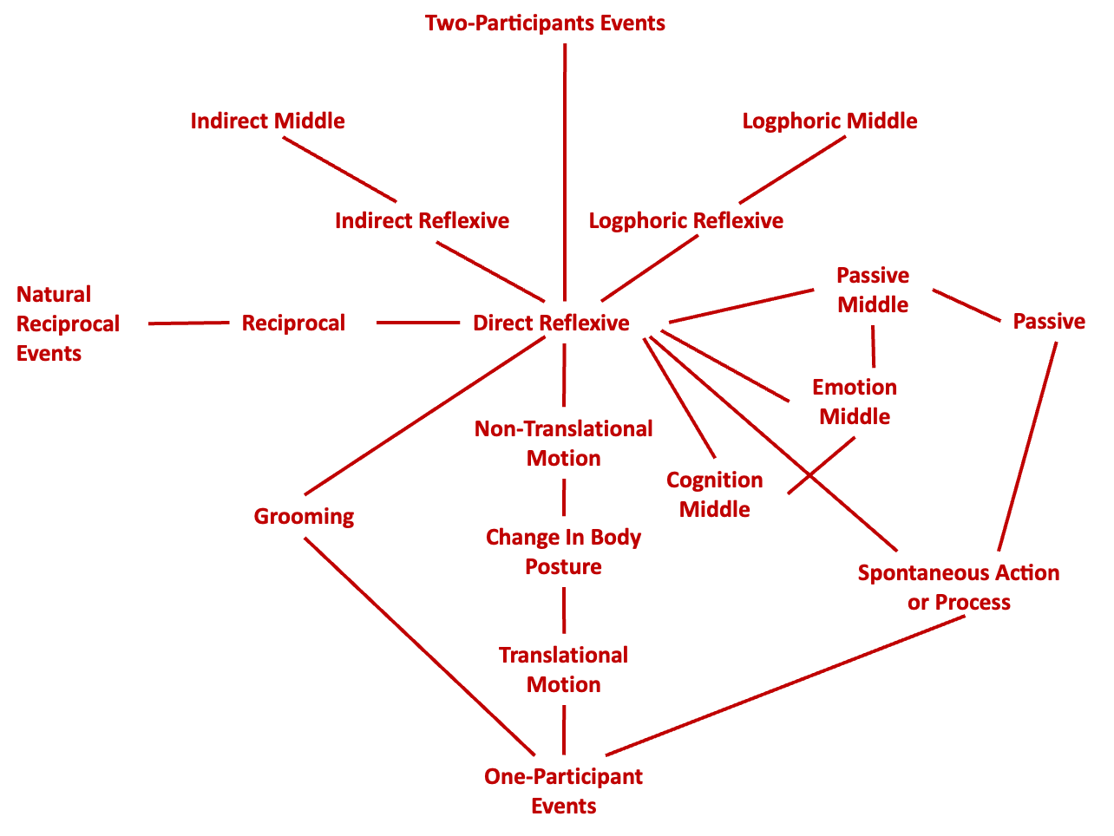
The semantic map of the middle
«A semantic map is a way to visually represent the interrelationships between meanings expressed in languages» (Georgakopoulos & Polis 2018: 1)

Slide 72
What is the meaning of the middle?
Reflexive
Grooming
Reciprocal
Passive
Body posture
Cognition
Anticausative
Perception
oppositional
non-oppositional
Compositional semantics: verb + MM —> grammar!
Non-compositional semantics: verb + MM not decomposable into meaning components —> lexicon!

Slide 73
5. The typology of the middle voice: a reassessment

Slide 74
Kemmer 1993: open issues
Definition: how are middle marker identified?
Unbalanced sample: 31 languages/12 families; entire families lacking, e.g. Afroasiatic (cf. Palmer 1995; Mous 2001 etc.), others overrepresented (Indo-European)
Explanation: does low degree of elaboration of events offer a satisfactory explanation as to the cross-linguistic distribution of middle voice systems?

Slide 75
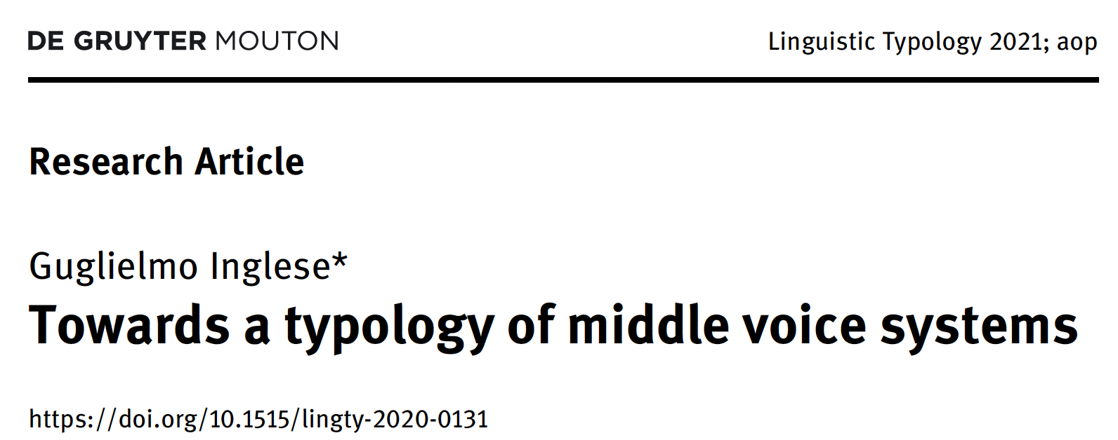
A) A new definition of the middle voice

Slide 76
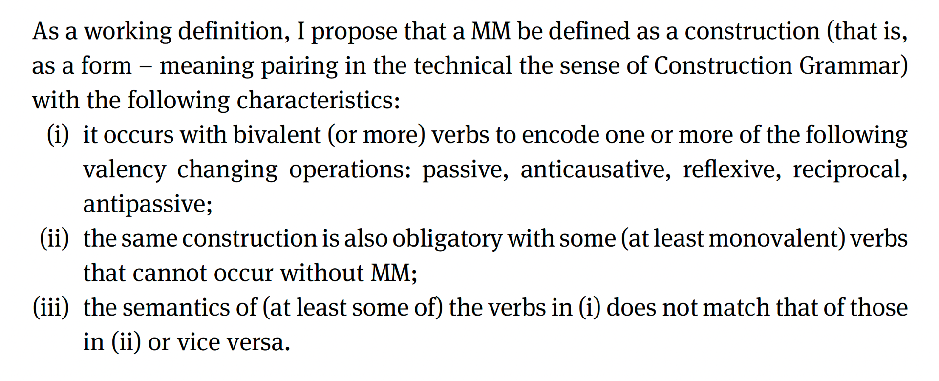
A new definition of middle marker (MM)
—> oppositional middles
—> non-oppositional middles
Inglese 2021: 6

Slide 77
Classes of middle verbs
Oppositional middles: adding the MM signals valency change (or other semantic nuances)
Non-oppositional middles: MMs are obligatory with these verbs
Optional middles: MMs may optionally be added to these verbs with no difference in meaning, e.g. Hitt. ḫaliye/a- ‘kneel down (act or mid)’ —> with these verbs voice alternation is not semantically motivated!
Unpredictable middles: the same verb attests to non-middle and middle forms, but these differ in meaning to the point that cannot be synchronically related to one another, e.g. Hitt. ḫink- ‘offer.act’ vs. ‘bow.mid’ (typically the result of lexicaliztation, see Kulikov 2010)
Data on 3. and 4. not systematically stored in grammars, excluded from this study

Slide 78
Advantages of this definition
It keeps in line with (less explicit) existing definitions of the middle (e.g. Klaiman 1991);
It conceives the middle voice, and middle markers, as comparative concepts (Haspelmath 2010);
It is grounded on a functional criterion (valency change) and a distributional one (non-oppositional middles) —> hybrid comparative concept (Croft 2016);
It is explicit and allows one to decide whether an individual languages features middle marking or not and thus to compare similar phenomena across languages;
It allows us to distinguish middle markers from intransitivizers (oppositional only) and some purely lexically distributed middle-like marking (non-oppositional only; e.g. person indexing in semantic alignment systems)

Slide 79
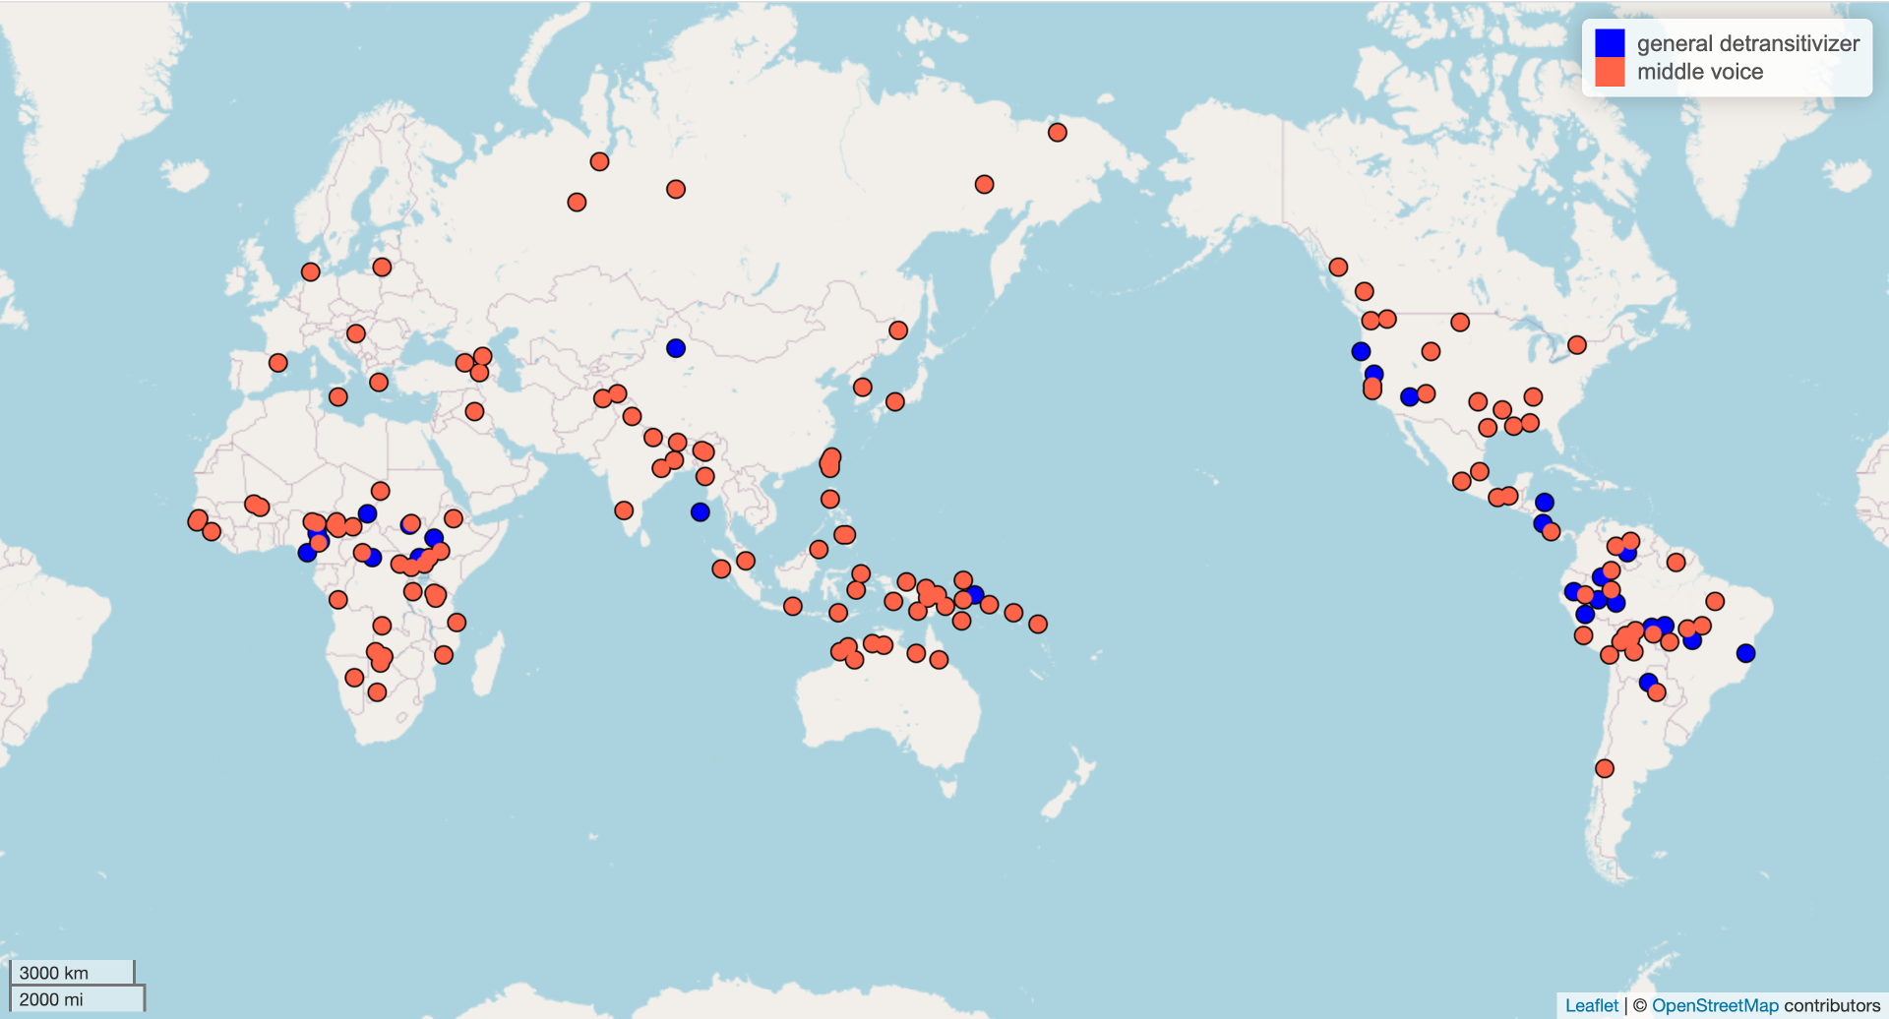

Slide 80
Comparing MMs

Slide 81
Kemmer 1993: open issues
Definition: how are middle marker identified?
Unbalanced sample: 31 languages/12 families; entire families lacking, e.g. Afroasiatic (cf. Palmer 1995; Mous 2001 etc.), others overrepresented (Indo-European)
Explanation: does low degree of elaboration of events offer a satisfactory explanation as to the cross-linguistic distribution of middle voice systems?

Slide 82
B) Language sample
Variety sample (cfr. Mattiola 2020): MMs are attested in 105/400 languages (+24 languages in a convenience sample): total of 129 languages for 149 MMs.
Diversity: 56 families + 12 isolates
MMs are often pervasives within families/groups: e.g. Indo-European, Afroasiatic, Oceanic, Bantu, Sino-Tibetan, Turkic, Athabaskan, Salishan…

Slide 83
Double-middle-marking languages
There are languages in which more than one construction satisfy the criteria for MM:

Slide 84
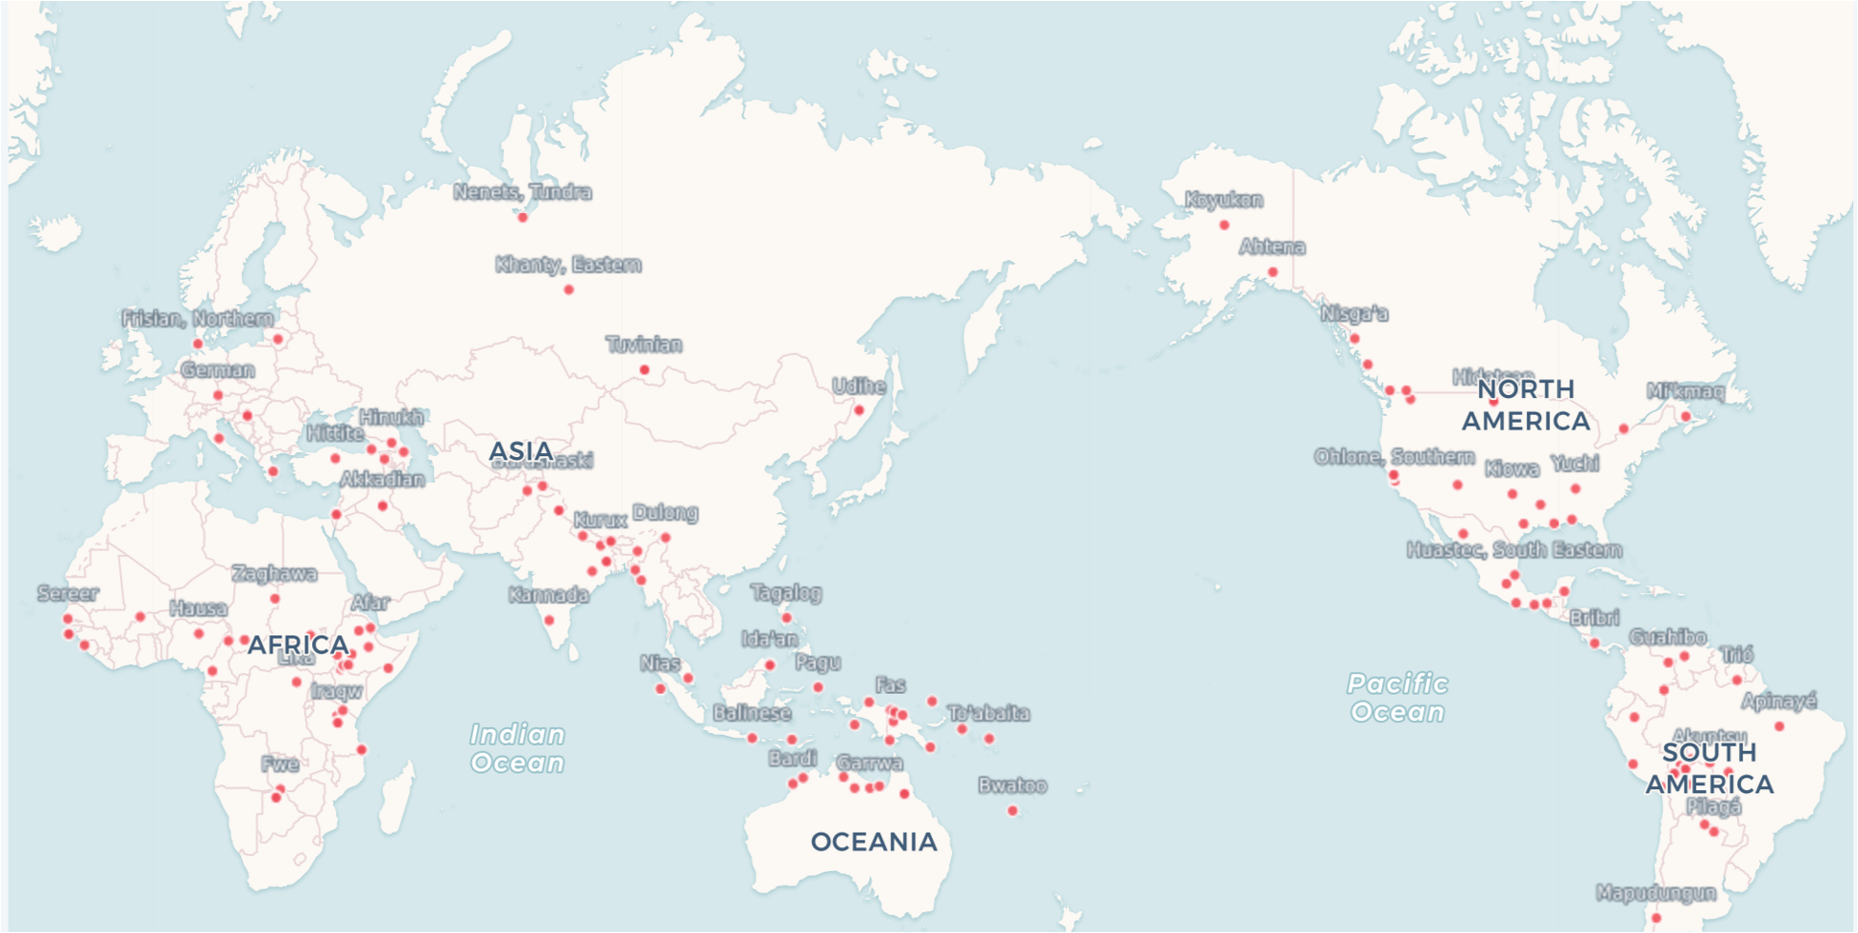

Slide 85
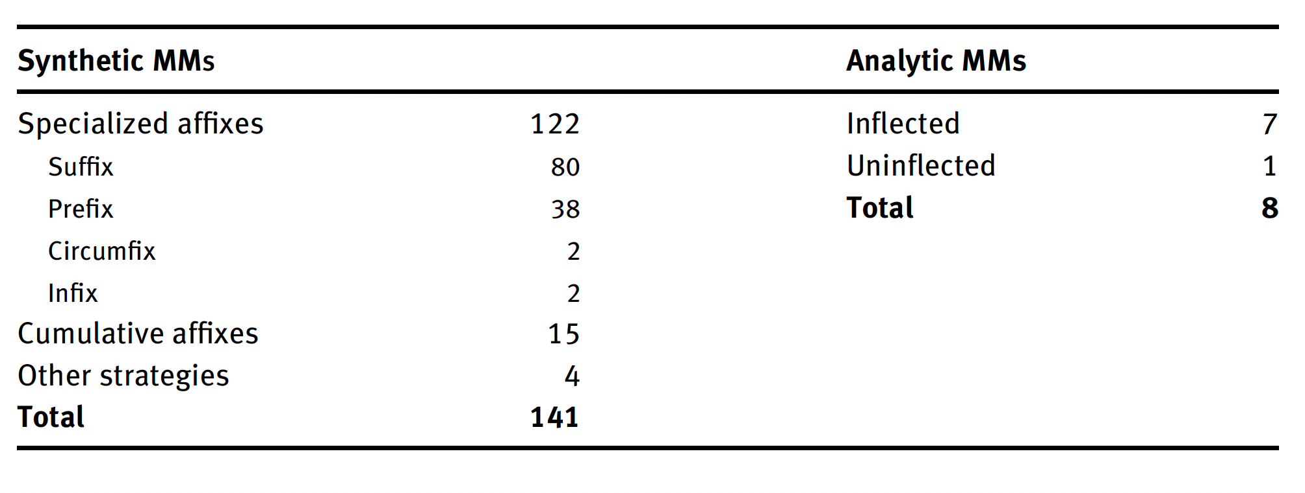
Data from the sample: forms

Slide 86
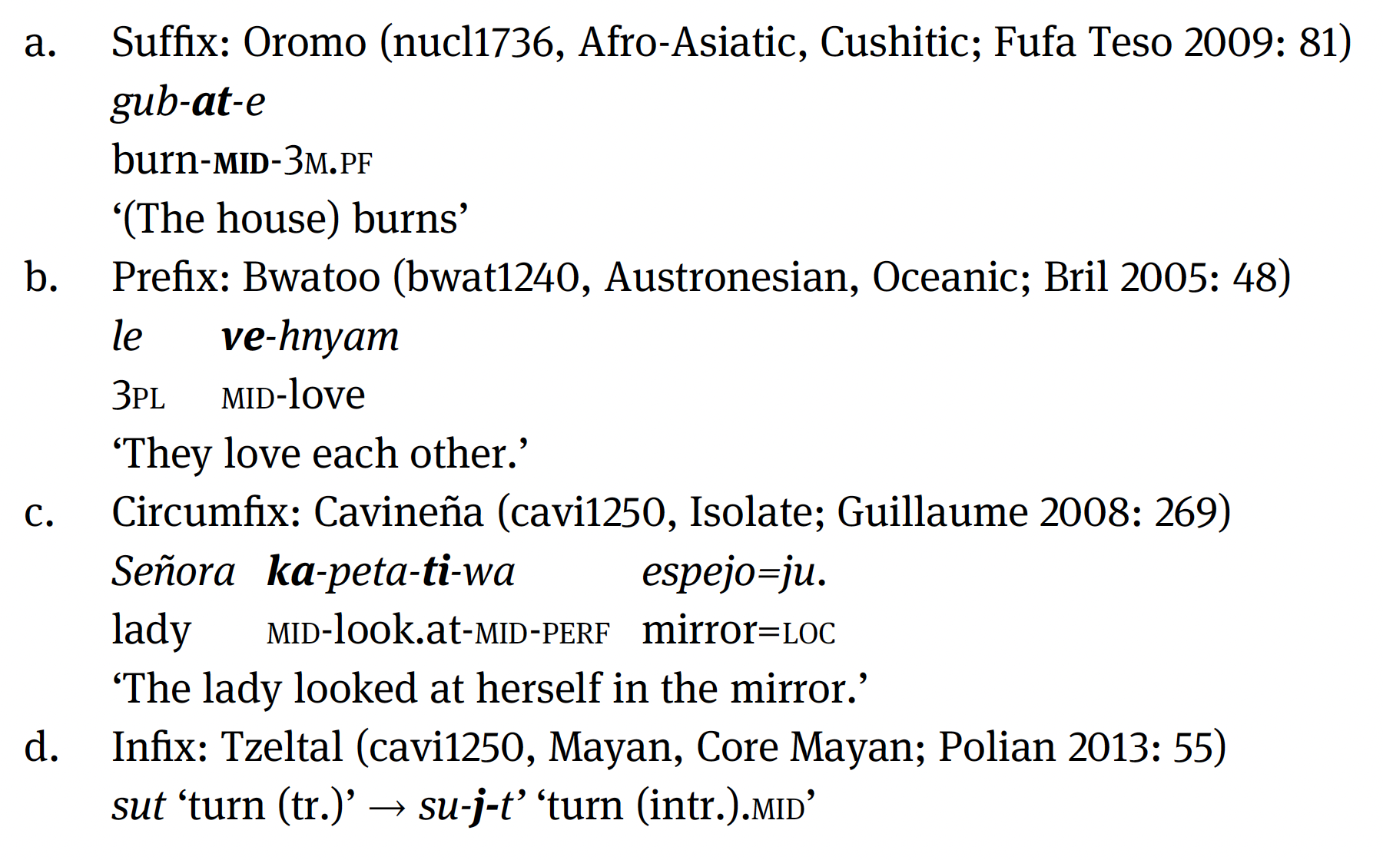
Dedicated middle morphology
Mostly derivational affixes (as is often the case of voice markers; Bybee 1985: 29-32)

Slide 87
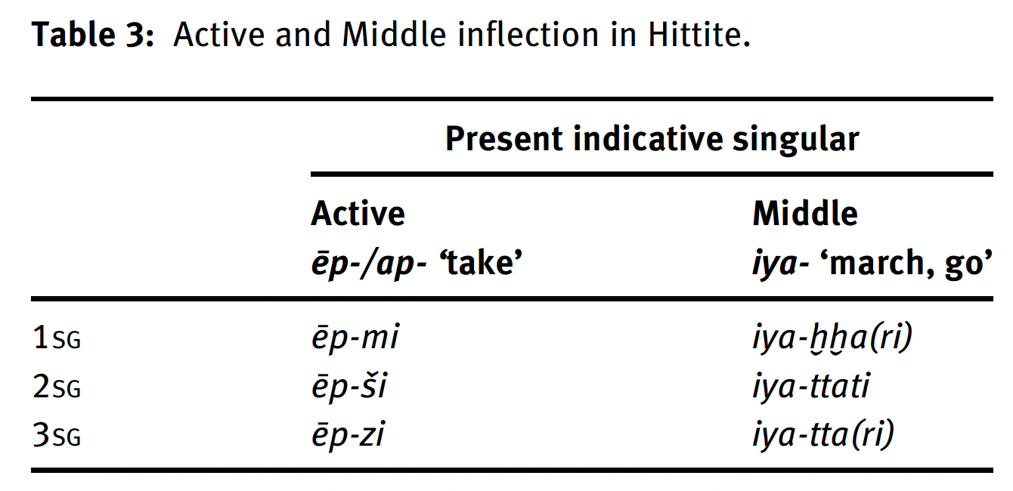
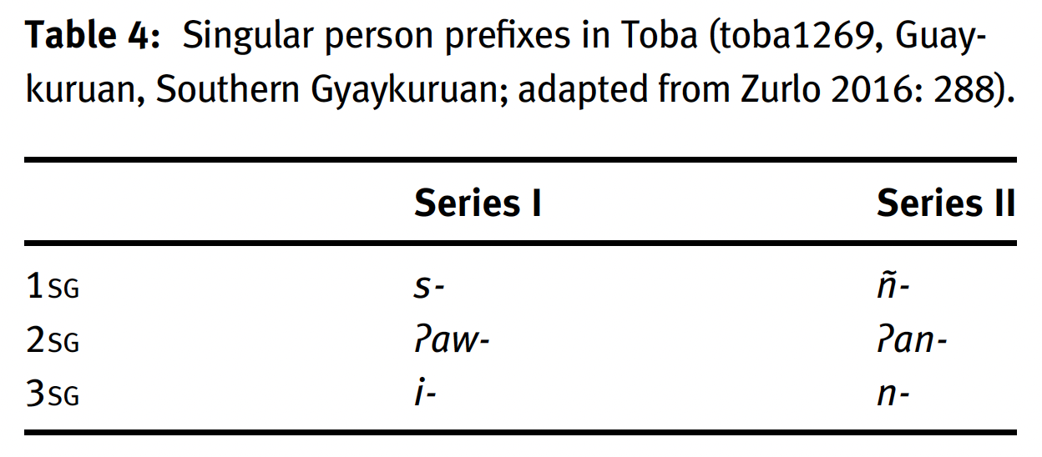
Cumulative strategies
The Indo-European inflectional middle voice is a typological rarity! (see Auderset 2015)

Slide 88
Oppositional functions
In the sample MMs perform a wider range of oppositional functions than reported in the literature:
Valency-related: the addition of MMs to non-middle verbs signal valency change, including reflexive, reciprocal, passive, antipassive, anticausative, plus impersonal, facilitative, and self-benefactive;
Non-valency-related: the addition of MMs to non-middle verbs adds a distinct semantic meaning component not amenable to the domain of valency: aspect-related, semantic-transitivity-related (plus others).

Slide 89
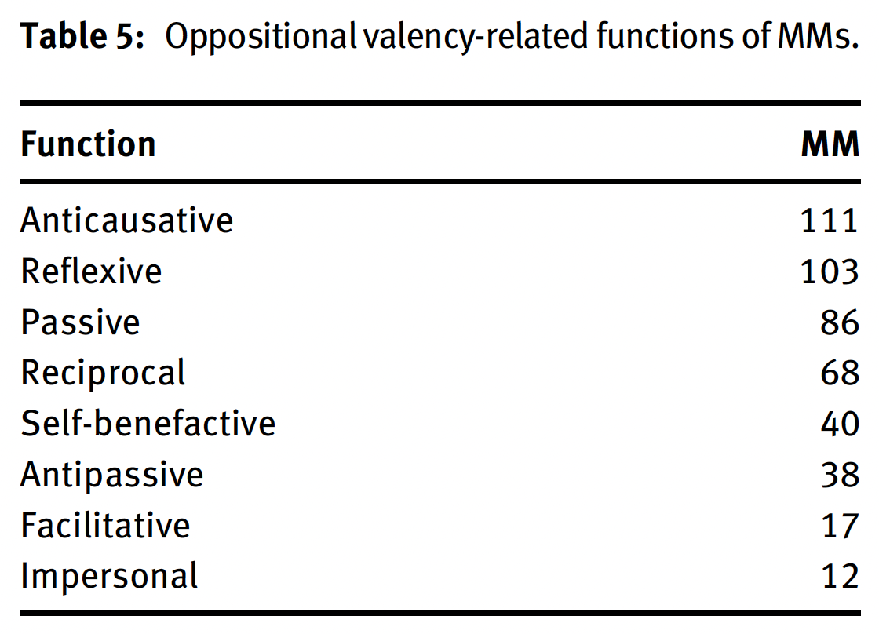
Data from the sample: valency-related functions
Reflexives rank high, but so do anticausative and passives (marginal in Kemmer’s account)

Slide 90
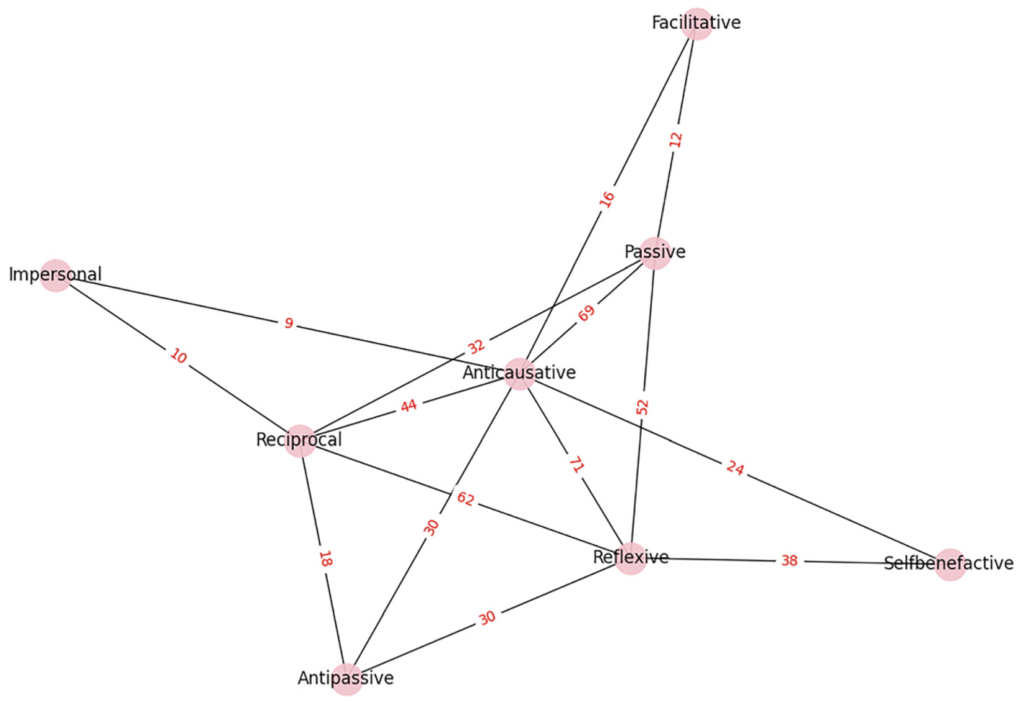
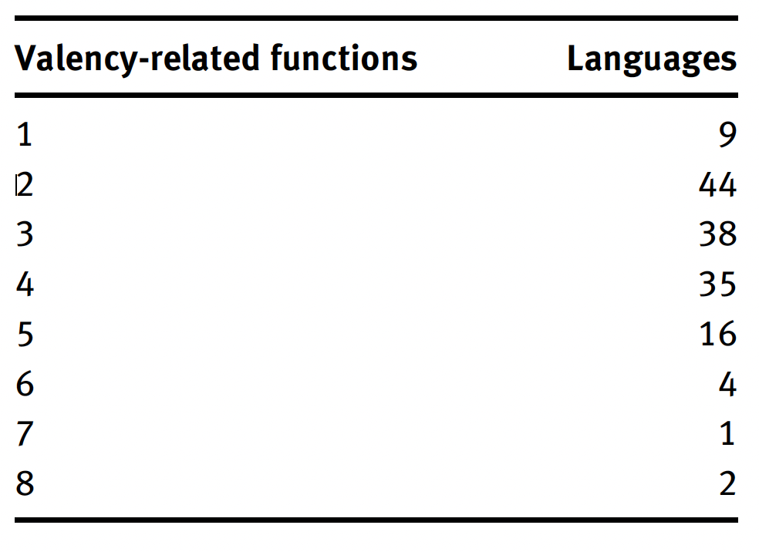
How many oppositional functions?

Slide 91
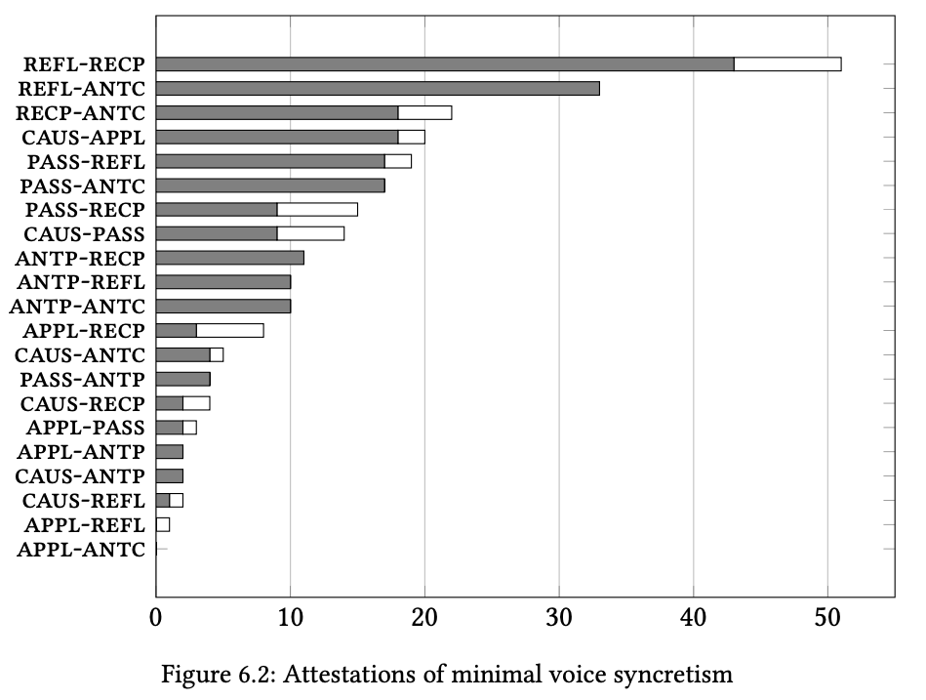
Voice syncretism (Bahrt 2021)
Anticausatives are in general less frequent than reflexives, reciprocals and passives! (Nichols et al. 2004)

Slide 92
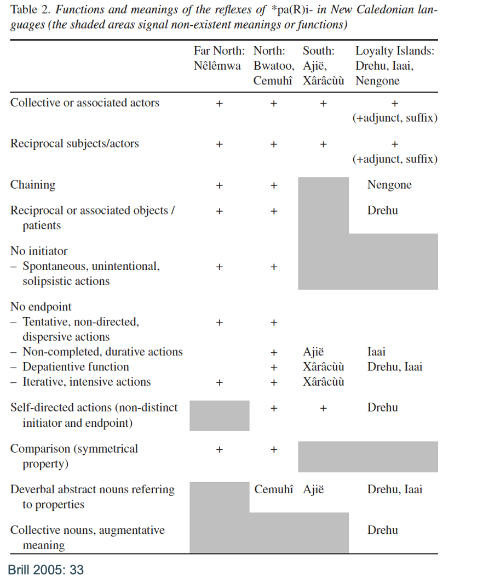
Middles without reflexives?
“In a number of Oceanic languages, the reciprocal and depatientive [antipassive] functions are united in polysemies that do not involve reflexives.” (Lichtenberk 2000: 58)
• Passive/anticausative ‘middles’: Hamer (Omotic) -ɗ-, Ho (Munda) -en, Palula (IE, Indo-Aryan) -íǰ-, Vlax Romani (IE, Indo-Aryan) -uv-, Salinan k-, Sandawe -ts’ì̥.
• Passive/anticausative/antipassive: Fas ni-, Wendat (Iroquoian) -at-.

Slide 93
Non-valency-related functions: aspect
Imperfectivity/atelicity
Perfectivity/telicity:

Slide 94
Non-valency-related functions: semantic transitivity
Unexpected/accidental events
Partially completed events
Intensive

Slide 95
Non-valency-related functions: summary?
Asymmetric distribution: all MMs in the sample have valency-related functions, only 54 attest to non-valency-related ones!
Not properly documented in grammars?
No clear trend emerges: in some languages connected to higher semantic transitivity (telicity, intensive meaning) in others to lower semantic transitivity (atelicity, low control)
In individual languages, MMs may perform more non-valency-related functions than valency related ones (e.g. Athabaskan)!

Slide 96
Typologizing non-oppositional middles: challenges
“their occurrence is strongly lexically determined [and] cross-linguistic comparison is not easy” (Haspelmath 2003: 224)
Empirical challenges: not properly documented in grammars (because they’re mostly a lexical phenomenon) —> they should be investigated with the methods for lexical typology (Koptjeskaja-Tamm, Rakhilina & Vanhove 2015)
Not clear how the situation types/semantic classes should be individuated. Kemmer (1993) argues for a distributional approach: two situation types count as distinct if there is at least one language that express them differently. However, in practice the grouping is often done impressionistically based on semantic similarity!

Slide 97
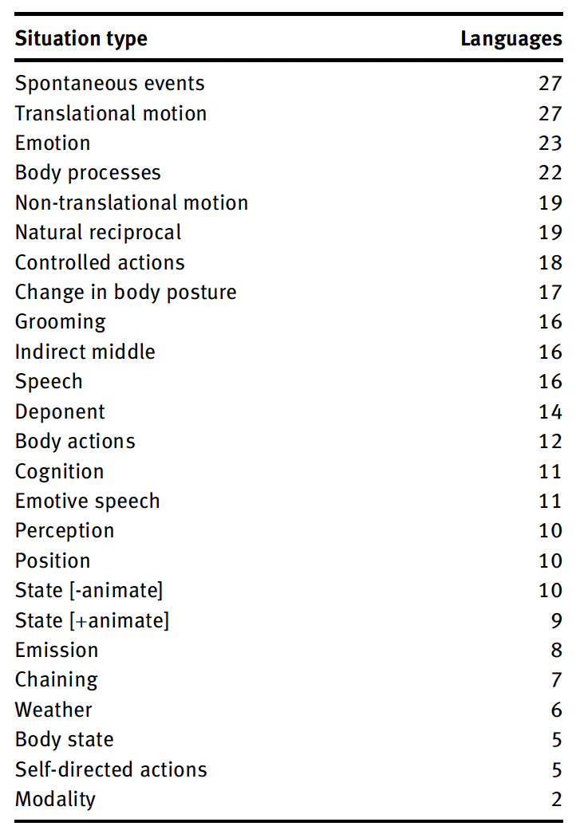
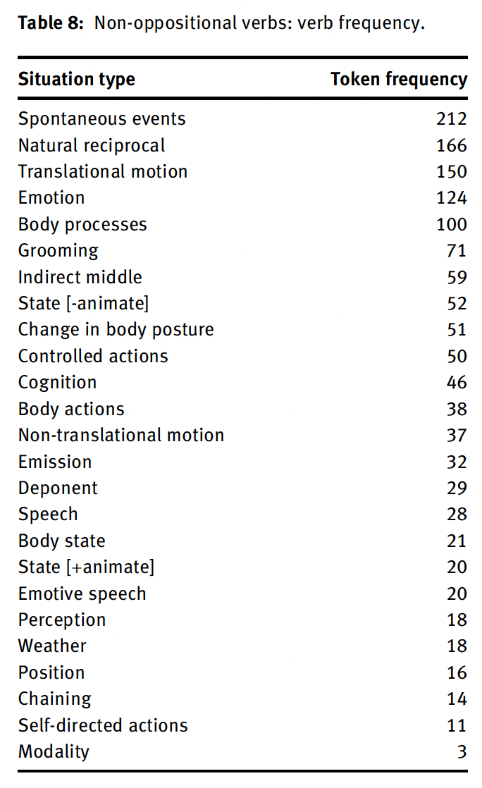
Sample data
Convenience sample: 29 languages in which non-oppositional middles have been described in some detail.
Some types not discussed by Kemmer 1993 emerge (e.g. wheater, emission, body processes)!

Slide 98
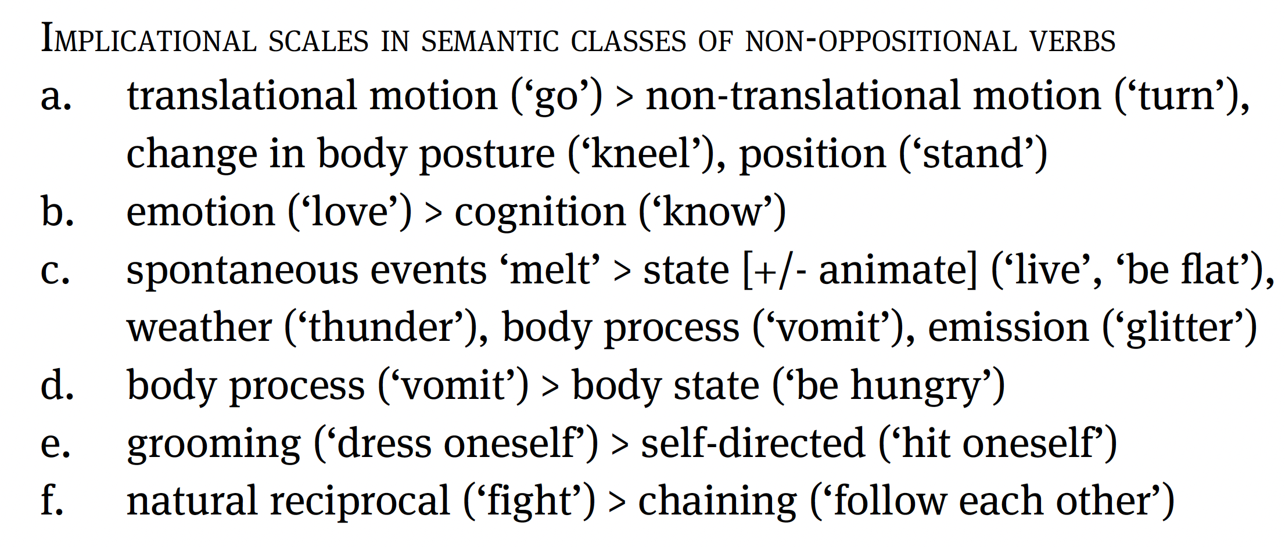
Granularity of situation types?

Slide 99
Oppositional vs. non-oppositional middles
There is substantial cross-linguistic variation in the ration of opp/nop middles (possibly also biased by documentation)
The existence of languages like Hittite counters Klaiman’s (1991: 105) claim that in middle marking languages oppositional middles outnumber non-oppositional ones!

Slide 100
Non-oppositional middles and productivity
“[Latin non-oppositional middles) constitute a category of morphological and semantic relics which can only be understood in a purely historical context” (Baldi 1999: 395)
→ Are non-oppositional middles idiosyncratic lexicalizations of oppositional ones? (thus e.g. Haspelmath and Müller-Bardey 2004: 1139)

Slide 101
Middle markers vs. reflexives
Three-way typology (Kemmer 1993: 24-26):
One-form languages: middle marker identical to the reflexive marker
Two-form languages: distinct reflexive and middle forms; two subtypes: cognate and non-cognate
 | Language | Middle | Reflexive
One-form | Italian | si | si
Two-form cognate | Russian | -sja | sebja
Two-form non-cognate | Turkish | -In- | kendi-

Slide 102
Expanding the typology
MMs and alternative valency-changing constructions display a more complex relationship, encompassing all possible valency-related functions.
Combination: MMs and other valency-changing markers simultaneously co-occur with the same verb
Complementarity: MMs and valency-changing markers occupy different portions of the voice domain
Competition: MMs and valency-changing markers overlap at least in one function (but do not co-occur)

Slide 103
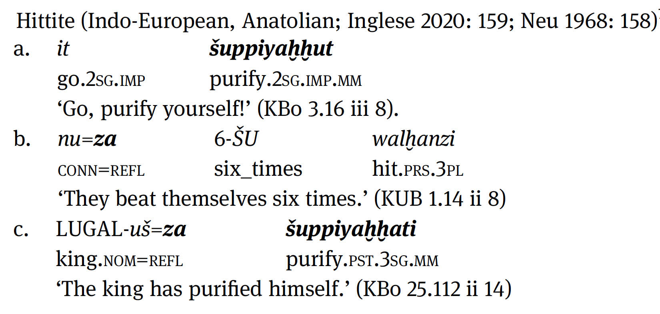
1. Combination

Slide 104
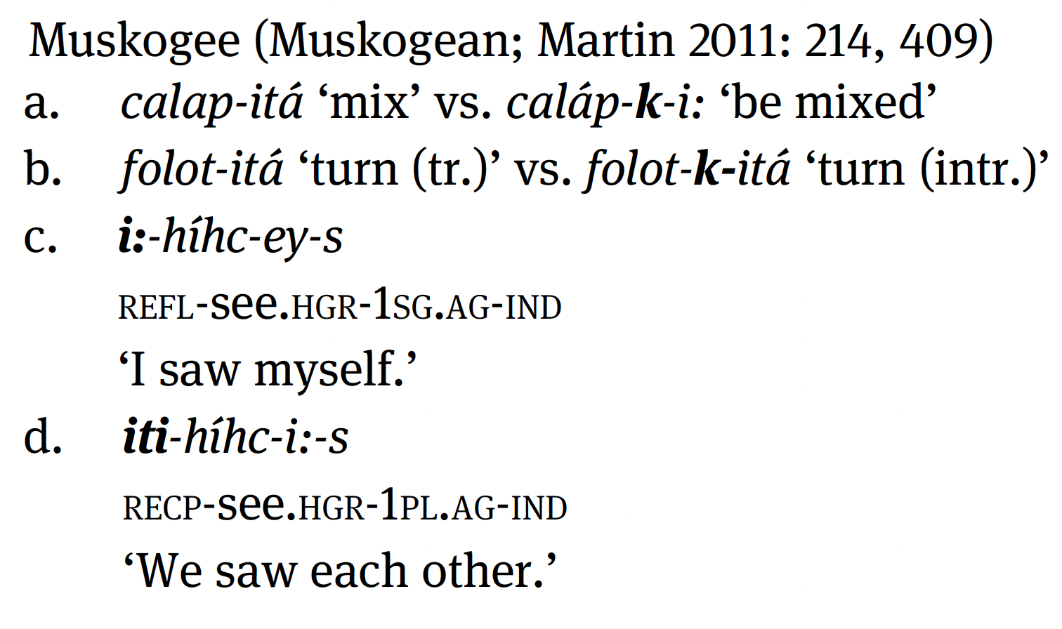
2. Complementary distribution

Slide 105
Complementarity: data from the sample
→ If a language has a MM, this will be more likely to express anticausative, antipassive, and passive function than reflexive and reciprocal functions!

Slide 106
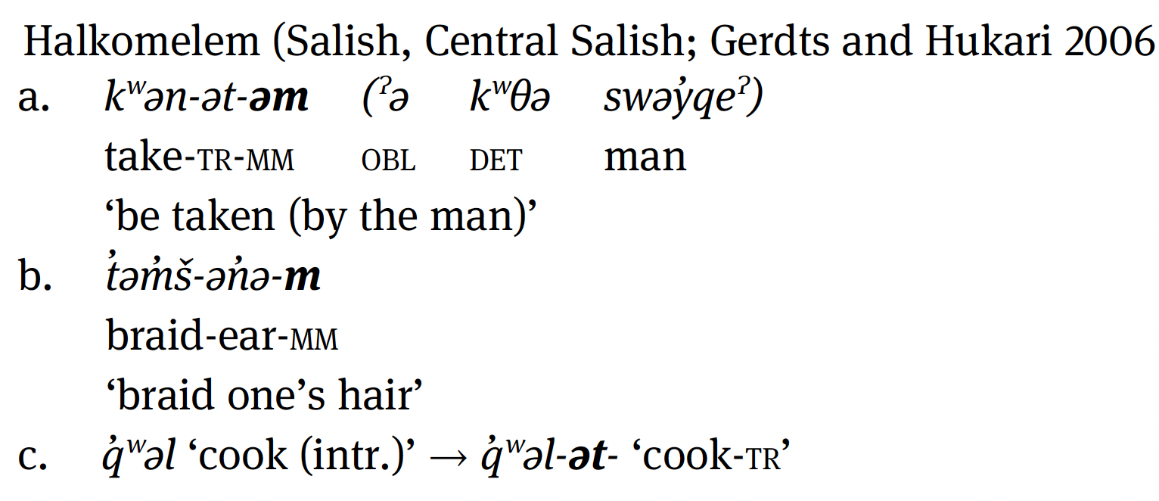
Complementarity and typological gaps

Slide 107
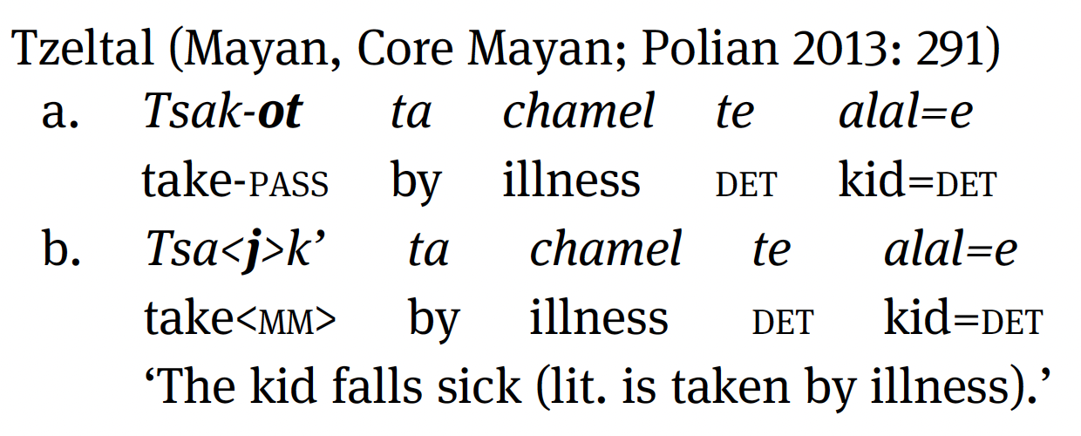
3.A. Competition: free variation

Slide 108
3.B. Competition: partial differentiation

Slide 109
Competition: data from the sample
Competition concerns all oppositional valency-related functions of MMs: even though this is most often the case of reflexives (and, surprisingly, passives)!
Only for reflexive/reciprocals explanations along the lines proposed by Kemmer (1993) can be detected: for the other function there is no generalised pattern.

Slide 110
Kemmer 1993: open issues
Definition
Unbalanced sample
Explanation: does low degree of elaboration of events offer a satisfactory explanation as to the cross-linguistic distribution of middle voice systems?

Slide 111
Explaining MVSs: low elaboration of events

Slide 112
The semantic map approach?
Kemmer’s map still in use in descriptive studies (e.g. (Peterson 2011: 186 on Kharia; Dom et al. 2016 on Bantu languages)
Problem: nodes are placed in semantic maps if they constitute analytical primitives (Cysouw 2007, 2010), that is, “if [a node] cannot be subdivided into two (or more) meanings that are expressed by separate linguistic items in a given language” (Georgakopoulos & Polis 2018: 4)
Unfortunately, nodes in Kemmer’s map are mostly arranged based on semantic connections!
While oppositional functions can be safely individuated, it is not clear how to integrate non-oppositional verbs.

Slide 113
6. The diachronic typology of the middle voice

Slide 114
An alternative approach: diachrony
“The manifold ramifications of the middle voice are the outcome of a heterogeneous set of mechanisms” (Holvoet 2020: 225)
“More generally, data from middle-like constructions in Trans-Himalayan languages seem to reflect a history in which sets of related forms have undergone similar yet ultimately distinct diachronic developments. This has resulted in a distribution which is both similar, and similar to middle-like marking in other languages, and yet – since it seems not to reflect the same type of underlying cognitive category – ultimately different.” (Post & Modi 2021: 20)

Slide 115
An alternative approach: diachrony
“Low elaboration of events seems to be the best approximation if one wants a common meaning for all middle situations, but couldn’t it be that there is no real common meaning that all situation types share? The existing obvious similarities could be attributed to the fact that that arose by grammaticalization from the same marker”
(Haspelmath 1995: 373)

Slide 116
Explanations in typology
Synchronic typology (result oriented): (universal) trends in the distribution of constructions are explained by resorting to synchronic functional motivations, such as, frequency, iconicity, economy, efficiency (processing), harmony, system pressure (cf. Sansò 2018).
Diachronic typology (source oriented): regularities in the cross-linguistic distribution of constructions (also) depend on mutational constraints, i.e. “constraints on possible diachronic transitions or possible diachronic sources, which can have an effect on synchronic distribution.” (Haspelmath 2019; see Bybee 2006; Cristofaro 2010, 2013, 2019, 2021; Anderson 2016; Sansò 2018, 2020; Collins 2019)

Slide 117
Explanations in typology: vowels
If a language has nasal vowels it also has oral vowels (cf. Greenberg 1966)
Synchronic explanation: degree of phonetic complexity oral > nasal
Diachronic explanation: origin of nasal vowels
VN > ṼN > Ṽ(N) > Ṽ

Slide 118
Explanations in typology: the middle voice
Synchronic explanation: middle voice systems display a recurrent distribution in the languages of the world because the situation types that they express all share a common overarching functional motivation.
Diachronic explanation: the distribution of the same middle marker across different situation types is the outcome of local developments that take place between individual pairs of source-target functions, but does not reveal much about the overall structure of the domain!
Lack of control (of the subject) (Klaiman 1991, Kaufmann 2007)
Low degree of elaboration of events (Kemmer 1993)
Unaccusativity (Lazzeroni 1990, Benedetti 2002, esp. on IE)

Slide 119
The diachronic typology of the middle
Typological studies have focused on the synchronic analysis of MMs, no comprehensive diachronic typology of this domain is available.
“Many verbal middle markers […] are so grammaticalized in all their occurrences across a particular family that no diachronically prior function can be stated with confidence” (Kemmer 1993: 197)

Slide 120
The diachronic typology of the middle
Source-target relations: what are the sources of MMs? Is there a regular association between some sources and some functions of MMs? Is there a unidirectional trend whereby certain sources give rise to certain functions of MMs but not vice versa?
Mechanisms: what are the dynamics and language change mechanisms involved in the rise of MVSs?

Slide 121
Diachronic predictions
reflexive > middle: reflexive markers are the main source of MMs;
oppositional > non-oppositional: middle voice systems arise because oppositional (reflexive) markers expand to non-oppositional verbs.

Slide 122
A. The reflexive origin of MMs
“the diachronic path connecting the reflexive and middle uses is probably unidirectional.”
(Kemmer 1993, Haspelmath 1990, 2003, Heine 2002, Heine & Miyashita 2008,
Sansò 2017, Kuteva et al. 2019, Holvoet 2020; see Zúñiga & Kittilä 2019: Chap. 8)

Slide 123
B. The oppositional origin of MMs
“Historical data provide evidence that the media tantum [non-oppositional] develop after both the direct reflexive and the anticausative reading in languages that encode the middle function by reflexive verbs (…). I therefore, assume that the existence of media tantum in middle marking languages is a consequence of a reinterpretation of the device which derives the differential readings (…). Once the device that derives middle stems is established in the verbal system the function of middle morphology is generalized to marking semantic verb classes with properties similar to that of the differential readings.” (Kaufmann 2007: 1688)

Slide 124
A. Non-reflexive sources of MMs?
“In most cases where comparative or historical evidence for an earlier function of the MM [middle marker] exists, that function is reflexive.” (Kemmer 1993: 197)
“The question of why the sources listed above seem to be less frequently met with than the reflexive source is an important one. It remains to be determined whether these other types of sources are simply less easily reconstructable because they re verbal […] or whether, on the other, hand there is simply a closer cognitive connection between the categories of reflexive and middle than between the middle and other categories.” (Kemmer 1993: 197)
Passive/Impersonal: Latin -r
Intensive: Hungarian kod-, Bahasa Indonesian ber-
‘buy’: Kannada –koLLu
Reciprocal: Bantu languages -na

Slide 125
Diachronic typology: methodology
“One obstacle in any diachronic-typological survey is that the identification of the sources of specific markers is bound to remain largely guess-work when we deal with languages with no documented history. This obstacle, however, is more apparent than real. First, as the survey in this paper will show, there are languages in which the source of the [marker] can be reliably reconstructed based on language-internal or comparative evidence. Second, in other languages there is synchronic resemblance between the source and the target (e.g. the same or similar formatives are used for both). Although synchronic resemblance does not necessarily entail diachronic relatedness, and alternative explanations cannot be excluded (e.g. chance or derivation of both from a common source), the more frequently a given resemblance pattern is attested across languages, the more likely is it that the source and the target are diachronically related, as long as a semantically plausible evolutionary scenario from the source to the target can be imagined.” (Sansò 2020: 408)

Slide 126
Valency changing markers
Passive/anticausative:
Palula -íj- (< Old Indo-Aryan -ya-, Liljegren 2016: 240-241)
Proto-Bantu *-ɩk- (Chavula 2018)
Passive:
Armenian -v- < Middle Armenian -vi- (Karst 1901)
Tzeltal -j- < Proto-Mayan *-h (Polian 2013)
Yeyi -aak < Proto-Bantu *-Ik- (Schadeberg 2003)
Antipassive: Huastec -n- < Proto-Mayan *-n- (Kondic 2011)
Impersonal (?): Athabaskan d- < Na-Dene *-n- (Thompson 1996)

Slide 127
Motion verbs and spatial markers
Motion verbs:
Chitimacha preverrà ʔapš < ʔap ‘come’ (Hieber 2018)
Moseten -ki-/-ti- < deictic verbs ‘bring here/there’ (Sakel 2007)
Other spatial markers:
Bantu ‘separative’ -uk- in Fwe (Gunnik 2018) < Proto-Bantu *-ʊk- ‘(out) from’ (Schadeberg 2003: 100)
Burushaski dd- < adverb ‘from there’ (Bashir 2006)

Slide 128
Other lexical verbs
‘say’:
Yurakaré -tA < ta- ‘say’ (Van Gijn 2010)
‘eat’:
Yakkha -ca (Schackow 2015)
Menya -n (Whitehead 2004)
‘become’:
Romaní Lovari -uv- (Bubenik 2013)
Bidyogo -ok- (Segerer 2002)

Slide 129
Other verbal sources
N-stems in Semitic languages, e.g. Akkadian bašûm ‘be present’ —> na-bšûm ‘emerge’, from a light verb construction with *n- ‘say, do, become’ (Kouwenberg 2010: 294-300
Creek -k- (Hardy 1994, Martin 2000) < pre-Proto-Muskogean auxiliary verb *-ka- (Haas 1977)
In most cases, even if we can identify a likely (lexical) source for a given MM, little or no information is available concerning the specific context starting from which that source construction develops into a MM!
!

Slide 130
Spontaneous event markers
Hittite (and Indo-European) middle inflection, Luraghi 2012, Inglese 2020)
Suffix -t in Cushitic languages (Hayward 1984)
Suffix *-dharri- in Australian languages (Dixon 2002)

Slide 131
Markers of plurality/reciprocity/sociativity
Proto-Oceanic *paRi- (Lichtenberk 2000, Bril 2005)
Proto-Turkic *-Iš- (Gandon 2018)
Proto-Bantu *-an- ( < comitative na, Maslova 2007)

Slide 132
Aspectual markers
Otomi n- (< *n, formant of the inflection of imperfective verbs, Palancar 2006)
Hausa -u- < Proto-Chadic resultative *-k^{w}o (Jaggar 1988)

Slide 133
Verbalizers/nominalizers
Kryz -aR- (Authier 2012)
Suffix *-si- in Tibeto-Burman languages (Matisoff 2003)
Prefix *ŋə- in Kuki-Chin languages (Jacques 2021)
Proto-Malayo-Sumbawan prefix *(mb)AR- (Sansò & Gajewski forthc.)
Bribri -r (Pacchiarotti & Kulikov forthc.)

Slide 134
Multiple sources
Cariban languages feature intransitivizing prefixes with VC- or V- shape (Meira 2000):
< *-ôte- reciprocal
< *-e reflexive
“the two have now become suppletive allomorphs of the same prefix, which now includes both [i.e. reflexive and reciprocal] semantic values” (Meira, Gildea & Hoff 2010: 511)

Slide 135
MMs and language contact
Matter replication: the MM -nggV- in Wambaya (mirndi) è is borrowed from neighbouring Garrwa, where the suffix -ngka is involved in reflexive/reciprocal pronouns (Green 1995)
Pattern replication: Mapudungu had a reflexive marker-(u)w-, which developed into a MM due to contact with Spanish se (Fernández Garay 2005):
casarse ‘marry’ > kasa-w- vs. Native kure- ‘marry’
See Grossman (2021) on transitivity phenomena in contact!
Matras & Sakel 2007

Slide 136
Back to the sample: source of MMs
“In most cases where comparative or historical evidence for an earlier function of the MM [middle marker] exists, that function is reflexive.” (Kemmer 1993: 197)
Non-reflexive sources:
Other valency reducing functions
Lexical verbs
Others
spontaneous events
plurality of relations
nominalizers/verbalizers
aspectual constructions

Slide 137
Why is reflexive > MM more frequent?
“The question of why the sources listed above seem to be less frequently met with than the reflexive source is an important one. It remains to be determined whether these other types of sources are simply less easily reconstructable because they’re verbal […] or whether, on the other, hand there is simply a closer cognitive connection between the categories of reflexive and middle than between the middle and other categories.” (Kemmer 1993: 197)

Slide 138
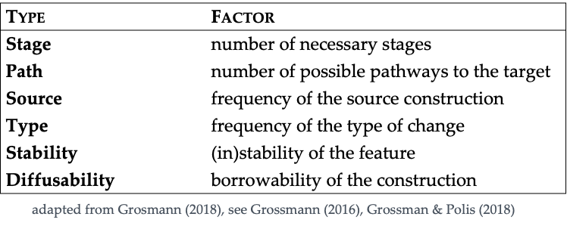
Why is reflexive > MM more frequent?

Slide 139
Why is reflexive > MM more frequent?
The special connection between middles and reflexives may just be a by-product of accidental factors:
higher frequency of reflexive markers as opposed to other sources, e.g. ideophones + ‘say’ construction (Yuracaré), converbs (Mosetén), verbal classes associated with spontaneous events (Hittite)
development reflexive > middle easier than others, e.g. passive > middle (Armenian), ‘eat’ > middle (Yakkha)

Slide 140
B. The reflexive origin of MMs
reflexive
oppositional
non-oppositional
e.g. the development in Romance, Germanic, and Slavic, Nilo-Saharan midddle (e.g. Kemmer 1993, Puddu 2005), Halkomelem (Gerdts & Hukari 2006), Na-Dene languages (Thompson 1996), Dogon (Culy & Fagan 2001), Tibeto-Burman (LaPolla 1996), Pama-Nyungan (Tsunoda 2006), Arawak (Brandão 2014) etc.;
This process has been mostly investigated with respect to reflexive markers, but in principle underlies also markers originating in other voice functions;

Slide 141
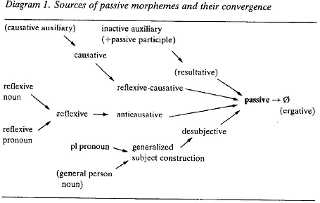
Reflexive > oppositional
Reflexive > passive as grammaticalization:
extension to new semantic/syntactic contexts
increasing morphological fusion
development of a “speaker-based subjective meaning” (Traugott 2010) ?
—> secondary grammaticalization (Breban 2014)
Haspelmath 1990, 2003

Slide 142
Reflexive > autocausative > decausative
“The semantic mechanism of the transition from reflexive [to anticausative] is clearly an instance of semantic bleaching. The main difference between reflexive and anticausative is that the latter are mostly non-agentive. Dropping the agency restriction on reflexives automatically leads to anticausatives.” (Haspelmath 1990: 44)
“The idea that motion verbs provide the lexical basis for the shift from reflexive to anticausative is supported by the fact that with these verbs the shift required only a minimal adjustment: the unique argument of predication, originally doubling as agent and theme, was divested of one of its two semantic roles.” (Holvoet 2020: 119)

Slide 143
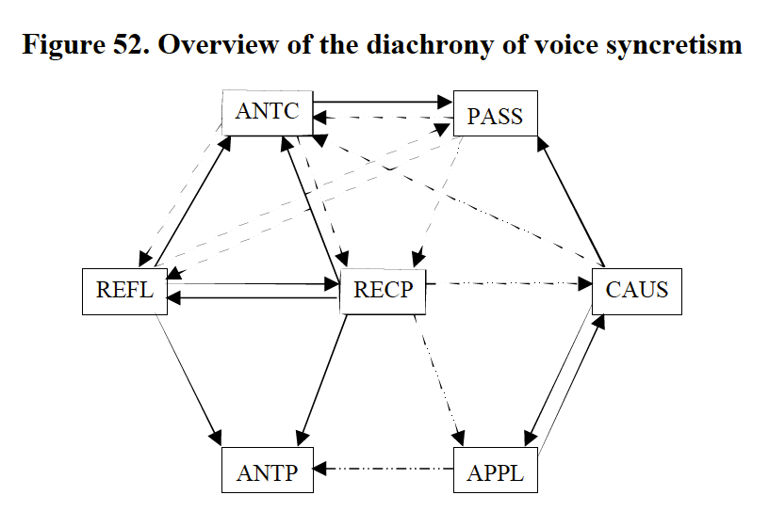
Directionality in the diachrony of voice
Bahrt 2020: 274

Slide 144
How do non-oppositional verbs come about?
‘‘Whenever a linguistic form falls outside the productive rules of grammar it becomes lexicalized’’ (Anttila 1989 [1972]:151)
“Furthermore, combinations of the verbal root and the valence-changing morpheme show a tendency toward lexicalization, i.e. loss of semantic segmentability. A good […] is provided by deponents.” (Haspelmath & Müller-Bardey 2004: 1139)
Latin quassare ‘shake, break’ > Lat. vulg. quassiare
Old Spanish quejar ‘afflict (tr.)’ vs. quejarse ‘be afflicted’
Old Spanish quejar ‘afflict (tr.)’ vs. quejarse ‘feel pain’ lexicalization
Spanish quejarse ‘complain’ loss

Slide 145
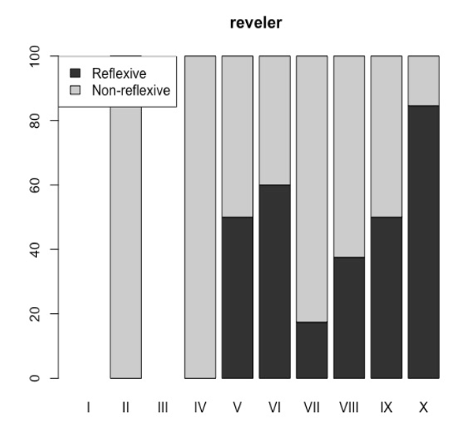
How do non-oppositional verbs come about?
“[…] middle morphology is generalized to marking semantic verb classes with properties similar to that of the differential readings.” (Kaufmann 2007: 1688)
Optional > obligatory marking
Lat. rideo ‘laugh’ > Sp. reír(se) > Coll. Sp. reírse
<— alegrar vs. alegrarse
L.Lat. rebellare ‘repent’ > OFr. (se) reveler > Fr. se rebeller
Denominal verbs
OFr. se deshoser ‘take off one’s hose’
< Germ. hösa <— OFr. se desarmer

Slide 146
B. Alternative developments?
oppositional
non-oppositional
source
non-oppositional
oppositional
opp
non-opp

Slide 147
From non-oppositional to oppositional?
“Some middle markers develop functions that enter the realm of syntax and thus come to serve a syntactic function where the valency of the verb is increased or decreased.” (Palancar 2004: 55)
Yurakaré MM -tA (Van Gijn 2006, 2010)
Oppositional middle
sisë ‘touch’ —> sisë-të ‘touch oneself’ intransitivizing
du-che ‘light fire’ —> du-ta ‘catch fire’ equipollent
Non-oppositional middle
dëjta ‘swallow’, dyojloto ‘be angry’

Slide 148
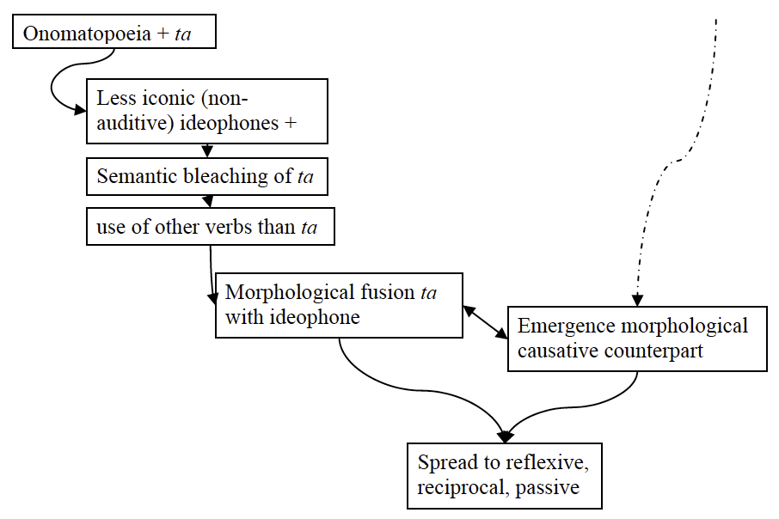
From non-oppositional to oppositional?
Source:
Stage 1:
Stage 2:
“In Yurakaré the middle category starts in the more peripheral semantic fields of Kemmer’s map, e.g. spontaneous events and body manipulations.”
(Van Gijn 2010: 288)
Stage 3:

Slide 149
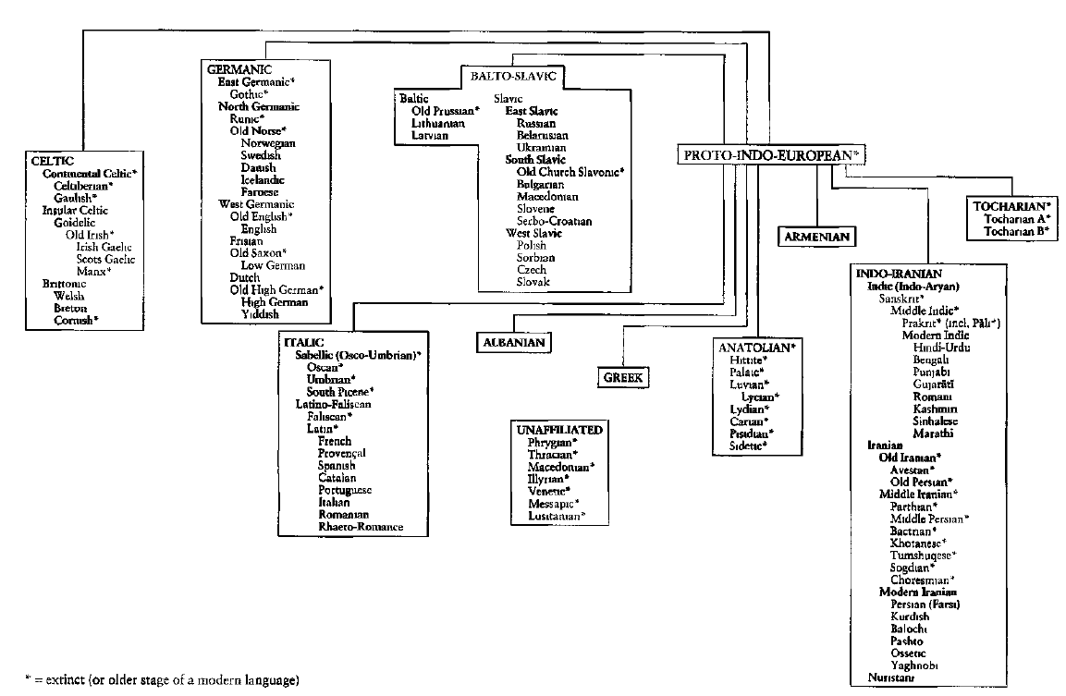
The middle(s) in Indo-European
Middle inflection
Reflexive middle
Non-reflexive middle

Slide 150
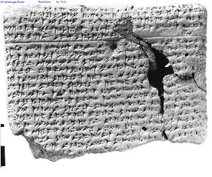
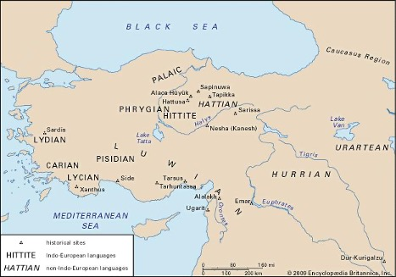
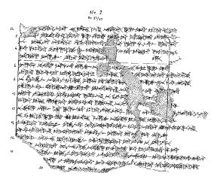
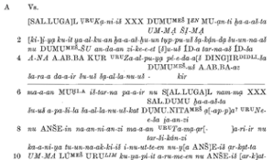
The origin of the Hittite middle voice

Slide 151
The Hittite middle voice
 | Present indicative
 | Active | Middle
 | ēp-/ap- ‘take’ | iya- ‘go’
1sg | ēp-mi | iya-ḫḫa(ri)
2sg | ēp-ši | iya-ttati
3sg | ēp-zi | iya-tta
1pl | epp-ueni | iya-wasta
2pl | ēp-teni | iya-dduma
3pl | app-anzi | iya-nta

Slide 152
The functions of the Hittite middle
Non-oppositional verbs:
ar-^{ta(ri)} ‘stand’, eš-^{a(ri)} ‘sit down’, ye/a-^{tta(ri)} ‘go’, ištu-^{ā(ri)} ‘appear’, ki-^{tta(ri)} ‘lie’, kiš^{-a(ri)} ‘become’, kišt-^{ā(ri)} ‘perish’, ur-^{ā(ri)} ‘burn’, zē-^{a(ri)} ‘cook’
Oppositional verbs:
zinna-^{i} ‘finish (tr.)’ —> zinna-^{tta(ri)} ‘finish (intr.)’ antc
tamašš-^{zi} ‘oppress’ —> tamašš-^{ta(ri)} ‘be oppressed’ pass
šuppiyaḫḫ-^{i} ‘purify’ —> šuppiyaḫḫ-^{ta(ri)} ‘purify oneself’ refl
zaḫḫ-^{i} ‘hit’ —> zaḫḫ-anda ‘hit one another’ recp

Slide 153
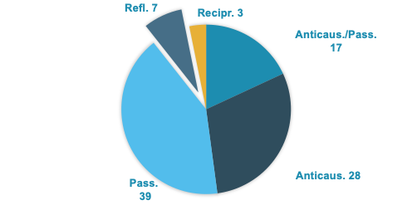
A reflexive origin?
1) Few reflexive middles!
2) Competition with =za
data from Inglese 2020

Slide 154
Oppositional vs. non-oppositional: chronology
 | NOPPs | OPPs | A=M
OH | 27 (73%) | 7 (19%) | 3 (8%)
MH | 16 (30%) | 19 (37%) | 17 (33%)
NH | 13 (18%) | 32 (45%) | 26 (37%)
data from Inglese 2020

Slide 155
Oppositional functions: chronology
 | Anticausative | Passive | Antic./Pass. | Reciprocal | Reflexive
OH | 3 | 2 | 0 | 1 | 1
MH | 6 | 7 | 6 | 0 | 1
NH | 9 | 13 | 8 | 1 | 0
data from Inglese 2020

Slide 156
Stage 1: lexical distribution
cf. Lazzeroni 1990, Benedetti 2002, Luraghi 2012, 2021

Slide 157
Stage 2: the anticausative alternation
Among media tantum, the largest group includes uncontrolled states and change-of-state events (Luraghi 2012: 14-16): kīš-^{a(ri)}, ‘become, happen’, kišt-^{ā(ri)} ‘perish’, lukk-^{tta} ‘get light, dawn’, marriye/a-^{tta(ri)}, marra-^{tta(ri)} ‘melt, stew (intr.)’
Emergence of voice alternation to express the anticausative alternation
Voice polarization:
Active voice with typically transitive verbs;
Active voice with causatives of media tantum (kist-ari vs. kista-nu-zi);
Lexical pairs: kīš-ari‘happen’ vs. ye/a-zi ‘cause to happen’.
Class | Verbs
Change in body posture | 1
Positional verbs | 2
Translational motion | 3
Spontaneous events | 10
Natural reciprocals | 1
Transitive deponents | 2
Other | 1

Slide 158
Stage 3: new oppositional functions
“middle markers from non-reflexive sources will not develop into markers of reflexive semantics” (Kemmer 1993: 229)

Slide 159
Anticausative > reflexive

Slide 160
Decausative > autocausative > reflexive
Addition of an animacy/control semantic component (thus the reverse of reflexive to anticausative, cf. Haspelmath 1990: 44)

Slide 161
Anticausative > reciprocal

Slide 162
Anticausative > reciprocal anticausative > reciprocal

Slide 163
The development of the Hittite middle
Reflexive
Grooming
Body posture
Reciprocal
Anticausative
Spontaneous events
Passive
Motion
oppositional
non-oppositional

Slide 164
Middle semantics and diachrony

Slide 165
A third way?
Development of Proto-Bantu verbal extensions into middle markers (cf. Dom et al. 2016)

Slide 166
Bantu *-ʊk- as a MM
Reflexes of *-ʊk- behave as MMs in in Yeyi (Seidel 2008: 246–247), Chuwabo (Guérois 2015: 254–257, 269–271), and Fwe (Gunnik 2018: 234–239; cf. Dom, Kulikov & Bostoen 2016: 140–143; Guérois & Bostoen 2018).

Slide 167
The diachrony of *-ʊk-: oppositional functions
Proto-Bantu *-ʊk-: optionally added to verb roots adding the meaning “movement out of some original position” (Schadeberg & Bostoen 2019: 186)
Ablative meaning: Proto-Bantu *-tá-ʊk- ‘come from’ and *-jín-ʊk- ‘come out (of water)’
Ablative > reversive (cf. Gibert-Sotelo 2018):-rwârà ‘become sick’ —> -rwárùkà ‘become better’
Reversive > anticausative (> passive): kúàr- ‘open (tr.)’ —> kúàr-ùk-à ‘open (intr.)’

Slide 168
The diachrony of *-ʊk-: oppositional functions
Proto-Bantu *-ʊk-: derivational suffix adding ablative semantics
non-oppositional
conventionalization of the [verb-ʊk-] construction and expansion to verbs with non-separative semantics, e.g. Fwe -bárùkà ‘taste a crop’ (Gunnik 2018: 236)
oppositional
development of oppositional functions: in Fwe -uk may function as anticausative, passive and facilitative marker (Gunnik 2018: 236)

Slide 169
Conclusions
while reflexives constitute a frequent starting point, cross-linguistic evidence shows the existence of a variety of other less frequent sources;
there exist different pathways of developments whereby MVSs come into being, and at leas three scenarios are able to explain the synchronic distribution of MVS at the lexicon/grammar interface;
the diversity of diachronic scenarios behind the emergence of MVS cast doubts on the possibility to explain their configuration in terms of recurrent overarching synchronic motivations (e.g. distinguishability of events);
the notions of middle voice, middle markers, middle voice systems are useful to compare clusters of constructions with similar distributional properties across languages: however, similarities are due to the accidental convergence of various diachronic processes, so that no single universal category of middle voice should be a priori assumed.

