Slide 1
Valency changing morphology and voice in the Oceanic languages of Northern New Ireland, Papua New Guinea
Lidia Federica Mazzitelli
Universität zu Köln
Academia Grammaticorum Salensis Vigesima
Salos - Lithuania
28.07.2023

Slide 2
Voice and transitivity in Oceanic
Most Oceanic languages lack morphological passives
Most (all?) Oceanic languages have morphological causatives (Proto-Oceanic *paka-); many have applicatives (= a morpheme which turns an oblique into a core argument of the verb) (Proto-Oceanic *-aki[ni], *-an)
Most Oceanic languages have some marking of transitivity on the verb (proto-Oceanic *-i)
Lakurumau
poxo ‘fall’ – va-poxo-i ‘CAUS-fall-TR’ ‘make fall’
Ne marot pan=a ruwai ‘I am afraid of the snake’
Ne maror-in a ruwai ‘I am afraid of the snake = I fear the snake’ (-in < POc*-an)

Slide 3
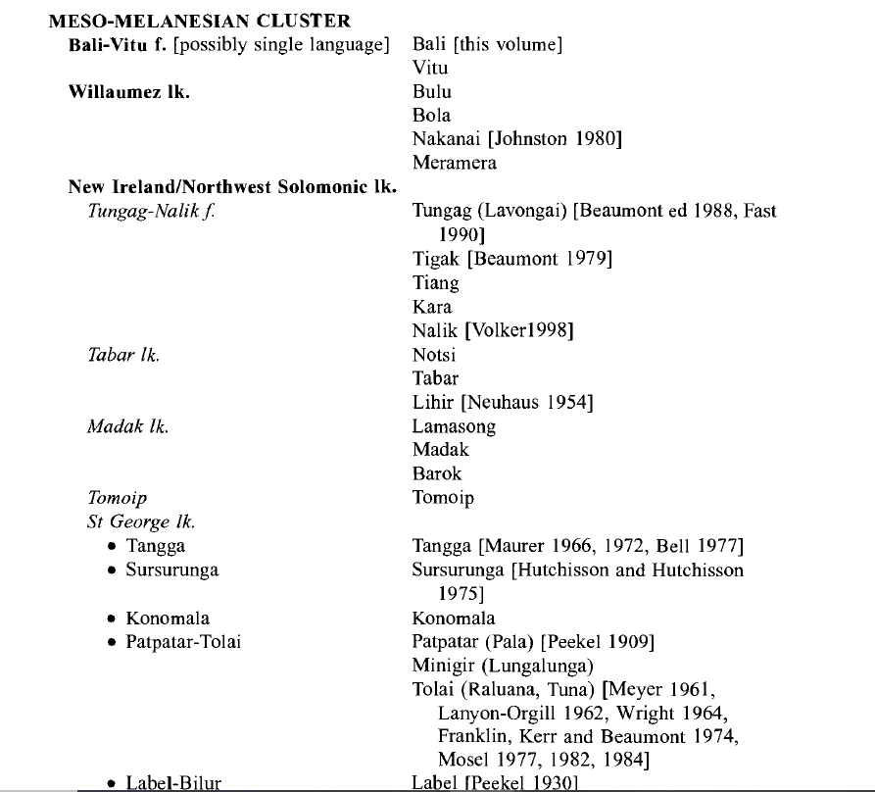
Kara
Kara is a Western Oceanic, Meso-Melanesian language spoken in New Ireland (Papua New Guinea)
It is a member of the Lavongai-Nalik family (Ross 1988; Lynch, Ross & Crowley 2002)
Two main dialectal areas: West Coast Kara / East Coast Kara
+ Lakurumau [Mazzitelli 2020]

Slide 4
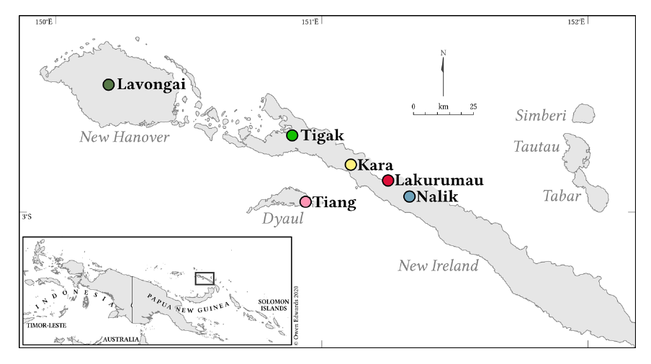
Kara & Lakurumau
Kara
Lakurumau

Slide 5
Kara - Previous descriptions
Virginia [Ginny] & Perry Schlie: Kara translation of the New Testament [1990]; some descriptive papers [Lemakot dialect]
Matthew Dryer: Grammar of Kara-Lemakot [based on the Bible translation, with no fieldwork], 2013

Slide 6
Kara factsheet
Several dialects (North/South; East Coast/West Coast)
AVO/ SV language
Subject marking: subject proclitics and/or NPs
A rafulak ri=pisin=a ball ‘The children kick(ed) the ball’
A lak a=matef ‘The child slept’
Object marking: =1SG.O [-aau] and =3SG.O [-a/-e/-i] suffixes
Kara Nonopai: Na Mary a=fapungun=aau ‘Mary woke me up’
In some dialects, -a also functions as a general marker of transitivity
Kara Nonopai: Maam=kaavang-a nano ‘We help you’!)

Slide 7
Voice and valency-changing morphology (Kara Lemakot; Schlie 1983)
Agentless passive –an (? < POc passive –an; Ross ms.)
Valency-increasing –Vn (? < POc applicative *ani (cf. Naitoro 2018; Mazzitelli 2020; Ross ms.)
Valency-decreasing –aai (< POc applicative *aki; Ross 1988; Evans 2003)
Losuk – an
Nonopai –an, -n
Lemakot –an
Lamusmus –in
Luburua –in

Slide 8
Voice and valency-changing morphology (Kara Lemakot; Schlie 1983)
Agentless passive –an (? < POc passive –an; Ross ms.)
Valency-increasing –Vn (? < POc applicative *ani (cf. Naitoro 2018; Mazzitelli 2020; Ross ms.)
Valency-decreasing –aai (< POc applicative *aki; Ross 1988; Evans 2003)
Losuk – an
Nonopai –an, -n
Lemakot –an
Lamusmus –in
Luburua –in

Slide 9
Valency-increasing: -an
Applicative: introduces a stimuli
Mataut ‘be afraid’: Ne mataut se-na [OBL] ‘I am afraid of him’ > Ne mataut-an nane [O] ‘I fear him’
Transitivizer: introduces a theme
[Nonopai] Faavus ‘accompany protein food with vegetables’: Ne faavus pana sasaak ‘I accompany [food] with sago’ > Ne faavus-n-a yin pana sasaak ‘I accompany fish with sago’
It can raise an instrument to direct object
Nane pit-a vaafa[O] pana waai [INS] ‘He hit the fence with a stick’
Nane pit-an-a waai [INS > O] xuluna vaafa [O > LOC] ‘He hit the stick on the fence’
Transitivity marker in verb pairs, where the TR is marked by –an and the INTR by –aai
ves-an-a ‘make.TR’ – ves-aai ‘make.INTR’; xet ‘bite’ – xet-an-a/xet-aai ‘bite and hold onto the prey’
Nane vesana lifu ‘he made a house’ – Nane vesaai lifu ‘He makes houses (for a living)’

Slide 10
Valency-decreasing: –aai
Intransitive marking in verb pairs with –Vn
ves-an-a/ves-aai ‘make’; [Nonopai] musung-an-a/ musung-aai ‘sniff’
Antipassive
(2a) A maalu a=fit a waai ‘The wind blew that tree.’
(2b) A maalu a=fit-aai se-na waai ‘The wind blew against that tree.’

Slide 11
Agentless passive: -an
punuk ‘kill’
(1a) Nane a=punuk a vio ‘He killed the pig’
3SG 3SG.S=kill ART pig
(1b) A vio a=punuk-an ‘The pig was killed’
ART pig 3SG.S=kill-PASS
The -an passive is found in other scattered Oceanic languages such as Vitu (Western Oceanic; PNG) and Abma (Southern Oceanic; Vanuatu)
It was said to be present in Tiang (also Lavongai-Nalik); but it seems not to be the case (Holz, pc.c)
It is absent in Lavongai and Nalik; in Lakurumau, it is an impersonal suffix; in Tigak, it has not be recognised until now

Slide 12
Main research questions
What are the morphosyntactic properties, discourse functions and conditions of use of passive –an?
Is it really agentless?
Are there dialectal differences?

Slide 13
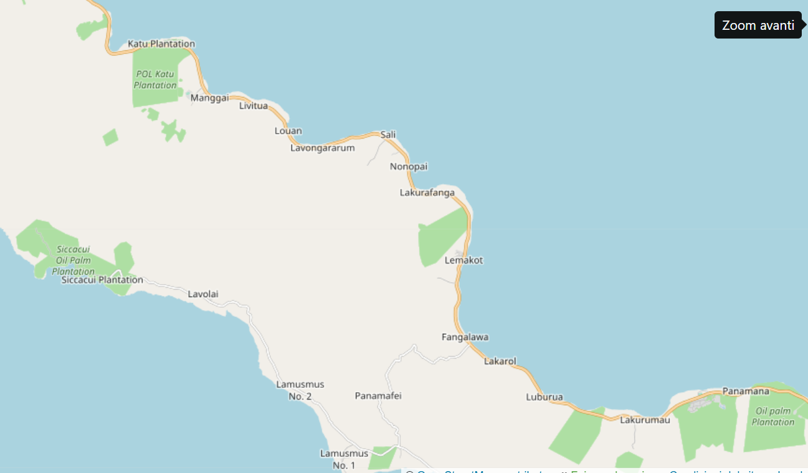
Fieldwork: locations
Lossuk
Tigak
Lakurumau
Nalik

Slide 14
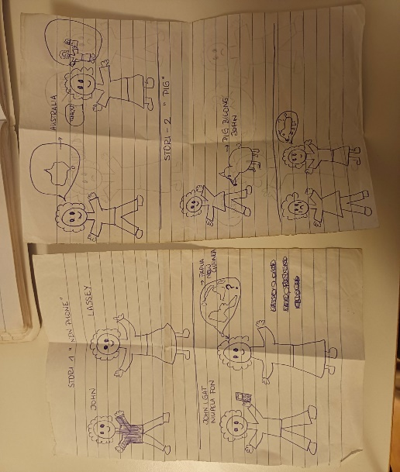
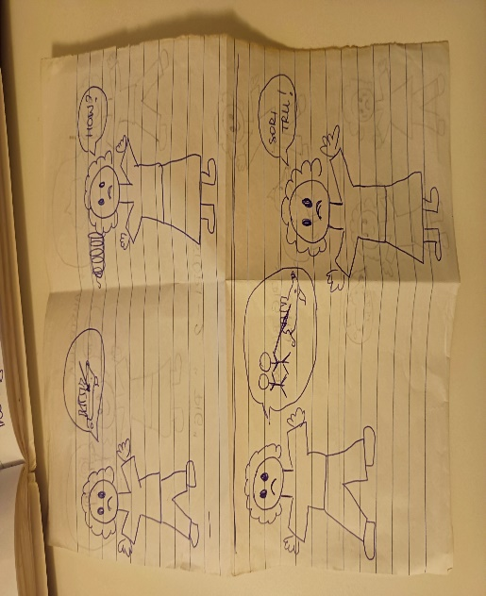
Fieldwork: methodology
Elicitation and translation from Tok Pisin
Storyboards and pictures
The Frog Story (Nonopai, Luburua only)
The Fish video
Pictures from the DISQUS and Cut&Break stimuli kits
Home-made videos
John & Lassey story

Slide 15
Passive: morphology
Lossuk (North) | Passive in –an; intransitivisation passive
Nonopai (North) | Passive in –an; intransitivisation passive
Lamusmus (South-West) | Passive in –an
Luburua (South) | Passive in –an

Slide 16
Passive in –an
It is equally productive in all dialects: all syntactically transitive verbs can build a passive in –an
It can also target locations and instruments (Luburua, Lemakot; not in Nonopai)
Luburua
(4a) E=faaisok pa-na pinis ‘I work with the knife’
1SG.S=work with-3SG.O knife
(4b) A pinis xong faaisox-an pana ‘The knife is worked with’
ART knife PERF work-PASS with-3SG.O

Slide 17
Intransitivisation passive
Nonopai: Punuk ‘kill’
(5a) Ne punux-a vio ‘I kill the pig’
1SG kill-3SG.O pig
(5b) Ne pu-punak vio ‘I kill pigs (usually; for a living; unspecified pigs)’
1SG RED-kill pig
(5c) A vio fo pu-punak ‘The pig has been killed’
ART pig PERF RED-kill
(or: punax-an)

Slide 18
Intransitivisation passive
Nonopai: ves-an-a/ves-aai ‘make’
(6a) Ne ves-an-a lifu ‘I build the house’
1SG make-TR-3SG.O house
(6b) Ne (va-)ves-aai lifu ‘I build houses (usually; unspecified houses)’
1SG (RED-)make-INTR house
(6c) A lifu fo (va-)ves-aai ‘The house has been built’
ART house PERF (RED-)make-INTR
(or: ves-an-an)

Slide 19
Intransitivisation passive
Nonopai: pisi-n-a/pisi-aai ‘make’
(7a) A ball ri=fo pisi-n-a ‘The ball, they have thrown it’
ART ball 3PL=PERF throw-TR-3SG.O
(7b) Ri=pisi-aai xo ‘They throw rubbish’
3PL.S=throw-INTR rubbish
(7b) A ball fo pisi-aai ‘The ball has been thrown’
ART house PERF throw-INTR
(or: pisin-an)

Slide 20
Intransitivisation passive
Losuk: kep-an-a/kep-aai ‘build’
(8a) Nane=ka po kep-an-a lui ‘He has built the house’
3SG=R PERF build-TR-3SG.O house
(8b) Nane=ka yaano ina kep-aai lui ‘He is a carpenter (house-builder)’
3SG=R man PURP build-INTR house
(8c) A lui=ka po ka-kep-aai ‘The house has been built’
ART house=R PERF RED-build-INTR
(or: kep-an)
In Lossuk dialect, only passive reduplicated forms with –aai!

Slide 21
Intransitivisation passive
It is productive, except in the following cases
Verbs where both A and O may be human: see, hear, bite
Xet ‘bite’: Rafulak fo xetan: The children have been bitten // Rafulak fo xexet: the children have bitten (something/somebody else)
Verbs with causative fa-
Minang ‘stay’ – fa-mining-a ‘put’: PASSIVE famining-an, *fafamining
Some cases seem to be idiosyncratic
Ul-a ‘roll-tr’ → A ball fo ulan/ *ulul ‘the ball has been rolled’

Slide 22
Passive and resultative
Resultative introduced by tV(la)- (< POC *ta-) denotes a spontaneous action
Nonopai: gurum ‘break’ → tu-gurum ‘broken’; Lamusmus kaas ‘open’ → thala-kas ‘open’
Passive is clearly actional: there must be an (implied) agent!
Luburua pak ‘peel’
(9a) A fut xong a=tala-pak
ART banana COS 3SG:S=RES-peel
‘the banana is now/already without its skin (because it fell by a tree)’
(9b) A fut xong a=pax-an
ART banana COS 3SG:S=peel-PASS
‘the banana has now been peeled’
Nonopai pak ‘peel’
(10a) A fut fo tala-pak
(10b) A fut fo pa~pak (or pax-an)

Slide 23
Passive and TAM
In the Losuk dialect, passive with –an is restricted to perfective past; the Losuk speaker I consulted said that «-an means past tense»
(11a) A kala ka=po kapis-an ‘Taro has been planted (yesterday)’
ART taro 3SG.S=PERF plant-PASS
(11b) A kala ka=po ka~kapis ‘Taro has been planted (in general)’
ART taro 3SG.S=PERF RED~plant
(12a) A kaapul ki=kapisi=ya kala amawa
ART woman 3SG.IRR=plant-3SG.O taro tomorrow
‘The woman will plant taro tomorrow’
(12b) A kala ki=ka~kapis (*ki=kapis-an) amawa
‘Taro will be planted tomorrow’

Slide 24
Passive agents
In Luburua, Lamusmus, Lemakot, and Nonopai the passive is always agentless; however, a causer can be introduced (a natural force; an inanimate object)
In Losuk, natural forces and animals are allowed as agents; not humans!

Slide 25
Passive agents
Nonopai
(13) A matana lifu fo xaxaas (PASS) sana reref/*piu/*mataa
‘the door has got shut by the wind/*dog/ *man
(14) A vakap a=ti-rirak (RES)/a=ririk-an (PASS) sana faat
‘the cloth got torn by the stone (because f. ex. I was pulling it from under it)
Lamusmus
(15) A mathana luhu xo thala-kas (RES) pana taai/*viu/*mataa
‘the door has got shut by the wind/*dog/*man
(16) A mathana luhu xo kas-an (RES) *pana taai
‘the door has been closed *by the wind’ (because passive = intentionality)

Slide 26
Passive agents
Lossuk
(17) A mul ka=po ririk-an pana liang ‘the cloth has been torn with a stone’
(here ‘stone’ is a proper instrument, and the agent is unexpressed)
(18) A vako ka=po musung-an tana piu ‘the pig has been smelled by the dog’
(19) A vako ka=po punux-an/pupunak tana piu ‘the pig has been killed by a dog’
(20) A yen koro ka=po kanam-an tana kaaino yen ‘this fish has been swallowed by another fish’
But: (21) A ur ka=po pil-an *tana oroko ‘*the banana has been peeled by a cuscus’

Slide 27
Passive in Kara discourse
Extremely difficult to get passive spontaneously produced by speakers; most of the time: 3PL with left-dislocated object (‘the pig they killed it’)
But easily recognised and produced with elicitation
Also easily admitted in syntactically convolute structures such as the pig which was eaten at the funeral was killed yesterday

Slide 28
Summary
In Kara, passive is formed by means of suffix –an and by means of reduplication (only in the northern dialects)
Intransitivisation passive is limited to predicates where there is a clear distinction of agent and patient: that is, if the predicate clearly only admits inanimate/non-human patients or where it is clear from the situation (e.g. A popo fo yoyot fadui ‘the baby was taken up’) that the human patient cannot be the agent
In Kara, the syntactically intransitive forms of bivalent verbs are not specified for the semantic role of their highest-raking argument (the subject)

Slide 29
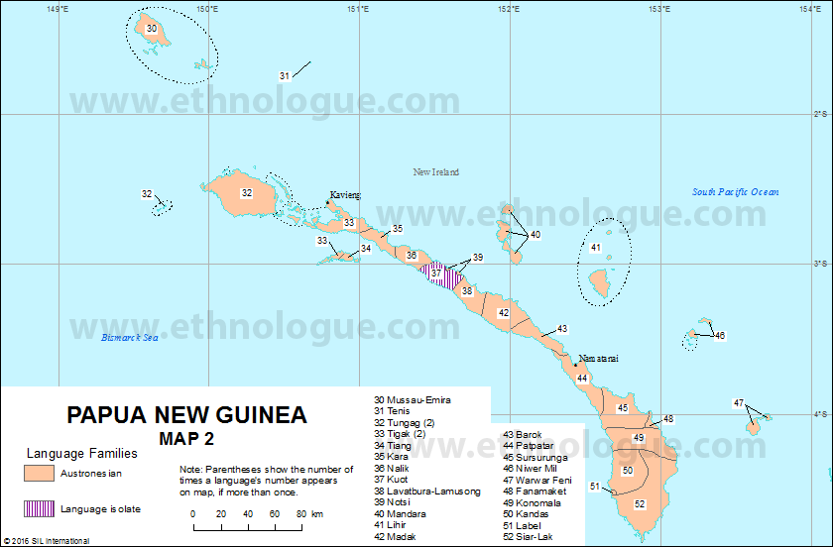
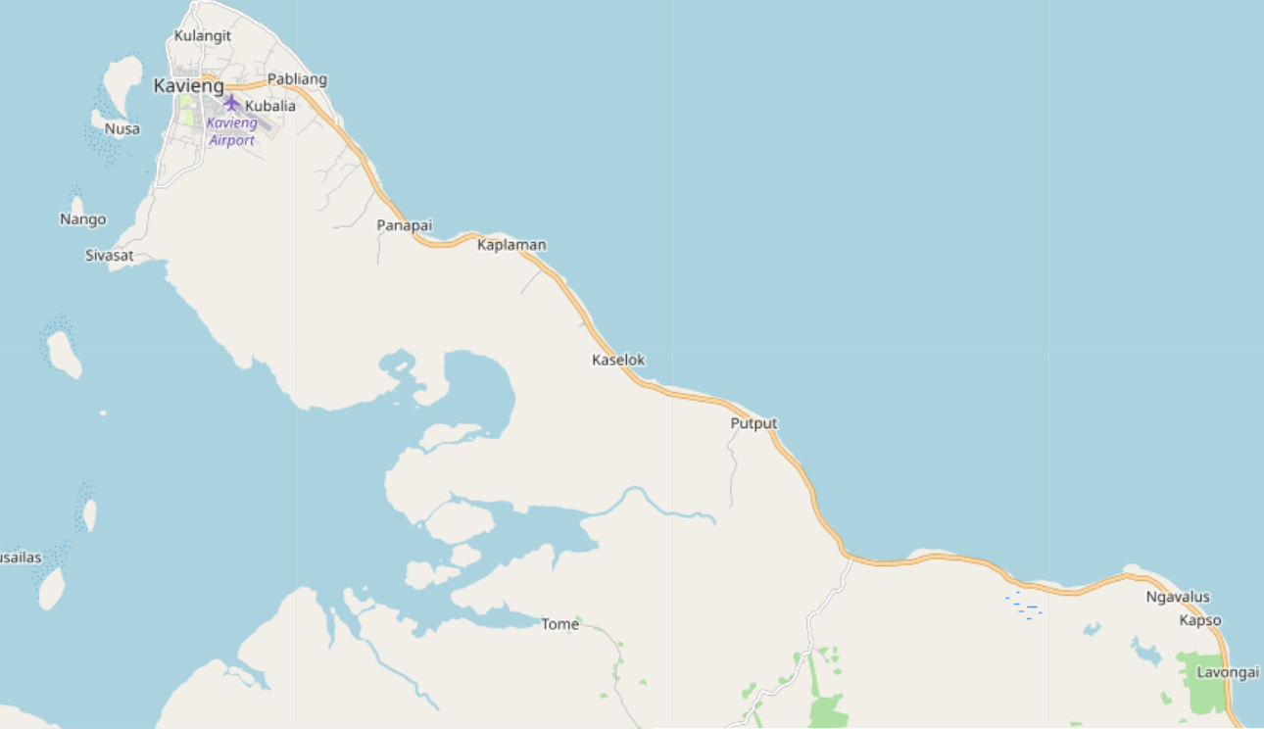
North of Kara: Tigak
Described by Beaumont (1989): no mention of a passive
Nusa Island
Panapai
Tigak
Kara
Losuk

Slide 30
North of Kara: Tigak
Actually, speakers from both Nusa and Ponopai produced passive in –an
Nusa
(22) Tang bogo ga=po punuk-an tana ta piu/*yaanu
ART pig R=PERF kill-PASS by ART dog/*man
‘The pig has been killed by the dog/*man’
(But: the speaker from Ponopai did not accept the agent here)
(23) Ta yaai ga=po maal-an tana ta rei
ART tree R=PERF blow-PASS by ART wind
‘the tree is blown by the wind’
Ponopai
(24) Ta ngata ga=po vus-an-an tana ta rei
ART fire R=PERF blow-TR-PASS by ART wind
‘the tree is blown by the wind’

Slide 31
Conclusions
There always (still) are more islands to go to and more languages and passives to discover!

Slide 32
Ka doxo marasaxaa, a roxo paaliu, ačiū ir thanks!
Thanks to all the speakers in Losuk, Nonopai, Lamusmus, Luburua and Lakurumau who shared their language with me
Sunset in Lakurumau

Slide 33
Verb types in Lakurumau
Types of stems (semantically bivalent roots; no valency-changing morphology as causative)
Transitive: simplex transitive stem; intransitive stem + TR –i; stem in –in
zop ‘hit.TR’; vazu-i ‘plant’; raxaam-in ‘see’
Intransitive: simplex intransitive stems; stems in –aai
sop ‘help.INTR’; vaazu ‘plant. INTR’; raxaam-aai ‘look at’
Labile: simplex labile stems
galong ‘break a coconut’

Slide 34
Valency and transitivity
Three types of clauses:
With overt object
With incorporated object
With implicit object
(I do not consider ditransitive clauses here)

Slide 35
Valency and transitivity
With overt object
(6) Ne zop fa-maat a boi
1sg hit caus-die art pig
‘I killed the pig’
Only transitive or labile stems can appear in these clauses

Slide 36
Valency and transitivity
(2) With incorporated object: The object is undetermined, non-specific and non-referential; it cannot be modified; all affixes follow the object NP and no elements can intervene between the verb and the object
(7) U vangan boi=raan
sm.3nsg eat pig=trial
‘The tree of them ate pig’
(8) A yot boi=an
art catch pig=nmlz
‘The capture of pigs’ (lox213)
Only intransitive or labile stems can appear in these clauses

Slide 37
Valency and transitivity
(3) With implicit object
(9) Pe di yaan Yaan is a transitive stem
so.that sm.1pl.incl eat
‘(Why are you cooking the shells?) For us to eat’ (lox131)
(10) Nanga ru-tun pana furalik sa-gu Rutun is an intransitive stem
sm.1sg red-cook for children poss-1sg
‘I cook for my children’ (lox151)
Usually, transitive and labile stems are used where the object is retrievable (8.) and intransitive and labile stems when it is implicit (9.)

Slide 38
Valency and transitivity
In Lakurumau, all verbal modifiers must be marked for transitivity:
(11) a. No vuna vangan fadi bul-aai
1sg hab eat.intr banana always-intr
‘You always eat bananas’ (lox106)
b. Mo a revin ka buxura ka vala i-yaan bulin a boi...
if art woman sm.3sg pregnant sm.3sg go.on red-eat.tr always-tr art pig
‚If a pregnant woman goes on eating pig...‘ (lox148)

Slide 39
Verb classes in Lakurumau
 | Intransitive clauses (with incorporated object) | Transitive clause (with overt object) | Morphological process
Class I. | galong | galong | No change (labile roots) | ‘break a coconut’
Class II. | kaabang ['kabəŋ] | xabong [ɣə'boŋ] | Phonetic alternations | ‘help’
Class III. | vaazu | vazu-i | -i | ‘plant’
Class IV. | raxaam-aai | raxaam-in | -in/-aai | ‘see/look at’

Slide 40
Class I.
The biggest class per number of verbs – labile roots (over 50 verbs)
Ia. yot ‘catch’, yuf ‘pull’, buaak ‘break’, ramin ‘put’, tis ‘splash with water’, pis ‘tie’, ftuk ‘cut into pieces’, maraan ‘buy’, saxot ‘love, want’, xus ‘tell’, fui ‘untie’
Ib. vazok ‘break’, vit ‘beat’, faai ‘put down’, weruf ‘fetch’, raxon ‘chew’, vangun ‘wake up’, goi ‘harvest (bananas)’
The verbs of the first group also have a reduplicated form, which is always intransitive: yot – yoyot ‘catch’. The verbs of the second group cannot undergo reduplication
No clear criteria for the subdivision

Slide 41
Class II.
Class II. verbs distinguish their transitive and intransitive form by phonetic processes – so far, I have found 15 verbs in this class:
kaabang - xabong ‘help’; kaali – xalin ‘build’; sop – zop ‘hit’; kaayas – xayos ‘peel’; kaavut – xavut ‘wrap’; faazak – vazaak ‘carry’
Lenition: sop [sɔp] INTR – zop [zɔp] TR ‘hit’
Stress: kaabang ['kabəŋ] INTR - xabong [ɣə'bɔŋ] TR ‘help’
Vowel alternations: kayas [kə'yəs] INTR – xayos [ɣə'yɔs] TR ‘peel’

Slide 42
Class II.
Lenition: inter-vocalic spirantization that affects all unvoiced consonants
[k] > [ɣ] Ne waan ‘I go’ vs. Maam paan ‘We go’
[t] > [r]
[p] > [v]/[β]
[s]> [z]
[f] > [v]
Even if, de facto, /ɣ/, /v/, /z/ and /r/ almost always occur as allophones of /k/, /f/, /s/ and /t/, they have morphological distinctive value, cf. the pair kon [kɔn] ‘spoil’ / xon [ɣɔn] ‘paddle’. In Class IV. verbs, when there are lenition alternations, the intransitive form always has a non-leniate consonant - also in intervocalic contexts
Ne kaabang ‘I help’ Maam kaabang ‘we help’

Slide 43
Class II.
Stress
The intransitive form usually has stress on the first syllable, while transitive forms have stress on the last one
INTR TR
kaabang ['kabəŋ] xabong [ɣə'bɔŋ] ‘help’
faazak ['fazək] vazaak [və'zak] ‘carry on shoulders’
Vowel alternations
INTR TR
[a] - [ə] kaavut ['kavut] – xavut [ɣə'vut] ‘wrap’
[ə] - [ɔ] kayas [kə'yəs] – xayos [ɣə'yɔs] ‘peel’
[ə] - [a] rabaf [rə‘bəf] – rabaaf [rə‘baf] ‘slap’

Slide 44
Class II.
Possible cause: effect of the loss of POC final vowels and/or object clitics
Displacement of stress: on the former penultimate, now last syllable:
Vowel quality changes due to stress displacement
The lenition in transitive forms might be linked to the weakening of the syllable due to the stress shift: faàzak / vazaàk ‚carry‘. However, the lenition process is also active in monosyllabic verbs: sop/ zop ‚hit‘; it is also present in languages where the object suffixes are still present (as Kara)
Other languages of the Lavongai/Nalik chain testify to the lenition differentiation between transitive and intransitive forms too (Kara, Nalik, Lavongai)

Slide 45
Class III.
Stems ending in vowel belong in Class III. (with a couple of exceptions). Transitive stems are derived by adding –i (< POC *-i) – which in Lakurumau only has a transitivzing function (does not change valency)
vaazu – vazu-i ‘plant’; saxo – saxoi ‘sew leaves for rooftops’; taba – rabaai ‘give’; te – rayaai ‘cut horizontally’
Stems ending in –i can be either classified as Class I or Class II:
roi – roi (*roii) ‘touch, hold’; woi – woi (*woii) ‘spear’
The transitivizer –i is also found in secondary transitives and adverbs:
waxo ‘fall’ – va.caus-paxo-i ‘make fall’
mara ‘first’ (in intransitive clauses) – mara-i ‘first’ (in transitive clauses)

Slide 46
Class IV.
The verbs in this class do not have a simplex stem, only a suffixed one: TR –in (-en)( < POC applicative *-ani; Ross un. ms.) vs. INTR -aai (< POC *-aki). So far, 11 verbs:
raxaam-in ‘see’ – raxaam-aai ‘look at’ *raxaam
rox-in – rox-aai ‘have’ *rox
Exception: woxin – woxaai ‘do; work’ → wok from Tok Pisin wok ‘work; do’
tangin – tingaai ‘find’; vazokin – vazokaai ‘hang - be hanging’; rapin – rapaai ‘throw’; xavin – xavaai ‘bury’; walongin – walongaai ‘hear’; fingin – fiaai ‘ask’; botin – botaai ‘protect, cover’; viren – viraai ‘teach’
Adverbs
bulin – bulaai ‘always’; marasaaxen – marasaxaa ‘very much’; fexaabunin – fexabunaai ‘together’

Slide 47
Class IV.
POC *-ani (Ross un. ms.)
Applicative
Reflects in some languages of the Admiralties group, Meso-Melanesian (New Ireland) and North New Guinea linkages, as well as in Daakaka (North Vanuatu linkage)
In Lakurumau: -in can also attach to simplex intransitive stems with a causative or applicative function (with no counterpart in –aai)
vaaigot ‘be ready’ → vaaigot-in ‘prepare’ (*vaaigotaai)
marala ‘be angry’: (12) a. Ne marala (pa-num) b. Ne maral-en no
1sg be.angry (obl-2sg) 1sg be.angry-appl 2sg
‘I am angry with you’

Slide 48
Class IV.
All Lavongai/Nalik languages have reflexes of *-ani, which is the general transitivizer (causative and applicative), and reflexes of de-transitivizing *-aki.
In other languages instead reflexes of *-ani and *-aki(ni) co-exist as valency-increasing devices
In the other Lavongai/Nalik languages, -(a)ai can apparentily attach to simplex stems to create intransitives (with antipassive function), with no need to have a counterpart in - *ani
Kara fun ‘hide.TR’ – fun-ai ‘hide.INTR’ (Dryer 2013)

Slide 49
Verb classes in Lakurumau – isolated examples
Suppletion
yaan ‘eat.TR’ – vangan ‘eat.INTR’
Only intransitive/transitive stems (semantically bivalent roots)
pik ‘pick firewood.INTR’
lis ‘bring.TR’
zalen ‘push through.TR’

Slide 50
Verb classes in Lakurumau - conclusions
Semantically bivalent roots in Lakurumau form four stem classes:
Class I. (labile) is a quite common class in Oceanic languages;
Class II. (TR with –i) and Class IV. (-in /-aai) display known Oceanic morphology
Class II. (phonetic alternations) is instead language (or better, language group) specific; it might have emerged as a consequence of stress shifts

Slide 51
Verb classes in Lakurumau - conclusions
Properties of the verb classes
Class I. (labile stems) No clear semantic or phonetic properties
Class II. (–i) No clear semantic properties; vowel stems
Class III. (phonetic alternations) No clear semantic or phonetic properties
Class IV. (-in /-aai) All verbs take Themes (not Patients)
find, see, throw, ask, hang, hear → due to the semantics of *-ani
Further research: the relation between *-ani and *-aki(ni) – both in their co-existence as valency-increasing devices and as as valency-increasing vs. valency-decreasing devices

