Slide 1
Predicative possession in the languages of the Circum-Baltic area
Lidia Federica Mazzitelli
Universität zu Köln
Academia Grammaticorum Salensis Vigesima
Salos - Lithuania

Slide 2
Contents
The Circum-Baltic area
CBA languages
Possession as a (linguistic) notion
The domain of possession
Attributive (adnominal), predicative, and external possession
Predicative possession in the languages of the CBA
Prototypical possession
Non-prototypical possession
Attribution, experience, and location

Slide 3
The Circum-Baltic area

Slide 4
Languages of the CBA (Dahl & Koptjevskaja-Tamm 2001)
Indo-European, Germanic
West Germanic: High German, Low German
North Germanic: Swedish, Danish, Norwegian
Indo-European, Slavic
East Slavic: Russian, Belarusian
West Slavic: Polish
Indo-European, Baltic
East Baltic: Latvian, Lithuanian, Latgalian
Indo-European, Indo-Aryan
Romani
Uralic, Finnic
Finnish, Estonian, Votic, Karelian (Olonets and North Karelian), Veps, Ingrian, Livonian
Uralic, Saamic
All Saami languages
Altaic, Turkic
Karaim

Slide 5
A Sprachbund around the Baltic Sea?
Mathiassen (1985): a Baltic Sprachbund
Stolz (1991): not a Sprachbund, but rather a sprachliche Konvergenzlandschaft (‚landscape of language convergences‘); particularly remarkable convergences between Estonian and Latvian
Nau (1996), Wälchli & Koptjevskaja-Tamm (2001): ‚Contact Superposition Zone‘. Not a Sprachbund, but many linguistic convergences dut to micro-contacts between two or more neighbouring languages.

Slide 6
Languages I will take into account today
Indo-European, Germanic:
West Germanic: German
North Germanic: Swedish, Norwegian, Danish
Indo-European, Slavic:
East Slavic: Russian, Belarusian
West Slavic: Polish
Indo-European, Baltic:
East Baltic: Latvian, Latgalian, Lithuanian
Ugro-Finnic, Finnic:
Finnish, Estonian,Veps,Votic, Karelian, Livonian, Ingrian
Ugro-Finnic, Saami:
North Saami

Slide 7
Sources
Grammars /dictionaries (all languages)
Electronic corpora (German, Finnish, Estonian, North Saami, Latvian, Latgalian, Lithuanian, Belarusian, Russian, Polish)
Parallel translations of “The Little Prince” (German, Swedish, Danish, Norwegian, Finnish, Estonian, North Saami, Latvian, Lithuanian, Belarusian, Russian, Polish);
On-line newspapers (Olonec and North Karelian)
Translations of the Bible (Olonec and North Karelian,Veps);
Collections of literary texts and transcriptions of interviews to native speakers:
19th century (Livonian)
1940 (Votic)
1970 (Olonec Karelian)
New fieldwork data on Votic and Ingrian: interview to speakers conducted by Feder Rožanskij (2015)

Slide 8
The notion of „possession“

Slide 9
What is „possession“?
Hansjakob Seiler, Possession as an operational dimension of language, 1983
“Semantically, the domain of possession can be described as bio-cultural. It is the relationship between a human being, his kinsmen, his body parts, his material belongings, his cultural and intellectual products. In a more extended view, it is the relationship between parts and whole of an organism.” (Seiler 1983: 4)
→ Possession a core concept of our existence as human beings

Slide 10
What is „possession“?
Possession can be defined on many levels:
Culture → what can one „possess“ or „own“ in a specific culture?
Law → how are relations of possession defined by law (f. ex. „theft“)?
Cognition→ how does the human brain conceptualise possession?
Language → how does language expresses possession? Which constructions and expressions can we define as possessive?

Slide 11
What is „possession“?
Possession can be defined on many levels:
Culture → what can one „possess“ or „own“ in a specific culture?
Law → how are relations of possession defined by law (f. ex. „theft“)?
Cognition→ how does the human brain conceptualise possession?
Language→ how does language expresses possession? Which constructions and expressions can we define as possessive?

Slide 12
What is „possession“?
The notion of „possession“ is a cognitive universals, and one of the few true linguistic universals: “every human language is expected to have some morpho-syntactic strategies for its expression” (Heine 1997: 1).
It is extremely difficult to find a satisfying definition for possession - Baron and Herslund (2001: 1): “possession is a vague and very elusive notion“

Slide 13
What is „possession“?
“Possession can be defined as an asymmetrical, abstract locative relation between two entities, the possessor (PR) and the posssessee (PE), where the first exerts control over the second.”
(Mazzitelli 2015: 22)
«A possessive relationship between two entities occurs when one entity (the possessor) functions as a reference point for identifying the domain where the second entity (the possessee, or possessum) is located, and when the first entity exerts control over the second.”
(Mazzitelli 2017: 4)

Slide 14
What is „possession“?
Asymmetrical: I have a laptop // * the laptop has me
Lidia’s laptop // * the laptop’s Lidia
Abstract locative relation: the possessee exists in my “Lebensraum” (vital space) (and in many cases it exists in my physical vicinity)
Control: I, and only me, can use the possessee however I want → exclusive right of access

Slide 15
What is „possession“?
Langacker (1991, 2000, 2002, 2009) defines possessive expressions as belonging to the class of the so-called reference-point relationships
laptop, apartment
mother, friends
happiness, work, hunger
Physical space: material things that are in my life (my material possessions)
Social space: people I have a relationship with
Physicological space: ideas, feelings, abstract concepts

Slide 16
What is „possession“
I have a laptop
There is a laptop (in the world) → Existence
I am the reference point, from which perspective the laptop is identified ( it is the laptop that exists in my vital space, Lebensraum → Reference point
I have an exclusive right of access to my laptop, whereby I can decide what to do with it (use it, sell it, or even destroy it)→ Control

Slide 17
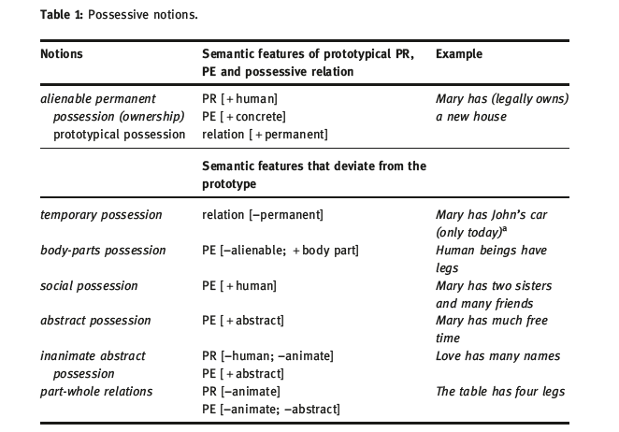
Possession as a prototypically organised domain
Possession can be conceived of as a prototypically organised domain
Different types of possessive relations (possessive notions; Heine 1997; Mazzitelli 2015, 2017) → ownership is the prototypical possessive notion
Mazzitelli 2017

Slide 18
Neighbouring possession
Possession
Location
Attribution
Experience

Slide 19
The domain of attribution
Physical characteristics (body-parts possession with modified possessee): I have blue eyes
Age: Lisa is twenty years old
The domain of experience
Diseases: I have a fever
Bodily sensations: I am hungry, I am cold
Psychical states: I am afraid
The domain of location
Part-whole relations with spatial inclusion: the house has three rooms

Slide 20
The domain of attribution
Physical characteristics (body-parts possession with modified possessee): I have blue eyes
Age: Lisa is twenty years old
The domain of experience
Diseases: I have a fever
Bodily sensations: I am hungry, I am cold
Psychical states: I am afraid
The domain of location
Part-whole relations with spatial inclusion: the house has three rooms
Possession (Part-whole relations)
The table has four legs
The house has a red roof (also attribution?) Location
The house has four rooms
The city has three main parks

Slide 21
Why should we also consider these domains?
Because notions pertaining to the domains of attribution, experience, anc location can be expressed in language by means of the same constructions used to express prototypical possession

Slide 22
Why should we also consider these domains?
Because notions pertaining to the domains of attribution, experience, anc location can be expressed in language by means of the same constructions used to express prototypical possession
Italian Ho un laptop ‘I have a laptop’ ownership
Ho fame ‚I am hungry‘ experience
Ho gli occhi marroni ‚I have brown eyes‘ attribution

Slide 23
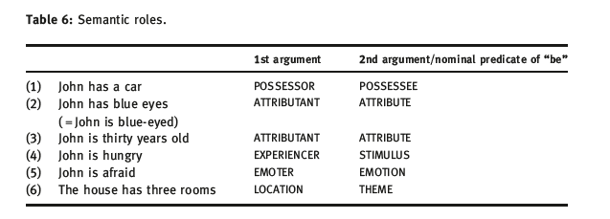
Why use possession to express other notions?
Possessors – experiencers – attributants – locations are all unprototypical actors or undergoers
The fundamental operation is to ascribe a property Y to a subject X; if the property Y is, or can be conceptualised as an entity, a linguistic possessive expression can occurr

Slide 24
Possession in language

Slide 25
Adnominal, predicative and external possession
Possessive constructions can be expressed in language on two levels
(1) Within the nominal phrase (NP): adnominal possession
[my book], [Claudia‘s sister], [the roof of the house]
On the sentence level, namely:
(2a) Predicative possession [I] [have] [a book]
(2b) External possession
Lithuanian [Jonas] [bučiavo] [jai] [ranką] (= [Jonas] [bučiavo] [jos] [ranką])
‚Jonas kissed her (‚to her‘) hand‘
Finnish Minulla on koira
I.ADES is dog
‘I have a dog’

Slide 26
Adnominal, predicative and external possession
Possessive constructions can be expressed in language on two levels
(1) Within the nominal phrase (NP): adnominal possession
[my book], [Claudia‘s sister], [the roof of the house]
On the sentence level, namely:
(2a) Predicative possession [I] [have] [a book]
(2b) External possession
Lithuanian [Jonas] [bučiavo] [jai] [ranką] (= [Jonas] [bučiavo] [jos] [ranką])
‚Jonas kissed her (‚to her‘) hand‘
Finnish Minulla on koira
I.ADES is dog
‘I have a dog’

Slide 27
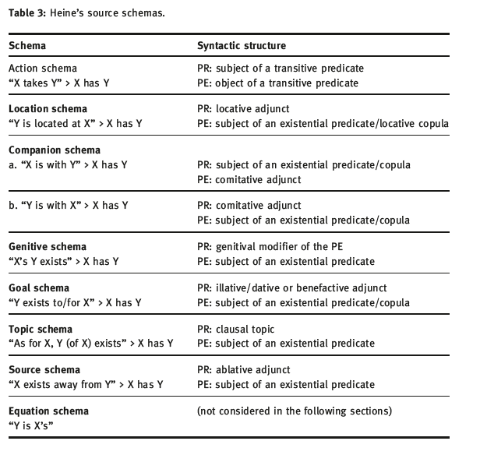
Predicative possession: Heine‘s (1997) typology
Action schema
English I have a house
Lithuanian Turiu namą
Location schema
Finnish Minulla on talo
Goal schema
Latvian Man ir māja
Companion schema
Sango (Bantu)
lo eke na bongo
he is with garment = ‘He has a garment’
Genitive schema
Turkish (Turkic, Altaic)
kitab-ım var book-my exists ‘I have a book’
Source schema
Slave (Athabaskan)
Ts’ét’u nets’e? cigarette (is) from.you ‘Do you have a cigarette?’
Topic schema
Mandarin Wo yoŭ yiben shu I exists one book ‘I have a book’

Slide 28
Split possession (Stolz et al. 2008)
Possession splits occur when one language uses different constructions for the expression of different possessive notions
Lakurumau (Western Oceanic, Papua New Guinea; own fieldwork)
A buk sa-gu ‚my book‘ alienable possession
ART book AL.POSS-1
A xaak-nangu ‚my leg‘ inalienable possession
ART leg-1SG

Slide 29
Summary – The object of today’s lecture
Constructions, which fulfil the following requirements:
1. Semantic requirement:
express a possessive notion or a relation, pertaining to one of the neighbouring domains of possession: location; attribution; experience;
2. Formal requirement
formally correspond to one of Heine’s (1997) schemata and include a predicate in their structure.

Slide 30
Research questions
How is prototypical possession expressed in the languages of the CBA?
How are non-prototypical possessive notions expressed in the languages of the CBA?
To what extent do CBA languages use possessive constructions to express non-possessive notions, such as attribution, experience, and location?
What non-possessive function has the verb ‚have‘ acquired in the CBA languages?

Slide 31
Prototypical possession (ownership)

Slide 32
Prototypical possession in the languages of the CBA
Location schema: all Finnic languages - except Livonian- , Russian, Belarusian
Finnic languages: adessive case
adessive constructions
Slavic languages: u ‘at’ + Genitive
locative case North Saami
 Action schema: all Germanic languages, Polish, Belarusian, Lithuanian
➢ ‘have’ verb
 Goal schema: Latvian, Latgalian and Livonian
➢ dative case

Slide 33
Prototypical possession in the languages of the CBA
Location schema: all Finnic languages - except Livonian- , Russian, Belarusian
Finnic languages: adessive case
adessive constructions
Slavic languages: u ‘at’ + Genitive
locative case North Saami
Action schema: all Germanic languages, Polish, Belarusian, Lithuanian
‘have’ verb
 Goal schema: Latvian, Latgalian and Livonian
➢ dative case

Slide 34
Prototypical possession in the languages of the CBA
Location schema: all Finnic languages - except Livonian- , Russian, Belarusian
Finnic languages: adessive case
adessive constructions
Slavic languages: u ‘at’ + Genitive
locative case North Saami
Action schema: all Germanic languages, Polish, Belarusian, Lithuanian
‘have’ verb
Goal schema: Latvian, Latgalian and Livonian
dative case

Slide 35
Estonian: Russian:
mul on raamat
u menja est’ kniga
adessive
North Saami: mus lea girji
locative
Swedish: Polish: Lithuanian:
jag har en bok mam książkę turiu knygą
‘have’
Latvian: Livonian:
man ir grāmata
minnon um romtod
dative
‘I have a book’

Slide 36
Belarusian
Adessive construction u + Gen.
U mjane ёsc‘ kniha
at me is book
‚I have a book‘
Verb mec’ ‘have’
Maju knihu
have.PRS.1SG book
‚I have a book‘
Location schema
Action schema
Both constructions are used for expressing prototypical possession!

Slide 37
PS. Russian imet’
In Russian, the verb imet’ ‘have’ indeed exists and it is used, but it has several constraints on its use (register, formality)
Sometimes its use is not semantically but syntactically determined, f. ex. with non-finite verbal forms
Russian Ne imeja deneg, on ne kupil bilety
*Ne buduchi u nego deneg, on ne kupil bilety
‚Not having money, he didn‘t buy the tickets‘

Slide 38
Beyond the prototype

Slide 39
Body-parts, social, abstract, and inanimate possession
In most languages of the CBA, the same construction used for the expression of ownership can also be used to express all other notions within the domain of possession

Slide 40
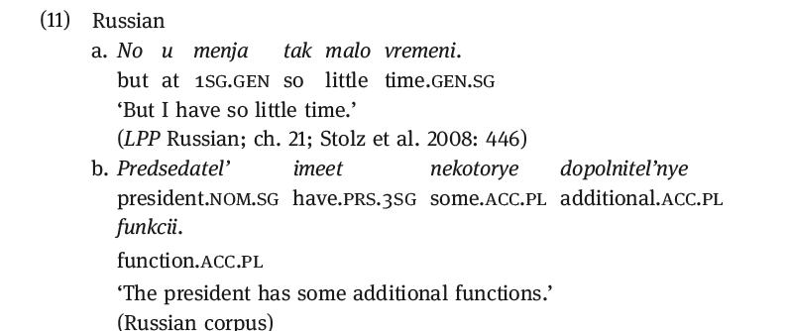
Abstract possession
Russian → the verb imet’ ‘have’ is overwhelmingly used with abstract possessees

Slide 41
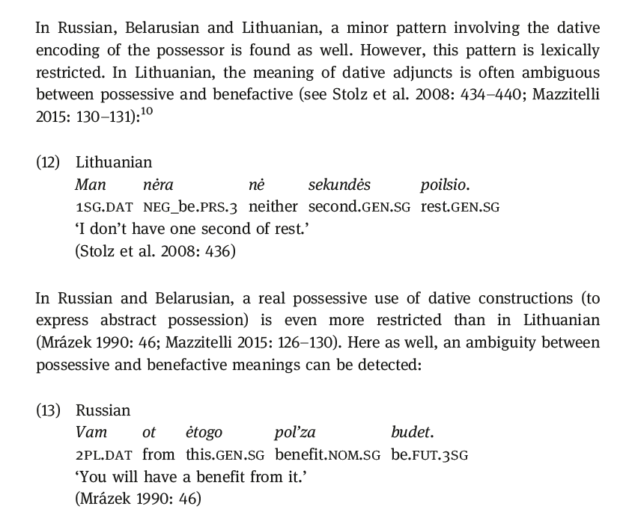
Abstract possession – Goal schema in Lithuanian, Belarusian, and Russian

Slide 42
Inanimate possession – part-whole relations in Finnic
1) Finnish and Karelian: inessive encoding of the PR (≠ ownership)
Finnish
*Talolla_{ad}// Talossa_{ines} on punainen katto
‘The house has a red roof’ (Metslang 2009)
2) Estonian and Ingrian: adessive encoding of the PR (=ownership)
Ingrian
Tall koill._{AD} (* taZ koiZ._{IN}) on üvä katto ‘this house has a good roof’ (fieldwork data provided by Fedor Rožanskij)

Slide 43
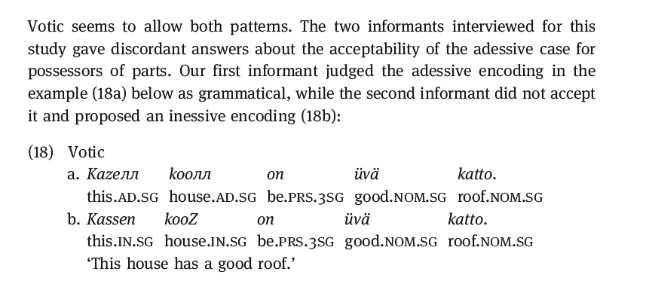
Inanimate possession – part-whole relations in Finnic
(fieldwork data provided by Fedor Rožanskij)

Slide 44
Inanimate possession – abstract inanimate possession
Finnish and Karelian use the inessive case for the encoding of part-whole relations: possessor = location
But they admit the adessive (= possessive) encoding of inanimate possessors if the possessee is abstract
North Karelian
Joka talolla oli oma nimi
each house.ADESS was own name
‘Each house had its own name’ (Vienan Karjala, 14.09.2011)
Finnish
Ta­lol­la on hy­vä kar­ma
house.ADESS is good karma
‘The house has a good karma’ (Finnish corpus)

Slide 45
Summary - 1: Possession in the CBA
The languages of the CBA use three schemas to express ownership
Action schema
Location schema
Goal schema
The same schema used for the expression of ownership is also used in most languages to express all other notions

Slide 46
Summary - 1: Possession in the CBA
Splits in the system
Abstract Possession in Lithuanian, Belarusian, and Russian with the dative case (lexically restricted; ambiguous between a beneficiary and a possessor)
Inanimate possession (part-whole relations) expressed with the inessive case in Finnish, Karelian, and Votic → But: inanimate abstract possession in these languages is expressed just like ownership!

Slide 47
Beyond possession
Attribution, experience, and location in the CBA

Slide 48
Attribution Physical characteristics
I have blue eyes

Slide 49
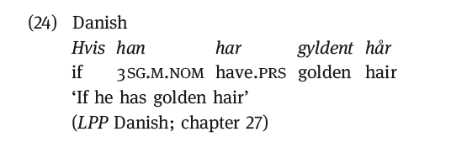
Physical characteristics in the CBA
In most languages of the CBA, the same construction used for ownership can also be used to express attribution (and in particular attribution of physical characteristics)
In all languages, attribution can also be expressed by non-possessive constructions

Slide 50
Belarusian & Lithuanian
(1) Permanent physical characteristics ‘She has blue eyes’
Possible: use of mec’ and turėti ‘have’ Belarusian Jana mae sinija vočy
Lithuanian Ji turi mėlynas akis
Preferred: use of the adessive construction in Belarusian and the genitive construction in Lithuanian
Belarusian u jae sinija vočy
Lithuanian jos.GEN mėlynos akys ‘hers are blue eyes’
(also: ji mėlynomis.INSTR akimis.INSTR she (is) blue.INSTR eyes.INSTR = ‘she has blue eyes’
(2) Non-permanent physical characteristics: ‘She has red eyes (because she has cried)’
Belarusian u jae sinija vočy //?? jana mae čyrvonyja vočy
Lithuanian jai.DAT raudonos akys, [jos akys] raudonos
?? ji turi raudonas akis
→ The use of mec’ and turėti would imply a permanent characteristic: ‘she (always) has red eyes’

Slide 51
‘she is twenty(years old)’
Age

Slide 52
 | Ownership | Age
Belarusian | adessive have | dative have
Lithuanian | have | dative Have
Russian | adessive | dative
Polish | have | have
Finnish | adessive | adjectival
Karelian | adessive /allative | adjectival adessive/allative
Estonian | adessive | adjectival
Veps | adessive | allative adjectival
Votic | adessive | allative adjectival
Livonian | dative case | dative adjectival
Swedish | have | adjectival
Danish | have | adjectival
Norwegian | have | adjectival
German | have | adjectival
North Saami | locative | adjectival
Latvian | dative | dative
Latgalian | dative | dative

Slide 53
Baltic and East Slavic: Dative encoding
Lithuanian: man dvidešimt metų
Latvian: man dvidesimt gadu
Russian: mne dvadcat’ let’
Belarusian: mne dvaccac’ hadoŭ
Polish, Belarusian and Lithuanian (under constraints): also ‘have’ is possible
Polish: mam dwadeścia lat
Belarusian: maju dvaccac’ hadoŭ
Lithuanian: turėdamas dvidešimt metų, ... ‘being twenty,…; when he was twenty,…’
→ as seen for Russian imet‘, Lithuanian turėti may be used because of syntactic constraints

Slide 54
Finnish, Estonian and North Saami: Non-possessive encoding
North Saami:
'to be X years old': Berggrav lea 56 jagi boaris 'Berggrav is 56 years old'
‘to be X-aged’: Dál son lea 74-jahkasaš ja Nikolaj lea 76-
jahkásaš 'Now he is 74 years old and Nikolaj is 76 years old'
Livonian and all Germanic languages:
‘to be X years old’
German: er ist zwanzig Jahre alt 'he is twenty years old'

Slide 55
Other Finnic languages
In Karelian, Veps, and Votic, age is expressed with an allative (‘to me’) construction
Olonec Karelian
Silloi minul oli seiččimtoštu vuottu ‘then I was seventeen years old'
North Karelian
Miula oli 17 vuotta, konša kuoli Stalin ‘When Stalin died, I was seventeen’
Veps
Konz Iisusale oli kaks’toštkümne vot ‘When Jesus was twelve’
Votic
Mille eli ühsteššemetta vuotta 'I was eleven‘
→ The allative has at least some of the functions of the Russian dative; probably: contact-induced replication

Slide 56
Experience
Diseases: ‘she has the flu’; ‘she has a cold’; ‘she has cancer’

Slide 57
Diseases in the CBA languages
To express diseases, most CBA languages use an ownership construction
Estonian
Mul_{ades} on nohu ‘I have a cold’
Mul_{ades} on maja ‘I have a house’
Exceptions are Belarusian, Lithuanian, and Finnic and Karelian

Slide 58
Diseases in Belarusian and Lithuanian
Belarusian: only the adessive construction is allowed
U mjane ‘at me’ hryp // *maju hryp ‘I have the flu’
U mjane prastuda // *maju prastudu ‘I have a cold’
Lithuanian: some diseases only admit dative encoding of the possessors, whilst other allow also the use of turėti ‘have’
Man.DAT gripas // *turiu gripą ‘I have the flu’
But: man slogas / turiu slogą ‘I have a cold’
man vėžys / turiu vėžį ‘I have cancer’

Slide 59
Diseases in Finnish, Karelian, and Ingrian
In these languages, the possessor of a disease can be encoded as a prototypical possessor
(adessive) or it can get an inessive encoding (Mazzitelli 2017)
Finnish
Hänellä_{ad} on syöpä // hänessä_{in}on syöpä ‘He has cancer’
Olonec Karelian Hänes_{in} oli suuri žuaru ‘She had high fever’ (Bible)
North Karelian Pekalla_{ad} oli kuumetta ‘Pekka had fever’ (Vienan Karjala)
Ingrian
Hänel_{ades}/häneZ_{ines} on lasiü ‘S/he has an illness’ (fieldwork data provided by Feder Rožanskij)

Slide 60
Diseases in Finnic
Estonian and Votic seem not to accept the inessive encoding of the experiencer of a disease
Votic
Siллə_{ad}/ *sinuZ_{in}on žaaru ‘You have a fever’ (fieldowrk data provided by Feder Rožanskij)
All Finnic languages, except Votic, accept, at least with some types of disease, the inessive encoding of the disease itself
Estonian
Ma olen palavikus ‘I am in fever = I have a fever’
(But: ‘cancer’ seems to be much rarer: F. ?olen syövässä; E. ?ma olen vähis)

Slide 61
Location: Part-whole relations with spatial inclusion
‘The house has three rooms’
‘The apartment has a bathroom’

Slide 62
Location: Part-whole relations with spatial inclusion
All the ‚have‘-languages of the CBA can use the ownership construction to express locative relations
Swedish
Huset har tre rum
‚The house has three rooms‘

Slide 63
Location: Part-whole relations with spatial inclusion
The languages that use an adessive construction, conversely, prefer another locative encoding
Russian
Kvartira imeet vannuju // v kvartire est’ vannaja ‘The apartment has a bathroom’
(?? U kvartiry est’ vannaja)
Finnish
Asunnossa.IN/*asunnolla.AD on kylpyhuone. ‘In the apartment there is a bathroom’ (Eeva Sippola, p.c.).
But Estonian allows also adessive (as well as inessive)

Slide 64
 | Ownership | Physical characteristics | Diseases | Being cold | Being hungry | Being sorry, afraid, | Age
Polish | have | have | have | dative | non possessive | dative | have
Russian | adessive | adessive | adessive | dative | non possessive | dative | dative
Belarusian | adessive have | adessive (have) | adessive | dative | non possessive | dative | dative have
Lithuanian | have | genitive have | dative have | dative | non possessive | dative | dative (have)
Latgalian | dative | dative | dative | dative | non possessive | dative | dative
Latvian | dative | dative | dative | dative | non possessive | dative | dative
North Saami | locative | locative | locative | locative | locative inessive (pe) | locative | non possessive
Finnish | adessive | adessive | adessive; inessive (PR) inessive (PE) | adessive genitive | adessive; genitive; inessive (PE) | adessive; genitive | non possessive
Karelian | adessive /allative | NA | adessive/allative; inessive (PR); inessive (PE) | NA | adessive/allative inessive (PE) | NA | non possessive
Veps | adessive | NA | adessive; inessive (PE) | NA | adessive; inessive (PE) | NA | non possessive
Estonian | adessive | adessive | adessive; inessive (PE) | adessive | adessive; inessive | adessive | non possessive
Votic | adessive | NA | NA | NA | NA | NA | non possessive
Livonian | dative case | NA | NA | NA | NA | NA | non possessive
Swedish | have | have | have | non possessive | non possessive | non possessive | non possessive
Danish | have | have | have | non possessive | non possessive | non possessive | non possessive
Norwegian | have | have | have | non possessive | non possessive | non possessive | non possessive
German | have | have | have | non possessive | non possessive have | dative have | non possessive

Slide 65
Conclusions - 1
Physical characteristics are treated as canonical possessees in all the languages of area with the exception of Belarusian and Lithuanian
Age is mostly expressed not in terms of possession; in Slavic and Baltic, age can be expressed in terms of possession through the use of the dative case; a notable exception is Polish, which uses its ownership construction with the verb mec’ ‘have’
Diseases are treated as canonical possessees in all languages with the exception of Belarusian and Lithuanian – they can be given a particular encoding in Finnic (inessive case both of PE and PR)

Slide 66
Conclusions - 2
The Finnic languages display splits in the field of expression of diseases and psycho-physical states (‘to be sorry, to be hungry’): yet they can use in all these contexts their adessive ownership construction as well; in particular, Estonian has largely generalised its ownership construction;
Belarusian and Lithuanian are the languages that present most splits in the expression of possession, because of their tendency to dislike the extension of ‘have’ to non-possessive contexts (such as possession of physical characteristics and diseases )
Conversely, Latvian, Latgalian, and North Saami have the least splits: the semantics of the dative case (LTV, LGL) and of the locative case (NS) is broad and flexible enough to accommodate different domains

Slide 67
‘Have’ in the CBA
Danish, Swedish, German and Polish
“Have” is the main possessive construction: it can be used to encode all possessive notions, as well as non-possessive notions such as physical descriptions and experience of diseases. In Polish, it can be used in expressions of age; in German, “have” also occurs in the expression of physical sensations like “being hungry”.
2. Lithuanian and Belarusian
“Have” is the main possessive strategy (in Belarusian together with the u + NP.GEN construction), but its scope of use is much more restricted than in the languages in group 1. Outside the domain of possession, it is barely accepted, especially in Belarusian, where u + NP.GEN is the preferred construction for the expression of non-possessive notions → in Lithuanian, and especially Belarusian, ‚have‘ has a much more „possessive“ flavour than in the languages of group 1
3. Russian
“Have” represents a marginal possessive strategy, whose use is limited by several semantic and stylistic constraints.

Slide 68
‘Have’ in the CBA
In general, ‚have‘ verbs are more specialised for the expression of possession than the de-locative and dative strategies of Finnic, Saamic, and Latvian/Latgalian
‚Have‘-verbs have developed from ‚hold; grasp‘ and presuppose control
The dative strategy has grammaticalised into a strategy for the expression of possession from its original experiential meaning

Slide 69
Areal convergences
the use of adessive constructions in East Slavic → the adessive construction was already present in Proto-Slavic; contact with Finnic-speaking populations functioned as a catalyser, reinforcing the use of a construction which was already present in Slavic
use of dative in Livonian to express possession < Latvian
dislike of Belarusian and Lithuanian for using ‘have’ in experiential or experiential-like relations;
the use of ‚have‘ to express age in Belarusian and Lithuanian < borrowing from Polish
the use of the allative case to express age in Veps,Votic, Karelian < replication from Russian

Slide 70
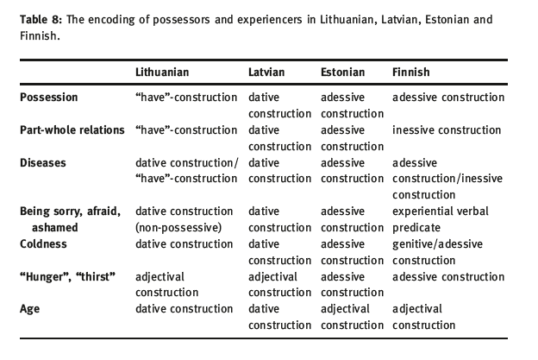
Areal convergences: Estonian and Latvian
Estonian and Latvian have a ho

Slide 71
Ačiu ir thank you!

Slide 72
Selected references
Dahl, Östen & Koptjevskaja-Tamm, Marija (eds.) (2001a): Circum-Baltic languages.Vol.1: Past and Present [Studies in Language Companion Series, 55], Amsterdam-Philadelphia: John Benjamins
Dahl, Östen & Koptjevskaja-Tamm, Marija (eds.) (2001b): Circum-Baltic languages.Vol.2: Grammar and Typology [Studies in Language Companion Series, 55], Amsterdam-Philadelphia: John Benjamins
Haspelmath, Martin (2001): “The European linguistic area: Standard Average European”, in: Haspelmath, Martin; König, Ekkehard; Oesterreicher,Wulf & Raible,Wolfgang (eds.): Language typology and language universals [Handbücher zur Sprach- und Kommunikationswissenschaft], Berlin: Mouton de Gruyter, 1492-1510
Heine, Bernd (1997): Possession: Cognitive sources, forces and grammaticalization, Cambridge:
Cambridge University press
Klaas, Birute (1996) Similarities in case-marking of syntactic relations in Estonian and Lithuanian
Mazzitelli, Lidia Federica. 2015. The expression of predicative possession. A comparative analysis of Belarusian and Lithuanian. De Gruyter.
Mazzitelli, Lidia Federica. 2017. Predicative possession in the languages of the Circum-Baltic area. Folia Linguistica 51.
Seržants, Ilja (2011) Dative-experiencer constructions as a Circum-Baltic isogloss
Stolz,Thomas (2011) Sprachbund im Baltikum? Estnisch und Lettisch im Zentrum einer Konvergenzlandschaft, Bochum: Brockmayer
Stolz,Thomas; Kettler, Sonja; Stroh, Cornelia & Urdze, Aina (2008): Split Possession.An areal- linguistic study of the alienability correlation and related phenomena in the languages of Europe [Studies in Language Companion Series, 101], Amsterdam: John Benjamins

